Slide 1
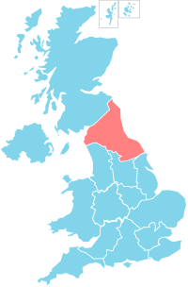
The North East & North Cumbria 6-8 Week Postnatal Maternal Health Review
Becca Scott
NENC ICS Strategic Lead Public Health Prevention in Maternity
NENC ICS Smoke Free Pregnancies Lead
NENC Integrated Care System
Karen Armstrong
Midwifery Matron, Newcastle Hospitals

Slide 2
Aims
NENC Reproductive Health
NENC ICB Public Health Prevention in Maternity Programme
Service user voices
Primary Care Postnatal Review
Tools and resources developed

Slide 3
NENC Reproductive Health
Increase in trend in repeat abortion rate in <25 year olds 29.2% in NENC. Stockton 36.4%, Hartlepool 22%, England 29.7%
34.7% of women <25 years in NE who access an abortion have already given birth in any period – England 26.0%.
19.8:1000 <18’s NE conception rate, 13.1:1000 England
NE GP prescribed LARC (excl. injections) 14.4:1000, 25.7:1000 England (PHE Fingertips, 2023) NB: North Cumbria not currently available
Notes:
840 <18 conceptions in the NE in 2021
Abortion after birth – similar trend
LARCS down ad abortions up
(PHE Fingertips, 2023)

Slide 4
Smoking at time of delivery 12.3%, 8.8% in England (NHS Digital, 2023).
37% of NENC pregnant women have low grade perinatal mental illness (NECS, 2023)
Approximately 30% of NENC women at 15 weeks gestation are of normal weight (NHS Digital, 2023a)
12 of the 16 localities within the NENC report greater levels of deprivation than the national average.
5 times more females residing within the most deprived areas, compared to the least deprived area.
The rate of stillbirth within the most deprived areas nationally was twice as high as the rate in the least deprived areas.
(PHE Fingertips, 2022: NHS Digital, 2023)
Notes:
Smoking is the main modifiable risk factor for a range of poor pregnancy outcomes. Infants born to smokers are much more likely to become smokers themselves which perpetuates cycles of health inequalities.
In the UK there are 1 in 4 women who have some degree of perinatal mental illness in pregnancy or the first year of birth (Howard et al, 2018; Centre for Mental Health, 2015) but with higher associated levels of deprivation in the North East this rises to around 2-3 in 4 of women. More recently, the NHS Long Term Plan (2019) states any mental health illness from the preconceptive period to the first two years after birth should be supported by perinatal mental health services, potentially placing extra demand on local services highlighting the need for preventative interventions.

Slide 5
Role of NENC Public Health Prevention in Maternity
Reproductive health identified as a priority area for maternity prevention programme in 2021:
“Improve reproductive health, safe pregnancy spacing and postnatal contraceptive care”
Scoping and best practice guide of postnatal care undertaken in 2021/22. Key improvements identified:
Postnatal care provision, including clarity around professional roles, responsibility and postnatal review.
Postnatal Contraception
Handover/transfer of care process and documentation
Ensuring that women and men achieve and maintain good health throughout their reproductive years and beyond is a public health challenge that impacts on future health for both themselves and future generations (PHE, 2018).
Notes:
Health Matters (2018)

Slide 6
Scoping of NENC Postnatal
Care: Postnatal Review Recommendations
Wherever possible services should aim to provide the universal mandated contacts on a face-to-face basis in line with national NICE (2021) guidance.
Alongside the Depression Indicator Test (Whooley), Maternity service providers should embed the use of the GAD-2 assessment tool to assess maternal mental health and wellbeing at every contact within the postnatal period.
Service providers should consider undertaking the day 10 Midwife universal review on day 21 with a focus on prevention, including; reproductive health, contraception, mental health, tobacco dependency, infant feeding, healthy weight/exercise and promotion of healthier home environments.
Notes:
The risk assessment, if unable to meet the expected standards and recommendations as per NICE Postnatal Guidelines (2021), should be consistently reviewed and reassessed as required to reflect change in service need and or staffing capacity. Escalating and addressing inline with local governance structures.

Slide 7
Consistent and equitable offer across NENC region regarding 6-8 week review
Support professionals
Collaborate, develop and share existing good practice
Ensure the service user voice is heard

Slide 8
Women and birthing peoples feedback in North Cumbria (2022)
Separate appointments for mum and baby – all mums feel that the check is about baby and not them
“review should be more woman focused, include a physical health assessment and examination and discussion regarding emotional wellbeing”
Discussion about lifestyle and support – real opportunity moment
This is part of a continuum of maternity care
Mum needs time, safety, eye contact, not rushing
Real useful advice about physical healing
Signposting to postnatal specialist support- for all mums healing, not just those with surgery or injuries
Notes:
Worthwhile pointing out that suggestion 4 may not seem a typical comment you would see from service users, however the mums that engage with MVP are typically professional mums., can be more difficult to reach the hard to reach populations.
MVP feedback North Cumbria – Mum’s view as a momentous app – disappointed as appointment focused on baby

Slide 9
Maternal Postnatal Review
February 2020 update to GP contract agreement
Postnatal review should be done by a medical professional
This agreement updated and enhanced existing five-year GP contract
Separate appointment to the 6-8 week baby review
Making Every Contact Count (MECC)
Review of mental health and general wellbeing
Review of physical health following childbirth including early co-morbidities identified before/during pregnancy e.g. gestational diabetes
identification of pelvic health problems
Family planning/contraception
Physical, sexual, emotional and social wellbeing
health promotion
Consider if any safeguarding concerns
Notes:
Change to GP Contract
On 6th February 2020 NHS England, NHS Improvement and the British Medical Association (BMA) agreed and New requirement – ‘Universal’ maternal 6-8 week postnatal review, supported by £12 million additional funding
Postnatal review should be done by a medical professional
This agreement updated and enhanced existing five-year GP contract deal
Provides an excellent opportunity to talk through any health issues/concerns the mum may have and to offer and signpost to appropriate support.
Importance of mum review is to probe and identify any risk of or current health inequalities/prevention.

Slide 10
Pre 6-8 week review questionnaire & Template
Notes:
As you can see it is quite a lengthy and extensive document and that is where the pre-review Questionnaire is of real great benefit as we appreciate it is a lot to cover in the time you have allocated to do the review.
The questionnaire has been developed to assist you in identifying the concerns the mum has in relation to her health which will hopefully enable you to tailor the appointment and individualised care for that woman.
resources will be circulated to you via GP Bulletins, templates will be available on EMIS/System One.
The pre-appointment health review questionnaire will be able to be printed out and sent out to the woman prior to her appointment or if your practice has AccuRUX and Florey Plus you will be able to sent this out digitally to women.

Slide 11
NENC ICS Handover and Transfer of Care Standard Operating Procedure

Slide 12
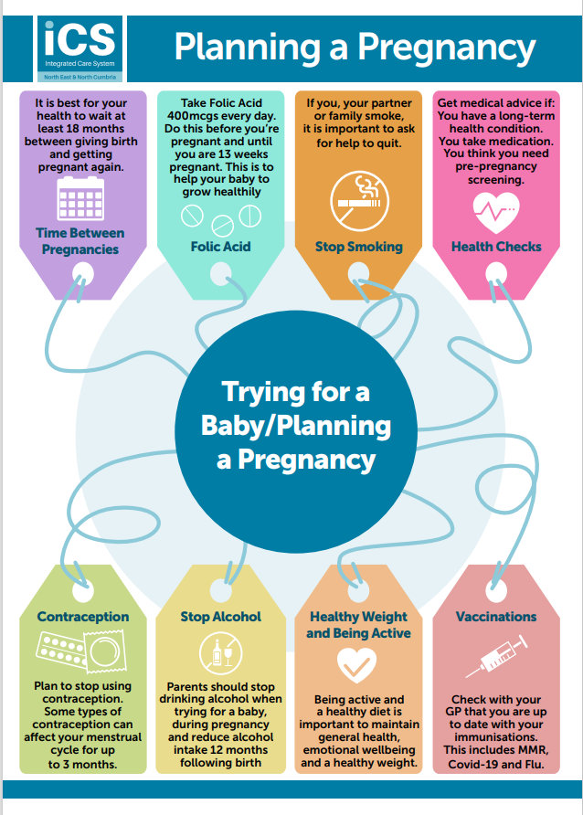
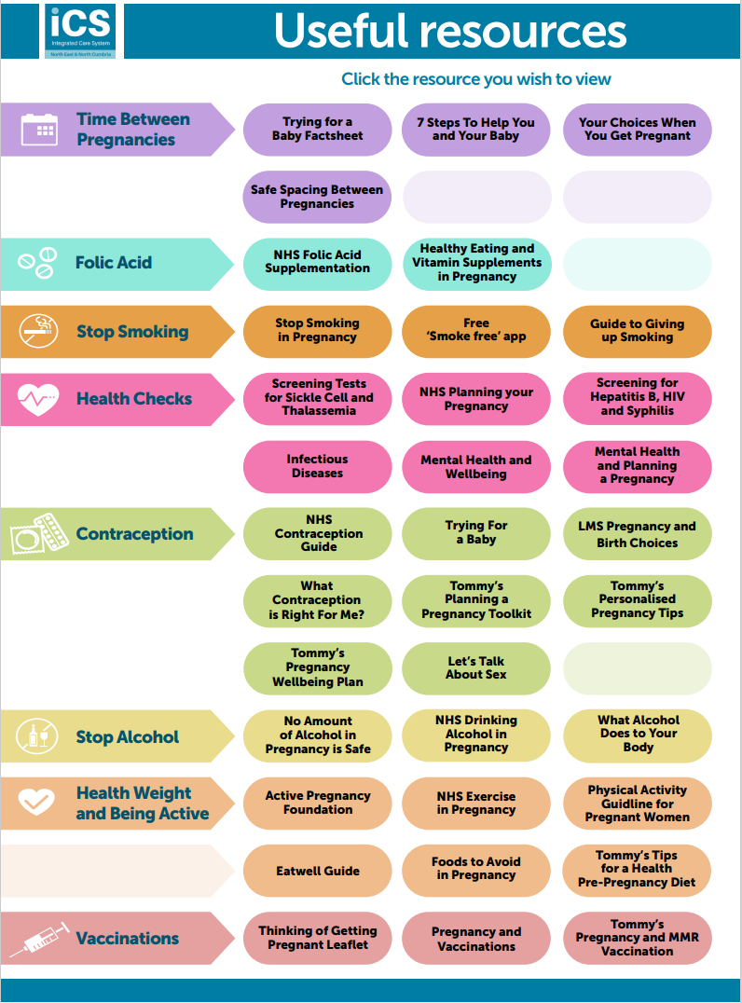
NENC ICS Planning a Pregnancy Interactive PDF
Notes:
As you can see it is quite a lengthy and extensive document and that is where the pre-review Questionnaire is of real great benefit as we appreciate it is a lot to cover in the time you have allocated to do the review.
The questionnaire has been developed to assist you in identifying the concerns the mum has in relation to her health which will hopefully enable you to tailor the appointment and individualised care for that woman.
resources will be circulated to you via GP Bulletins, templates will be available on EMIS/System One.
The pre-appointment health review questionnaire will be able to be printed out and sent out to the woman prior to her appointment or if your practice has AccuRUX and Florey Plus you will be able to sent this out digitally to women.

Slide 13
Resource pack for Primary Care
Notes:
Appreciate lots of information within the pack and its for you to use as you wish.
Please feel free to share with your Practice Managers and introduce at future staff training sessions.
Some GP practices have lifted and shifted some of the resources (for examples the smoking cessation contacts/resources – Smoke Free App) into their existing IT systems/health pathways to aid themselves during appointments.

Slide 14
In conclusion
Significant disparities in access to good reproductive health.
Opportunity in the postnatal period.
Strength in systemwide joined up approaches.
Service users voices should be used to tailor approaches and interventions.
Interventions should also bring benefits to clinicians.
There is a role for everyone in improving perinatal health.

Slide 15
Any questions?

Slide 16
References:
NECS, (2023) Raidar Data via PHPiM Dashboard, accessed 12/10/2023
NHS Digital, (2023) Smoking at time of delivery, available from: Statistics on Women's Smoking Status at Time of Delivery: England, Quarter 4, 2022-23 - NHS Digital (accessed 02/10/2023)
NHS Digital, (2023a) Maternity Dashboard Data, available at: Maternity Services dashboard - NHS Digital
NICE, (2021) Postnatal Care: NG194, available at: Overview | Postnatal care | Guidance | NICE
PHE, (2023), Fingertips: Reproductive Health, available at: https://fingertips.phe.org.uk
PHE, (2018) Health Matters, available at: Health matters: reproductive health and pregnancy planning - GOV.UK (www.gov.uk)
Scott R & Armstrong K, (2022) North East and North Cumbria ICS Public Health Prevention in Maternity (PHPiM) ‘Postnatal Scoping Report’ available at: https://www.northernlms.org/wp-content/uploads/2022/10/NENC-ICS-PHPiM-Postnatal-Scoping-Report-V5-FINAL-28.04.2022.pdfPHE

Slide 17
Resources:
The North East North Cumbria ICS PN 6-8 Week Maternal Health Resources that are on the website are:
NENC ICS Reproductive Health and Postnatal Maternal Health Check (6-8 week) Presentation Video:
NENC ICS PN 6-8 Week Maternal Health Review Template
NENC ICS PN 6-8 Week Maternal Health Pre-review Questionnaire (V1.1)
How To Guide Locating: NENC ICS PN 6-8 Week Maternal Health Review Template (V1.0)
ICS PHPiM Resource Pack for General Practitioners and Primary Care Network
Other useful resources:
NENC ICS Handover and Transfer of Care SOP (Version 7) https://www.northernlms.org/wp-content/uploads/2022/11/Handover-SOP-V7-Final-26.09.2022.docx.pdf
NENC ICS Planning a Pregnancy Tool (Version 5) Planning a pregnancy - Local Maternity Systems Northern England Local Maternity Systems Northern England (northernlms.org)
NENC ICS Safe Pregnancy Spacing factsheet https://www.northernlms.org/wp-content/uploads/2023/03/NENC-ICS-Safe-Pregnancy-Spacing-Factsheet-V2-Final-17.03.2023.docx.pdf

