Slide 1
Peri-Menopause and Menopause in the Workplace Working in partnership

Slide 2
Why do we need to talk about it?
Menopausal women are the fastest growing demographic in the workforce.
According to the Faculty of Occupational Medicine (FOM), nearly 8 out of 10 of menopausal women are in work.
3 out of 4 women experience symptoms, 1 in 4 could experience serious symptoms.
One in three of the workforce will soon be over 50, and retirement ages are now 68
It’s a subject for everyone whether it affects you directly or because you have a partner, colleague, friend or family member affected
ONS

Slide 3
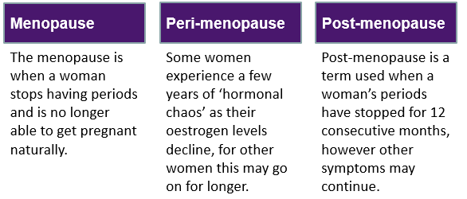
What is it?

Slide 4
When does it happen?
For most women, between ages 45 and 55
Can be experienced at younger age
1 in every 100 women will experience a premature menopause (NHS estimate)
Premature menopause is menopause that occurs before the age of 40 years
Early menopause occurs between the age of 40 and 45

Slide 5
Common Symptoms
Hot flushes
Heavy bleeding
Night sweats and sleep deprivation
Urinary problems
Migraines
Hair loss
Osteoporosis
The two symptoms most commonly described as either very or somewhat difficult were difficulty sleeping (84%) and poor memory or concentration or difficulty focussing on tasks, sometimes called ‘brain fog’ (73%).
Fawcett Society

Slide 6
Impact on Work
Nearly two-thirds (65%) said they were less able to concentrate
More than half (58%) said they experience more stress
More than half (52%) said they felt less patient with clients and colleagues.
Nearly a third of women surveyed (30%) said they had taken sick leave
CIPD (Chartered Institute of Personnel and Development
One in ten women who worked during the menopause have left a job due to their symptoms

Slide 7
The Law and Menopause
The Equality Act 2010
Health and Safety at Work Act 1974
Handout

Slide 8
Our Menopause Support Journey
Menopause in the workplace was raised in our UNISON self-organised women’s group
We launched a survey to gather more views from colleagues
Worked with our Organisational Development team to build on the existing support in the workplace
Using the steps above and working in partnership developed an enhanced package of support for colleagues and managers

Slide 9
What the survey told us
89% of respondents said symptoms affected their ability to do their job to some extent
219 responses (2021)
Satisfaction with support received from managers was wide-ranging
37% of respondents said they had spoken with a manager who was knowledgeable and understanding.
13% said adjustments had been put in place. This had made them feel supported and valued.
Workplace improvement supported:
Increased Awareness
an effective Menopause Policy
UNISON / Staff Support Groups
Dedicated contact in workplaces to discuss issues

Slide 10
What we did to improve Awareness & Support
Training
Managers Online Training Module developed and created in-house
‘Menopause in Minutes’ online Menopause video for all staff
Ongoing Menopause workshops and webinars
Ongoing UNISON Menopause member learning sessions
Support
Review of NCC Menopause Policy and guidance and promotion to staff
Menopause Teams Channel launched – peer support (245 members)
Menopause Café events commence – regular informal events for all staff. (a safe space for sharing experiences and peer support via Teams or in person)
Women’s Health page including lots of information on the menopause
World Menopause Day 18 October
World Menopause Month October

Slide 11
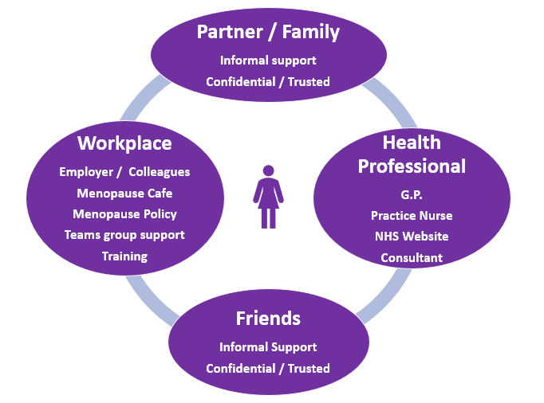
Circle of Support
Handout

Slide 12
Impact
A ‘menopause inclusive’ approach supports colleagues affected by the menopause to maintain better health and remain in work by providing:
Increased awareness of the policy and support available (including reasonable adjustments when appropriate).
More awareness and understanding of Menopause across managers and staff.
Continue to develop the offer.

Slide 13
World Menopause Month World Menopause Day 18th October
2023 Theme: Cardiovascular Health
Menopause and Heart Disease
Before the menopause, women in general have a lower risk of being affected by coronary heart disease.
But after the menopause, your risk increases.
Menopause and heart and circulatory conditions - BHF
Health and Wellbeing
Information
Exercise
Workplace Walks
Health checks Available

Slide 14
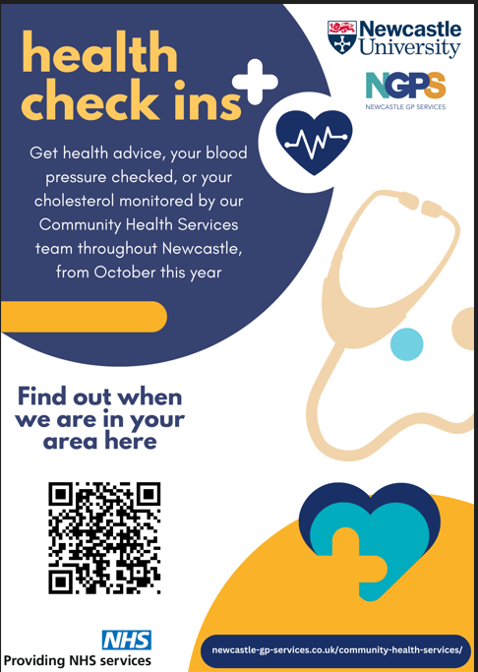
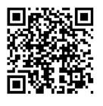

Slide 15
Questions
Caroline Collinson
Equalities Officer
UNISON Newcastle City
Ground Floor, Civic Centre
Newcastle On Tyne NE1 8PN
Email: unison.newcastle@newcastle.gov.uk
Thank You

