Slide 1

Female Genital Mutilation – Routine Enquiry and how this can impact on the long-term health of women and girls
Rebecca Humphreys
Specialist Health Visitor
Complex and Vulnerable Families
This Photo by Unknown Author is licensed under CC BY-SA-NC

Slide 2

FGM Definition
FGM comprises of all procedures that involve partial or total removal of the external female genitalia, or other injury to the female genital organs for non-medical reasons’
FGM is most commonly carried out on young girls between infancy and 15years old.

Slide 3
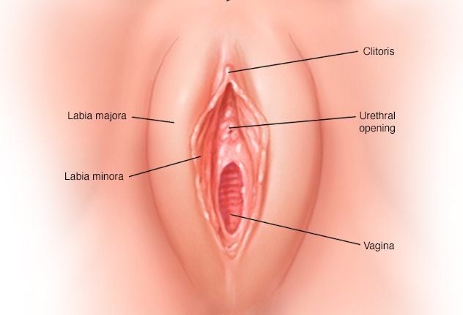
Types of FGM
Type 1 – Clitoridectomy partial or full removal of the clitoral glans
Type 2 - Excision Partial or total removal of the clitoral glans and the labia minora, with or without the removal of the labia majora
Type 3 – Infibulation narrowing of the vaginal opening through the creation of a covering seal it includes cutting and stitching and can include removal of the clitoral glans
Type 4 – Includes all other harmful procedures to the female genitalia for non-medical purposes e.g. piercing

Slide 4
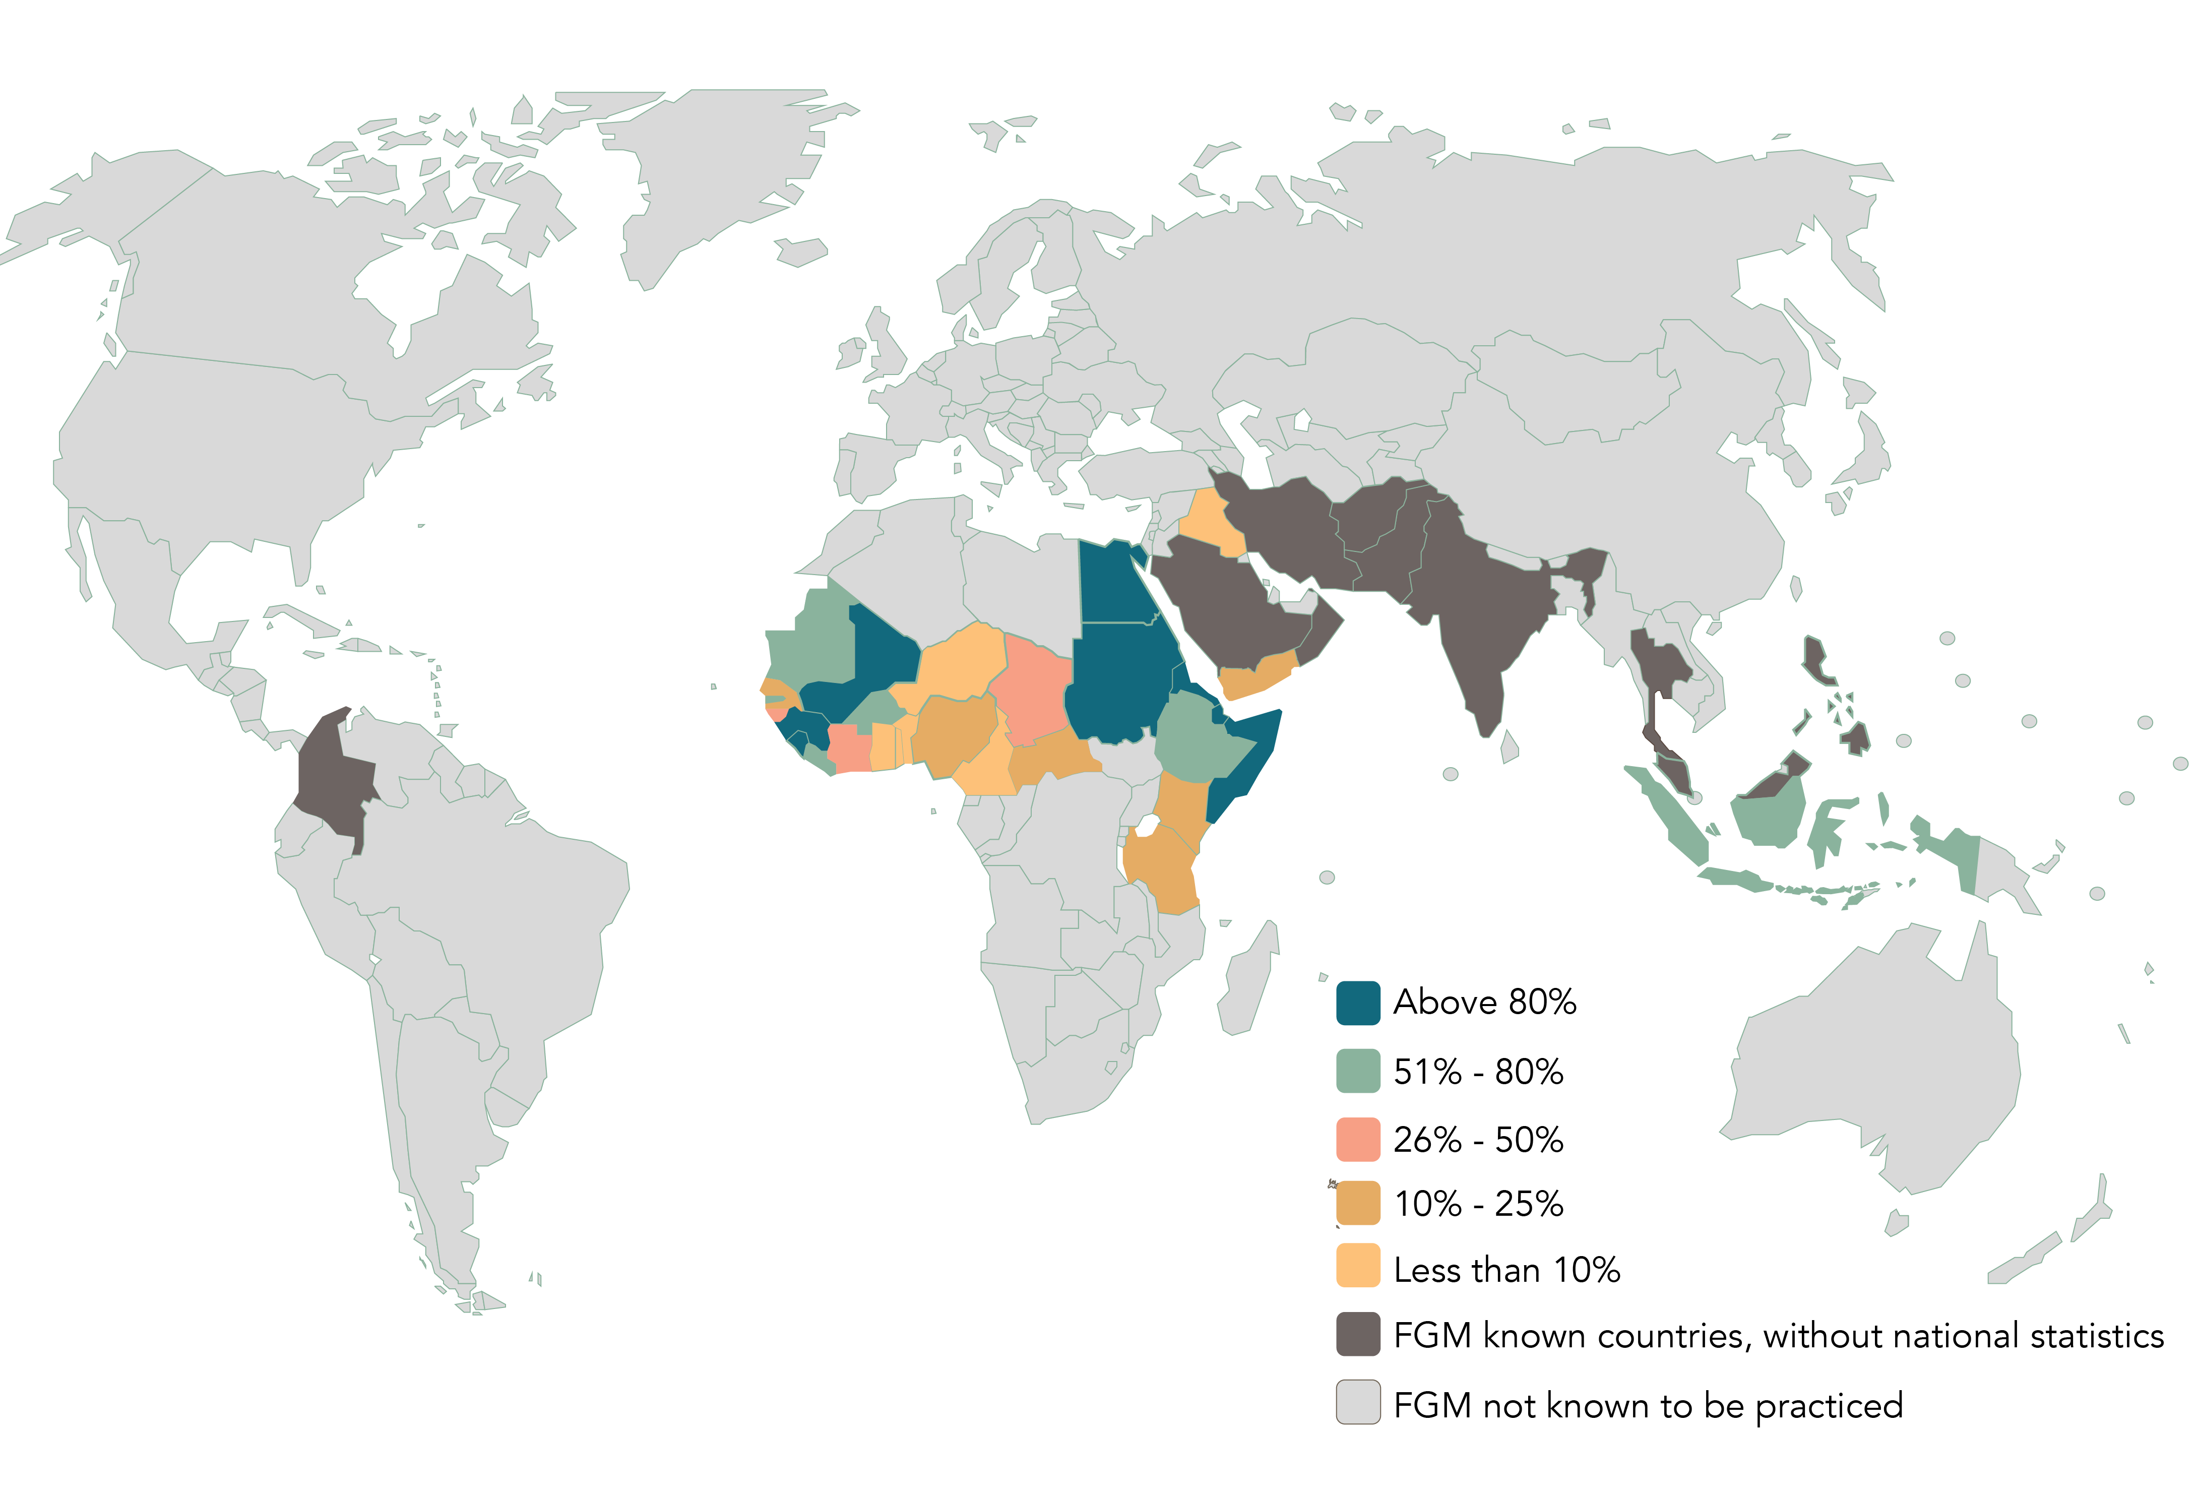
Prevalence of FGM
125 Million women and girls worldwide
103,000 women aged 15-49 in England and Wales
24,000 women over 50 and have migrated to England and Wales
10,000 girls under 15 years have migrated to England and Wales
There are 78 England and Wales FGM offences recorded by police (does not include Manchester police force)
There is no LA area in England and Wales that is likely to be free from FGM

Slide 5

Routine Enquiry of FGM
Working Together to Safeguard Children (2018) and Working Together to Safeguard People (2018) sets out the expectations and requirements of professionals to safeguard and promote the welfare of the child and provide a multi-agency response to need.
Wherever possible professionals should actively seek to reduce the prevalence of FGM
Routine FGM enquiry has been embedded in 0-19 practice since 2016

Slide 6
What do Newcastle 0-19 service do to support women and girls FGM health needs?
Open conversations with all families around the legalities of FGM and the health implications.
Awareness raising with all families regardless of ethnicity and who they can share their worries with if they do have any concerns.
Health pathway now includes direct referrals into GNCH Paediatric Forensic Network or GP referral to Gynaecology
Flag records

Slide 7
Health complications of FGM
Death
Severe haemorrhage
Pain
Broken limbs from being held down
Urine retention
Injury to adjacent tissues
Increased risk to HIV and aids
Uterine, pelvic and vaginal infections
Cysts and neuromas
Infertility
Increased risk of fistula
Complications in childbirth
Depression
Postnatal depression
Psycho sexual problems
Sexual dysfunction
Difficulty in menstruation
Trauma and flashbacks

Slide 8
Closing thoughts
Routine enquiry can have a positive impact on the identification of FGM and the resulting health needs can be addressed and supported.
Early identification can support health needs from increasing in severity or prolonging the discomfort experienced
Early referrals can be made for support
Reduce the risk of familial cycle of FGM

Slide 9
Further information
www.virtual-college.co.uk Female Genital Mutilation Recognising and Preventing FGM
Home Office FGM Unit FGMEnquiries@homeoffice.gov.uk
Multi agency Statutory Guidance on Female genital mutilation 2020 The Home Office
Rebecca Humphreys Rebecca.Humphreys@nhs.net 07919627898

