Slide 1
Healthcare use by women with joint hypermobility in Northumberland
North East & North Cumbria Women’s Health Conference 2023
Dr Ben Frankel, Dr Vadivelu Saravanan, Jeff Powell Davies, Dr Emma Reinhold, Dr Joanne Demmler, and Dr Iain Loughran

Slide 2
Background
Hypermobile Ehlers-Danlos-Syndrome (hEDS/HSD) is inherited and used to be called rare.
Influence of hormones causes more joint pain and instability in women.
It used to be referred to as benign joint hypermobility, but it is anything but benign.
It co-exists with other long-term conditions, many of which are more common in women.
Clinically, it has widely been thought that the prevalence of the condition is much higher than reported.
Funding provided by the NIHR Research Capability Funding in 2022 to explore prevalence & impact.
Anxiety and depression
Autism and ADHD
Bowel disorders
Bladder disorders
Pelvic organ prolapse
Difficult pregnancies

Slide 3
Approach
The aim of the project was to
Compare and contrast the findings
Analyse the secondary care data
Analyse the primary care data
Import data into NECS RAIDR
Sign off new sharing agreements
Approach individual GP practices
Develop aims and approach
To measure the burden of hEDS/HSD
Prevalence reported in primary care
Pattern of service use across healthcare
Costs of service use across healthcare
We analysed the number of people with a diagnosis of hypermobility from 30 out of 36 GP practices in Northumberland (approximately 300,000 population).
We compared secondary healthcare activity and costs between people with and without hypermobility (from 34 out of 36 GP practices).

Slide 4
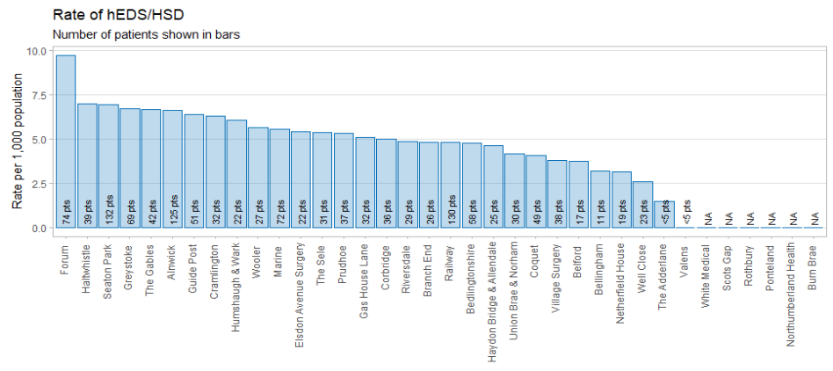
Findings – Primary Care
There are 1,302 people (4.4 per 1,000 population) with hEDS/HSD in GP practices in Northumberland. This varies considerably across practices in the area.
This is higher than the commonly quote prevalence of 0.2 per 1,000 population.

Slide 5
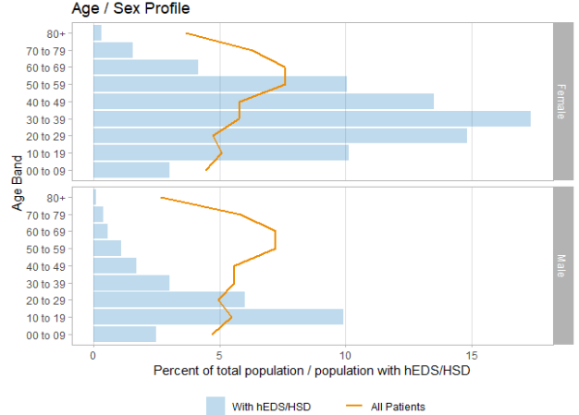
Findings – Primary Care
Significantly more women than men have hEDS/HSD (75% of patients with the conditions are female), and that 17% (226 people) of all those with hEDS/HSD are women aged 30-39.

Slide 6
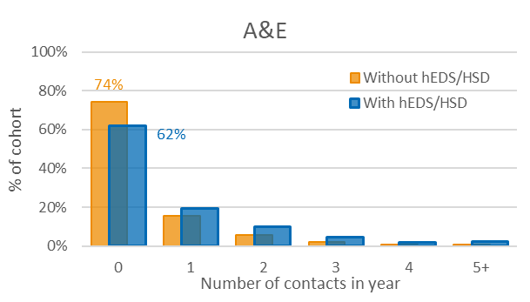
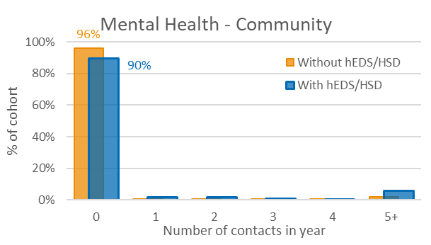
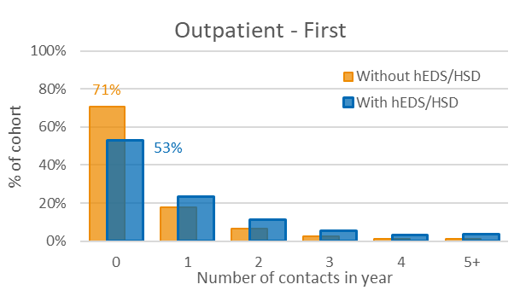
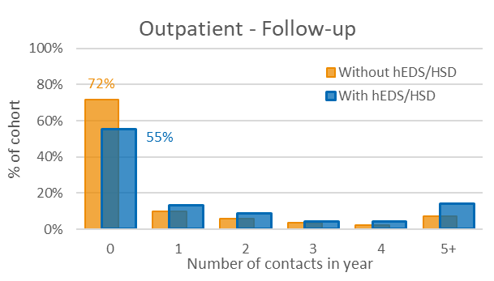
Findings – Secondary Care Usage
These graphs show the number of contacts in 2022.
For each of these care types, patients with hEDS/HSD were more likely to have had at least one contact.
They were also more likely than those without the conditions to have had 5 or more contacts.
The high use of physiotherapy (and rheumatology for female) service stands out.

Slide 7
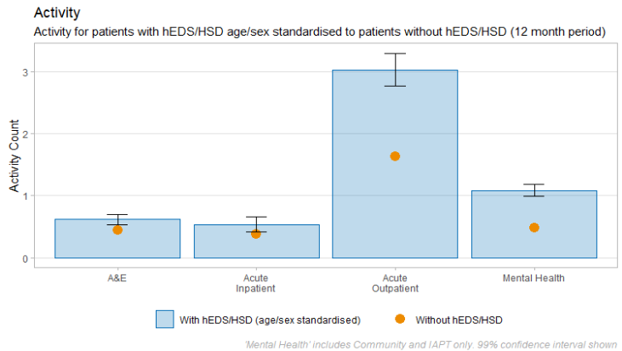
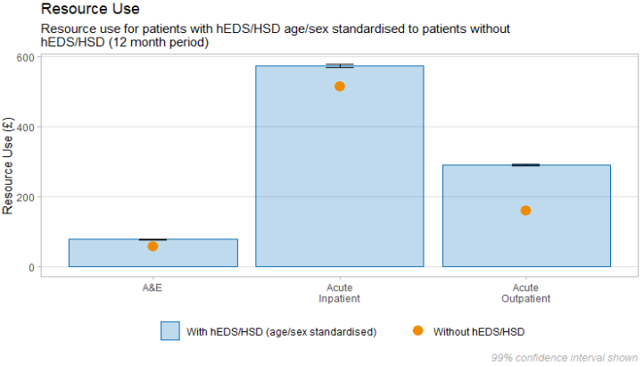
Findings – Secondary Care Costs
Patients with hEDS/HSD have around twice as many Outpatient and Mental Health (excluding Mental Health Inpatients due to small numbers) appointments than those without the condition.
For patients with hEDS/HSD, the mean resource use was £943.50 (vs £731.88). Taken over the 1,302 patients with hEDS/HSD in Northumberland this is an additional £275,527 spend each year.

Slide 8
Conclusions
Joint Hypermobility (hEDS/HSD) is likely to be much more common than previously thought.
The condition affects far more women of childbearing age – creating additional complications.
The condition is linked to multiple obs/gyna conditions as well as other mental health conditions.
The service use and NHS costs are significantly higher for people with hEDS/HSD than without.
There is a lack of co-ordinated care for people with hEDS/HSD which contributes to the additional use.
Secondary care expertise is being fragmented and diminished adding to poor/inefficient management.
Explore in a larger sample (NENC ICS)
Provide more co-ordinated diagnosis services
Provide more co-ordinated treatment services
Develop the workforce to better support hEDS/HSD

Slide 9
Acknowledgements
Dr Ben Frankel
GP, and Project Lead
Dr Vadivelu Saravanan
Consultant Rheumatologist, and Project Co-Lead
Jeff Powell Davies
Principal Information Analyst​, NECS, Lead Analyst
Dr Emma Reinhold
Independent Researcher, and Subject Matter Expert
Dr Joanne Demmler
Health Data Scientist, and Subject Matter Expert
Dr Iain Loughran
Senior Research Manager, NECS, and Project Manager
EDSUK - Co-applicant, no financial contribution.

Slide 10
Healthcare use by women with joint hypermobility in Northumberland
North East & North Cumbria Women’s Health Conference 2023
Dr Ben Frankel, Dr Vadivelu Saravanan, Jeff Powell Davies, Dr Emma Reinhold, Dr Joanne Demmler, and Dr Iain Loughran

