Slide 1
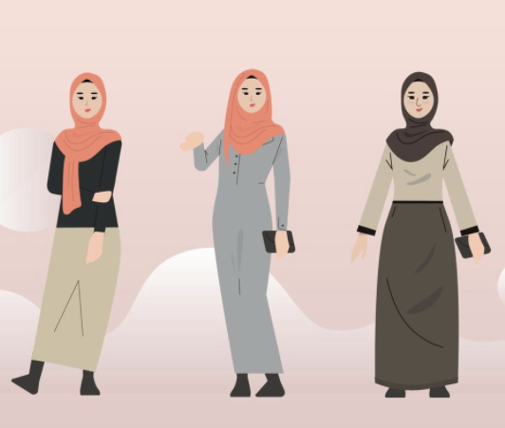
IMCAN project Improving Muslim Women’s CANcer Screening Uptake
Floor Christie-de Jong, Rawand Jarrar, Aasim Padela, Cerysh Sadiq, Fozia Haider, Marie Kotzur, Rana Amiri, Alex McConnachie, Katie A. Robb

Slide 2
Background
Screening and early detection reduce breast, bowel, and cervical cancer mortality¹
Socioeconomic and ethnic inequities in cancer and its screening persist
Uptake of cancer screening is lower in deprived areas¹
There are almost 4 million Muslims in the UK²
Ethnically diverse population
Shared religion
40% live in the most deprived areas based on the Index of Multiple Deprivation
Muslim women are less likely to access screening than the general population³

Slide 3
Barriers to screening

Slide 4
Pilot Study
Glasgow
Participatory approach (co-production) with 4 workshops
Public Involvement and Community Engagement (PICE) group (n=10)
The Behaviour Change Wheel and the Reframe, Reprioritise and Reform model⁵
Funded by Scottish Inequalities Fund

Slide 5
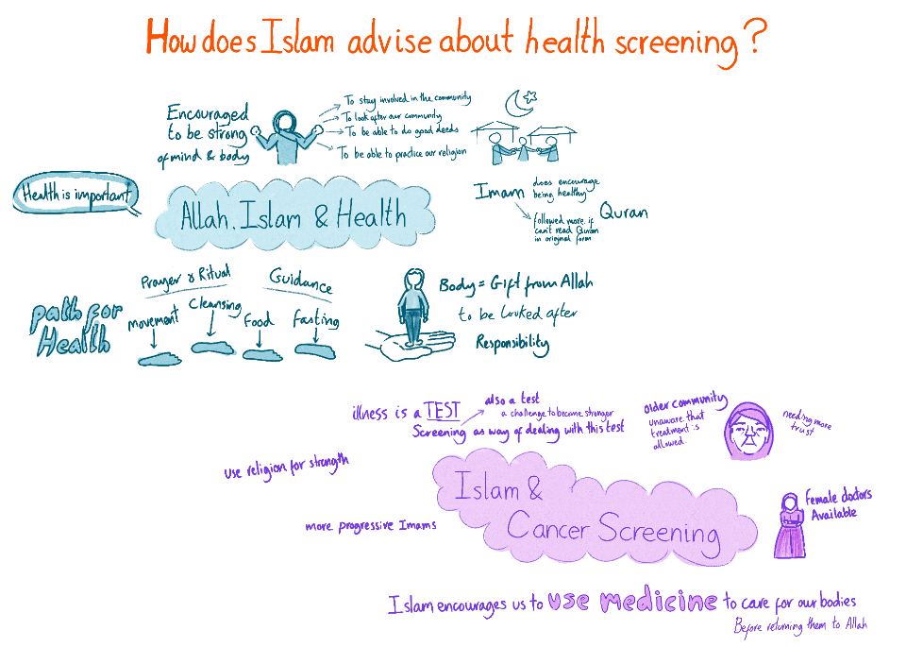
Workshop 1

Slide 7
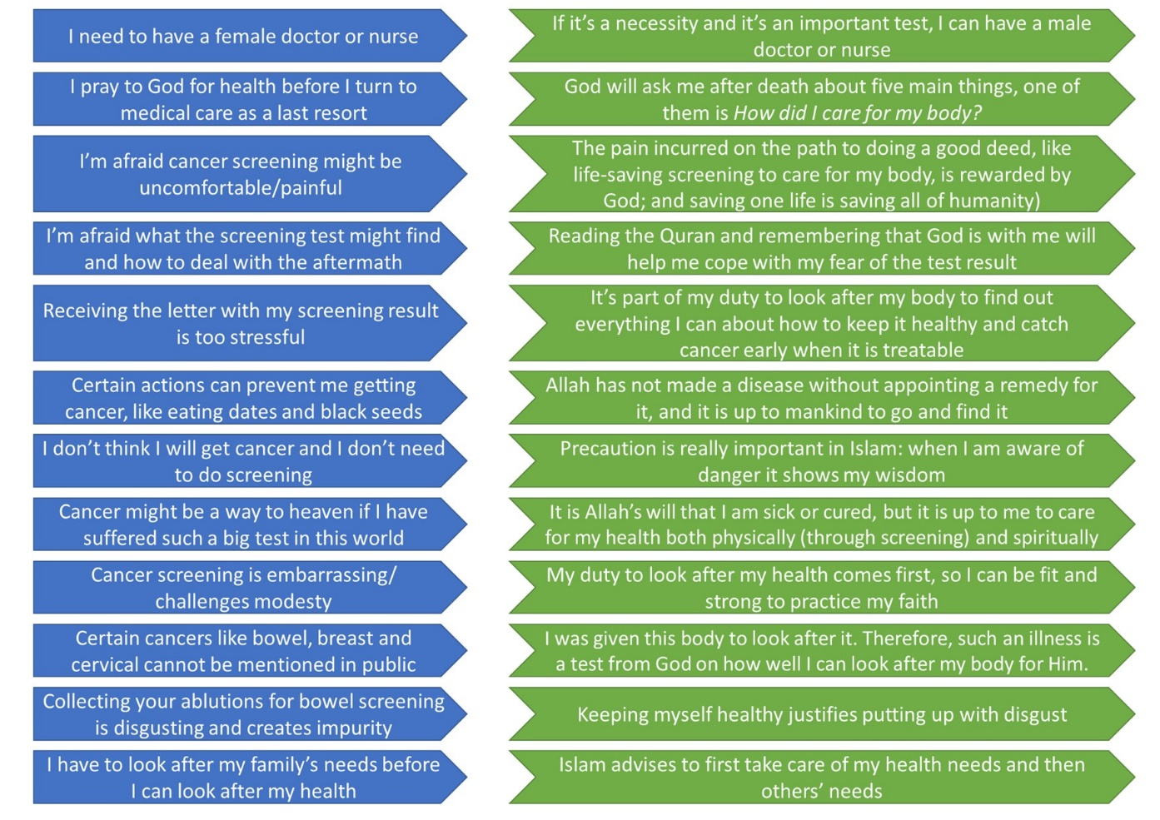
Workshop 3 Bringing faith-based screening advice to Muslim women

Slide 8
Co-designed, peer-led, faith-based Intervention to encourage uptake of breast, bowel and
cervical cancer screening
Evaluation
Part 4
Part 3
Part 2
Part 1
A religious perspective on cancer screening delivered by a female religious scholar
Videos of Muslim women’s experiences of cancer or screening
A peer-led discussion of barriers and enablers to breast, bowel and cervical cancer screening.
A health education session led by a female GP on screening followed by Q&A
.
Intervention well
received
Faith as Enabler
Testimonials
Health Education
Barriers and Enablers

Slide 9
Next steps-3-year Feasibility trial (2023-2025)
Aim: To improve uptake to cancer screening among Muslim women using a faith-based intervention.
This will be achieved through the following objectives:
Implementing a non-randomised, two-arm feasibility trial.
Exploring the perspectives on intervention and trial acceptability and implementation.
Examining feasibility of a definitive trial.
Developing effective data dissemination strategies and prepare the next phase.
200 participants
Muslim women from any ethnic background
Aged 25-74 years
Living in the North-East or Scotland
Not up-to-date with all the screening

Slide 10
What is a feasibility trial?

Slide 11
Overview trial
Group 1
Workshop online
Women fill in questionnaire before/after workshop
1. Fill in same questionnaire at 12 months
2. Examine actual screening uptake
Fill in same questionnaire at 6 months
Option to take part in focus group
End
Group 2
Workshop in-person in the mosque/community setting
Women fill in questionnaire before/after workshop
PICE group input

Slide 12
Conclusions
‘One size fit all’ public health Interventions do not work for everyone
Complex public health issues require complex and multifactorial responses.
Participatory approaches and community-centred approaches can play an important role in health improvement and tackling health inequalities.
Asset-based approaches (here applied as faith-based) should be utilised to enhance health improvement efforts.
Working closely with community partners and religious leaders is a useful part of successful health improvement.
The multifactorial and targeted faith-based approach used in this study could be applied to other populations and other public health issues

Slide 13
References
Cancer Research UK. Beating Cancer Sooner-Our Strategy. 2014.
Muslim Council of Britain (2022). 2021 Census: As UK Population Grows, So Do British Muslim Communities
Campbell C, Douglas A, Williams L, Cezard G, Brewster DH, Buchanan D, et al. Are there ethnic and religious variations in uptake of bowel cancer screening? A retrospective cohort study among 1.7 million people in Scotland. BMJ Open. 2020;10(10):1–11.
Christie-de Jong F, Kotzur M, Amiri R, Ling J, Mooney JD, Robb KA. Qualitative evaluation of a codesigned faith-based intervention for Muslim women in Scotland to encourage uptake of breast, colorectal and cervical cancer screening. BMJ Open. 2022 May;12(5):e058739.
Padela AI, Malik S, Ally SA, Quinn M, Hall S, Peek M. Reducing Muslim Mammography Disparities: Outcomes From a Religiously Tailored Mosque-Based Intervention. Health Education and Behavior. 2018;45(6):1025–35.

