Slide 1
Co-producing Colposcopy Communications: A Service Improvement Project
Allison Cowling – Public Health Registrar
Nicol Bradley – Public Health Communications Officer

Slide 2
What is Colposcopy?
Notes:
A colposcopy is a quick and simple way to take a look at your cervix, the lower part of the womb at the top of your vagina.
It's often done if cervical screening (also known as your smear test) finds abnormal cells in your cervix.

Slide 3
Why Colposcopy?

Slide 4
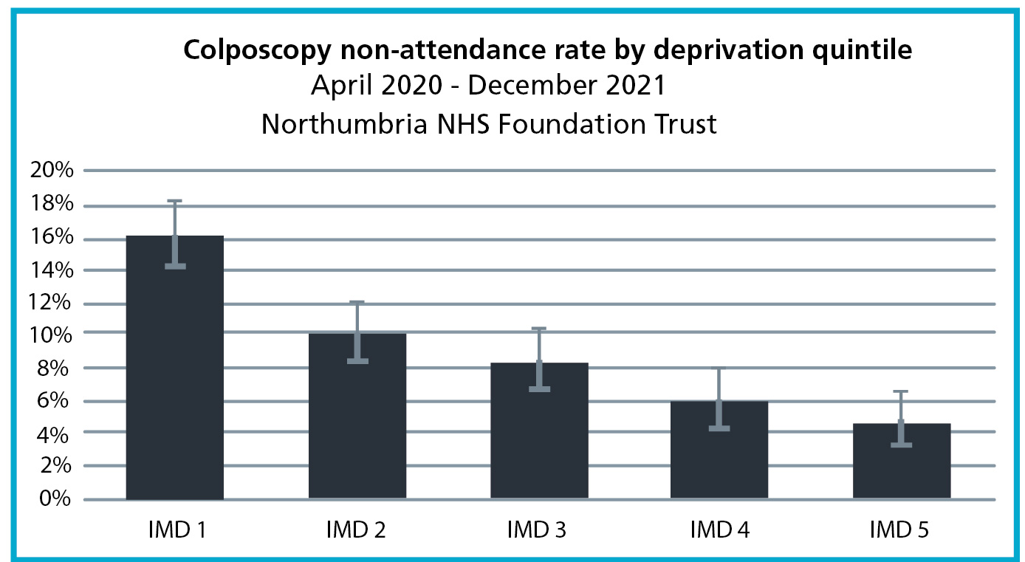
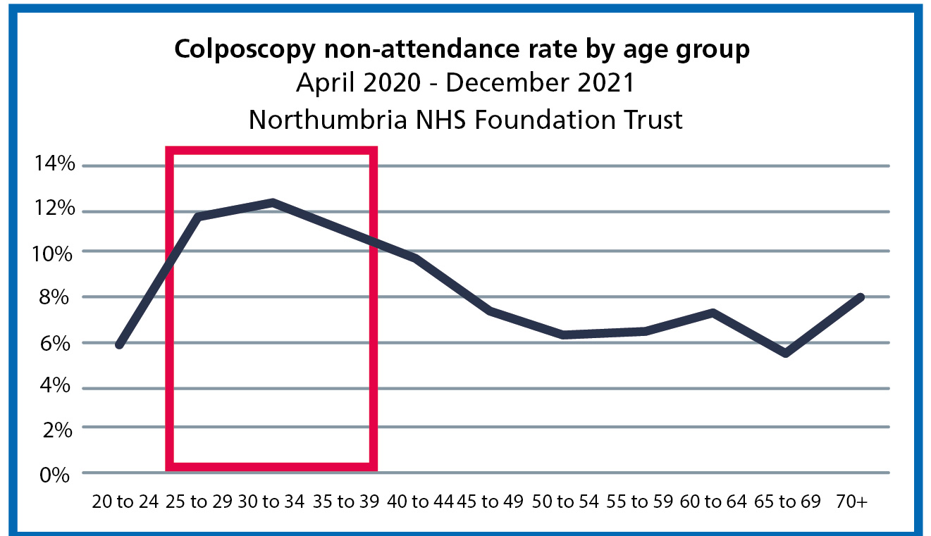

Slide 5
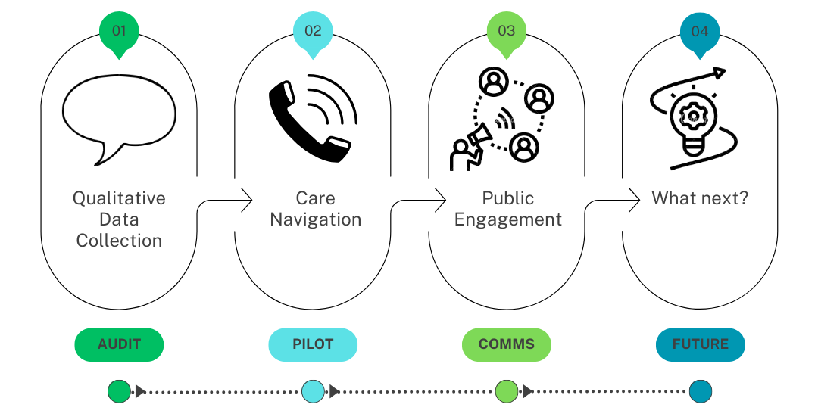
Project Overview

Slide 6
Qualitative Data Collection

Slide 7
Key Themes
Forgetting/Not aware of Appointment
Caring Responsibilities
Anxiety
Transport
Work

Slide 8
Case Study
Referred with High-Grade Smear
Initial Appointment – alone & frightened
Further Appointment – High-grade pre-cancerous changes
Multiple cancellations and DNAs – Discharged back to GP
GP Re-referred – Further DNA
Audit Phone Call
Nurse Counselling and bespoke appointment
Attended appointment – successful treatment
Notes:
Referred in with high-grade smear
At initial appointment felt unable to have examination as she was alone and frightened.
Follow-up arranged where she attended with a friend, biopsies confirmed high-grade pre-cancerous changes.
She agreed to return to Colposcopy clinic for treatment
DNA x 2, discharged back to GP. GP spoke to patient, assured she would attend.
Further DNA, at risk of being lost to follow-up.
Phone Call with patient as part of Audit – patient expressed anxiety about appointment, offered phone call with Nurse Colposcopist
Nurse spoke to patient on the phone, reassured her/answered questions. She booked her in the next day. Attended for loop treatment. Discharged back to GP.

Slide 9
Phone Call Pilot
2022
Jan | Feb | Mar | Apr | May | Jun | Jul | Aug |  | Sep | Oct |  | Nov | Dec
Pre-intervention period |  |  |  |  |  |  |  | Intervention |  |  | Post-intervention period
 | Attendances | Non-attendances | Total | DNA Rate
2022 Pre-Intervention | 1,736 | 195 | 1,932 | 10.1%
2022 Intervention | 494 | 45 | 539 | 8.3%
 | Pre-Intervention DNA rate (2022) | Intervention DNA rate | Change (PP)
Women in 20% most dep | 16.2% | 11.1% | -5.1
Women aged 25-39 | 11.7% | 9.3% | -2.3
Women in 20% most dep aged 25-39 | 20.1% | 11.5% | -8.6
Notes:
383 patients spoken to (595 calls)

Slide 10
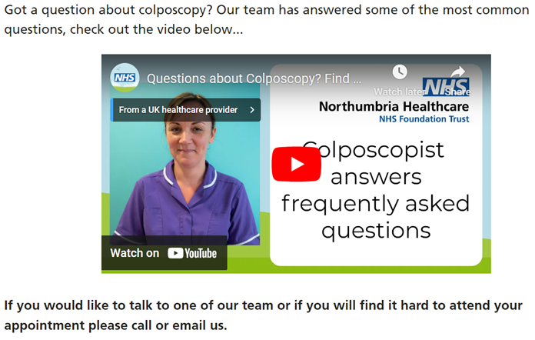
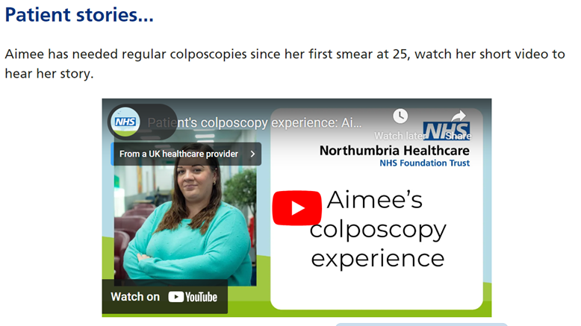
Comms Strategy
Used learning from audit to review and simplify patient
letter and produce a new webpage.

Slide 11
Engagement
Our local voluntary and community sector was key in helping us reach those who are seldom heard...
Notes:
Patients are at the heart of everything we do and we need to be an advocate for their voices and needs. Take those into consideration both in the service and promoting the service.
Harbouring community assets

Slide 12
Focus Groups
Deprived areas
BAME
Cancer Networks
Domestic Abuse
Learning Disabilities
Antenatal/Postnatal

Slide 13
Survey
VCS
Social media
448 responses
Thematic Analysis
Notes:
Found 15 themes for enabling people to attend and 10 barriers
For sake of time we've pulled top two themes from each

Slide 14
Importance of attending (inclusion of facts and figures to stress importance / how common colposcopy appointments are) : 137
Include reassuring language / Avoid fear-mongering language (i.e. ‘cancer’) : 51
It would help to know how common it is for women to need to have a colposcopy so they don’t feel alone
Make it clear that the worst case scenario is not the most likely outcome.
“Changes do not mean cancer”
“Give clear message that screening could stop cancer before it starts”
“Don’t be scared we all have one (like prostate campaign)”
“Rate of recovery for those who have caught cancer early due to colposcopy”
“These are routine tests”
“20 minutes of your life could be what saves it, don’t delay!”
“Reassure that pain will be taken seriously ”
“Most come back normal”
“Positive outcomes after an abnormal smear”
“Simple, Quick procedure to carry out”
“Please attend your appointment. It could save your life” or “Don’t die of embarrasment (AIDS campaign)”
“Precautionary”

Slide 15
Avoid fear inducing language: 52
Avoid graphic visuals (Medical) : 37
“The word cancer. Often, a colposcopy is done soon enough to avoid this. The word cancer scares people.”
Visual images may be concerning.
Definitely no pictures of beds/chairs with stirrups!
“Negative drivers aren’t always the best approach. Including positives on there could help”
Avoid triggering images such as the tools used, as it could put people off.
“Avoid phrases such as worried/concerned/anxiety. Keep it as positive as possible.”
Avoid images where people look nervous.
“Stick to uncomfortable rather than painful”
Images of speculums and equipment could be distressing.
“Words that are too clinical and the overuse of the words ‘cancerous’ or ‘abnormal’. ”
No real life anatomical images or anything too clinical.
“explicit mention of cancer. Could use ‘could develop into something more serious’”
“Get the balance right between educating/highlight versus being patronising”.

Slide 16
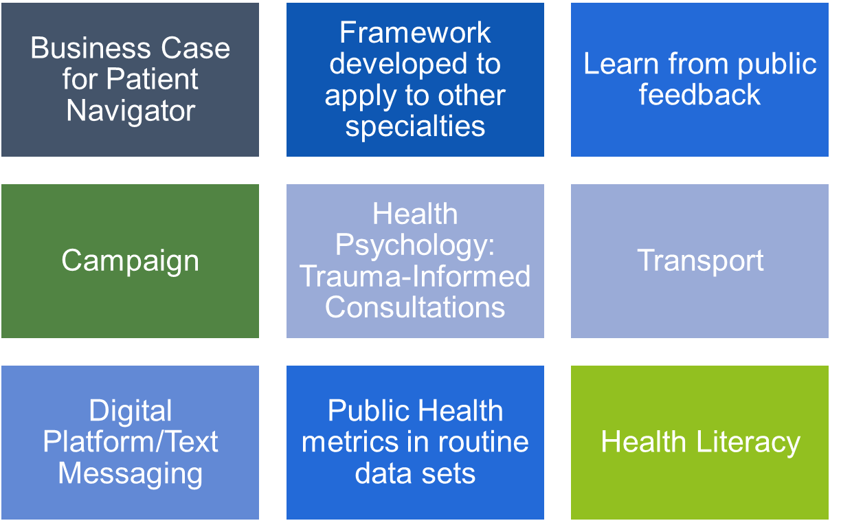
What's next...

Slide 18
Questions

