Slide 1
Breast pain pathway
October 2023
Dr. Carol Ellen Holmes
Joint Clinical Lead
Breast Managed Clinical Network

Slide 2
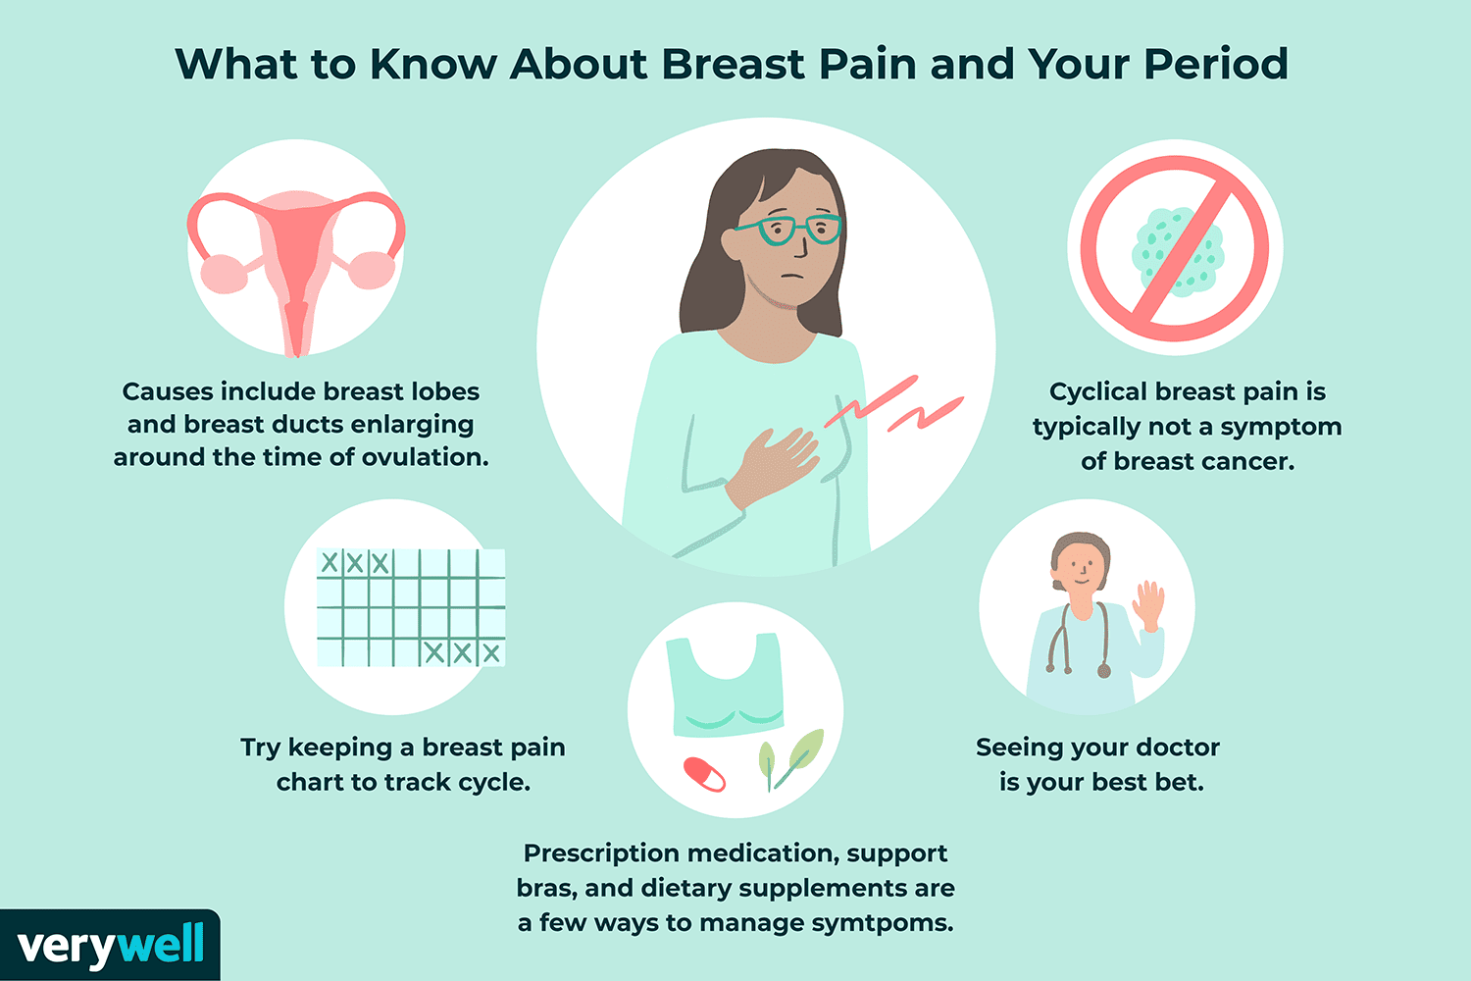
What is breast pain?
Breast pain can be described as tenderness, throbbing, sharp, stabbing, burning pain or tightness in the breast tissue. The pain may be constant or it may occur only occasionally, and it can occur in men, women and transgender people.
Breast pain can range from mild to severe.

Slide 3
Background
For many breast problems, especially in younger patients or patients presenting with breast pain only, reassurance and a period of watchful waiting may be suitable.
Breast pain is not usually associated with cancer. It is a common symptom and, if of short duration with no other clinical concern, may be managed initially in a GP setting. Studies show that breast pain often settles with 3-6 months.
Minor or moderate degree of breast pain with no lumps/bumps, when initial treatment fails and/or with unexplained persistent symptoms, greater than 3 months need to be referred onto the breast pain pathway.
Cyclical breast pain in the younger patient does not need to be referred and can be managed supportively.
Notes:
breast-pain-statement-final.pdf (associationofbreastsurgery.org.uk)

Slide 4
Why develop a Breast Pain Pathway?
Where breast pain is the ONLY presenting breast symptom there is a very low level of cancer risk (less than for breast screening population, who have no symptoms)
Currently there is variation in referral for women with breast pain (fast-track cancer referral, symptomatic pathway, other options)
Where women are referred into secondary care they are often seen alongside women on a fast-track cancer pathway, raising anxiety for the women with breast pain only
Has the potential to reduce unnecessary imaging whilst ensuring that these patients concerns are addressed (especially concerns about family history)
Allows for better resource management of those waiting for investigation for breast cancer and better patient experience for those waiting for breast pain investigation only
Excellent examples from elsewhere (East Mids and G Manchester)

Slide 5
Northern Cancer Alliance Approach
Review of Breast Pain Pathway development
Review of GP information, strategies/contacts for sharing the pathway
Supporting development of Breast Pain Clinics across the region

Slide 7
Staged approach
All areas can take up the primary care management once patient education and primary care education is in place
Newcastle, Gateshead, North Tees and Northumbria deployed initially
Other sites are being added as the local evidence base grows

Slide 8
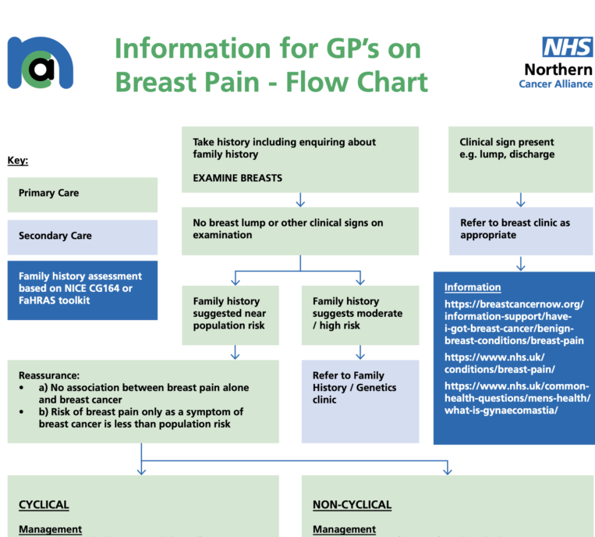

Slide 9
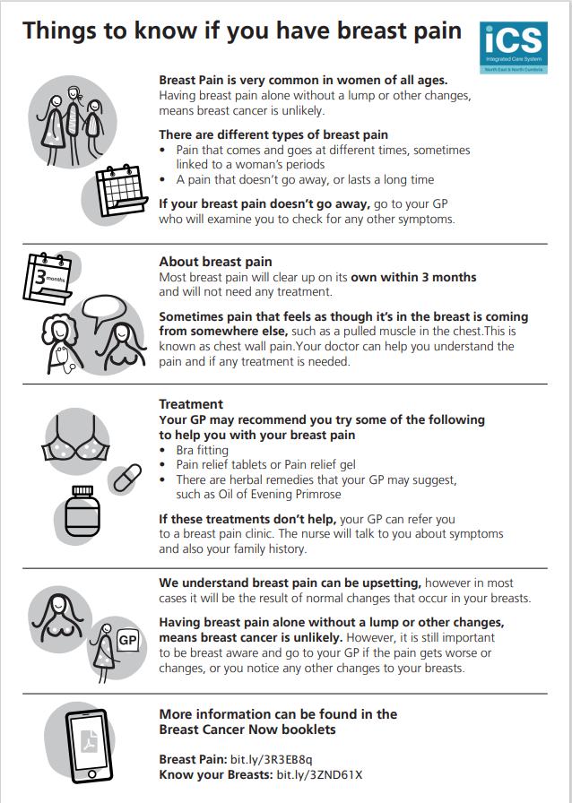
Breast_pain_patient_leaflet_3.pdf (northerncanceralliance.nhs.uk)
The leaflet was developed and tested with groups of people with a learning disability to ensure that the information is as accessible to as wide a health literacy range as possible

Slide 10
Notes:
QR code for things to know about breast pain

Slide 11
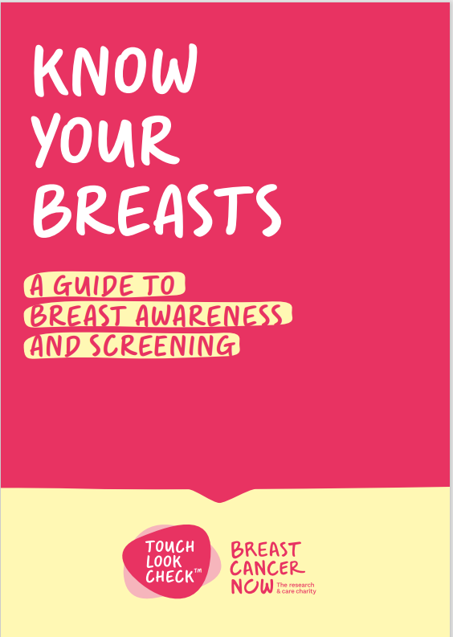
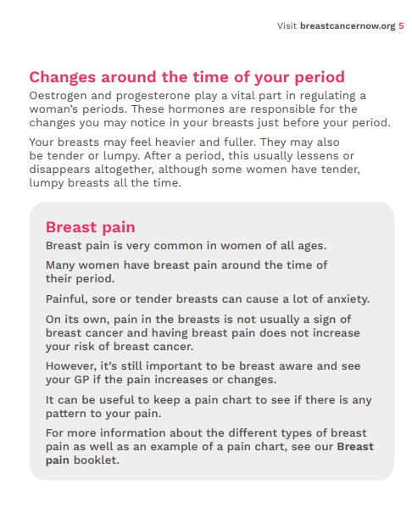
Breast-Cancer-Now_know_your_breasts.pdf (northerncanceralliance.nhs.uk)

Slide 12
Notes:
QR code for Know your breasts

Slide 13
Take home messages
Breast Pain on its own has an extremely low risk of breast cancer.
The breast pain pathway has been developed so that those ladies with breast pain only will get better support with their symptoms. This will mostly be provided in their GP practice. However if they are not responding they can be referred into a specific breast pain clinic.
Anyone who is worried about their breast symptoms should see their GP.

