Slide 1
Dismantling Disadvantage
Transforming Services for Women's Futures:
Key Findings
agendaalliance.org
@agenda_alliance
#TransformingServices

Slide 2
Women’s unmet needs and regional inequalities – ‘Triple Shock Effect’
Public services in the North East have been disproportionately impacted by:
Austerity
2. COVID-19
3. Cost-of-living crisis
Between 2009 and 2018, council spending fell by 13% across the whole of England - it fell by 23% in the North East
The North East has the highest poverty rate of all regions - 26%
In the North East, women can expect to spend 26% of their lives in "not good/ poor" health, compared to 23% of those in England as a whole
agendaalliance.org
@agenda_alliance
#TransformingServices

Slide 3
Women’s experiences of public services
Women with multiple unmet needs grapple with interconnecting challenges including:
Homelessness; unsupported parenthood; substance misuse; poor mental health; child removal; poverty; violence and abuse; and contact with the criminal justice system
When accessing services, many of them face barriers, such as:
Living with trauma
Shame, stigma and discrimination
Poverty
Systemic racism
Inaccessible services
Abuse within services
agendaalliance.org
@agenda_alliance
#TransformingServices

Slide 4
The scale and consequences of failing women
Our data analysis suggests that, in Northumberland and Tyne and Wear, between 2021 and 2022:
81% of women in need of mental health services missed out on support
76% of women in need of domestic abuse services missed out on support
60% of women in need of drug and alcohol recovery services missed out on support
agendaalliance.org
@agenda_alliance
#TransformingServices

Slide 5
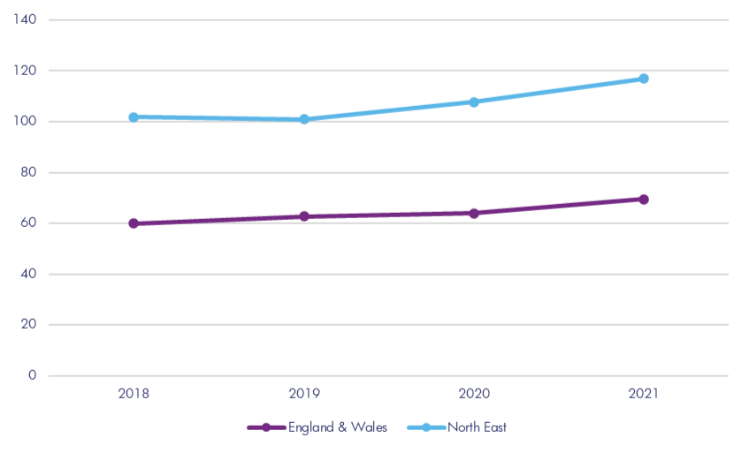
The scale and consequences of failing women:
Avoidable mortality
Number of women dying due to either suicide, drug poisoning, alcohol, or domestic homicide (age-standardised rate per 100,000)
Our data analysis shows that in 2021, the mortality rate for women due to either suicide, drug and alcohol misuse, or domestic homicide was 1.7 times higher in the North East than in England and Wales as a whole
agendaalliance.org
@agenda_alliance
#TransformingServices
Notes:
Between 2018 and 2021, the number of women who die in the North East as a result of suicide, drug and alcohol misuse, and domestic homicide hasincreased by 15%

Slide 6
Recommendations for systems change
1. Prevention and early intervention
2. Gender-, trauma- and culturally responsive support
3. Services working together
4. Co-production and responding to power dynamics
5. Long-term and sustainable funding and commissioning
agendaalliance.org
@agenda_alliance
#TransformingServices

Slide 7
Thank You

