Slide 1





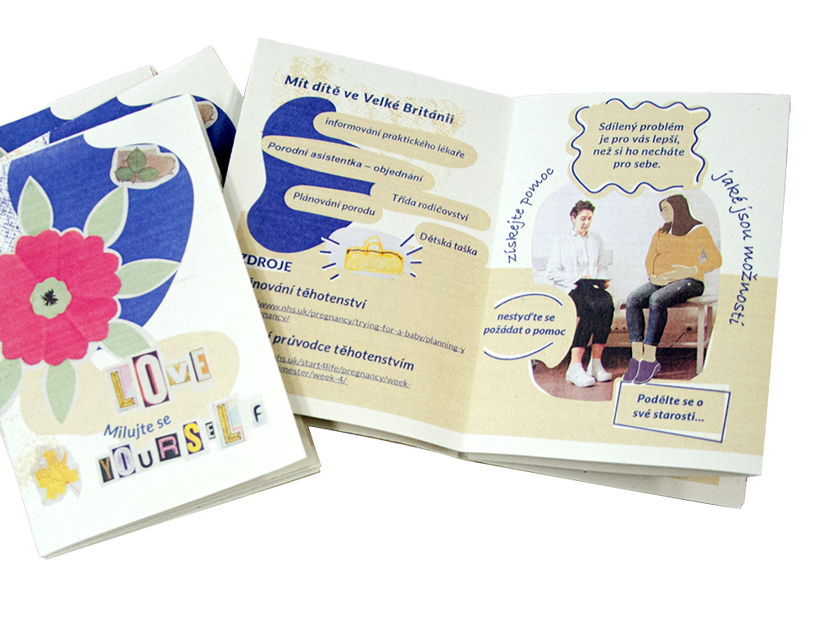
Public Health Intervention Development Scheme
MR/X503046/1
EP/T022582/1
ERicar:
Engaging Roma women
in the co-creation
of an antenatal care information resource​
Mabel Lie, Caroline Claisse, and Zaneta Karchnakova​
Advisers: Gayle Cain¹, Abi Durrant², Sally Ellis³, Shona Haining⁴, Vicki Harris⁵, Susan Jones⁶, ​
Raksha Pande⁷ and Heather Smith⁸​; Interpreter: Irma Karchnakova
¹Gateshead MVP; ²CDC; ³Children North East; ⁴NECS; ⁵Connected Voice HAREF; ⁶Teesside University; ⁷SGPS; ⁸ECLS; ​
ERicar NENC | 19 Oct 2023

Slide 2
Understanding Central and Eastern European Roma​
Why Roma? – largest ethnic minority community in Europe​
Migration from 2004 onwards as a result of EU expansion
Complex identity; 40 different tribes, variety of Roma languages​
Political mobilisation around ‘Roma’ e.g., Roma rights groups because of racism and exclusion​
UK “Gypsy, Roma, and Traveller” category elides distinctive characteristics​
Challenges of ethnic categorisation and stereotyping​​
ERicar NENC | 19 Oct 2023

Slide 3
Methods: engagement and planning​
Community venue​
Recruitment​
  11 women​, aged between 27-61​
  29 children​ between them
  5-9 women attending each time​
Breakfast​
Study information and consent​
Translation
Story-telling
Shopping vouchers​​​
ERicar NENC | 19 Oct 2023

Slide 4
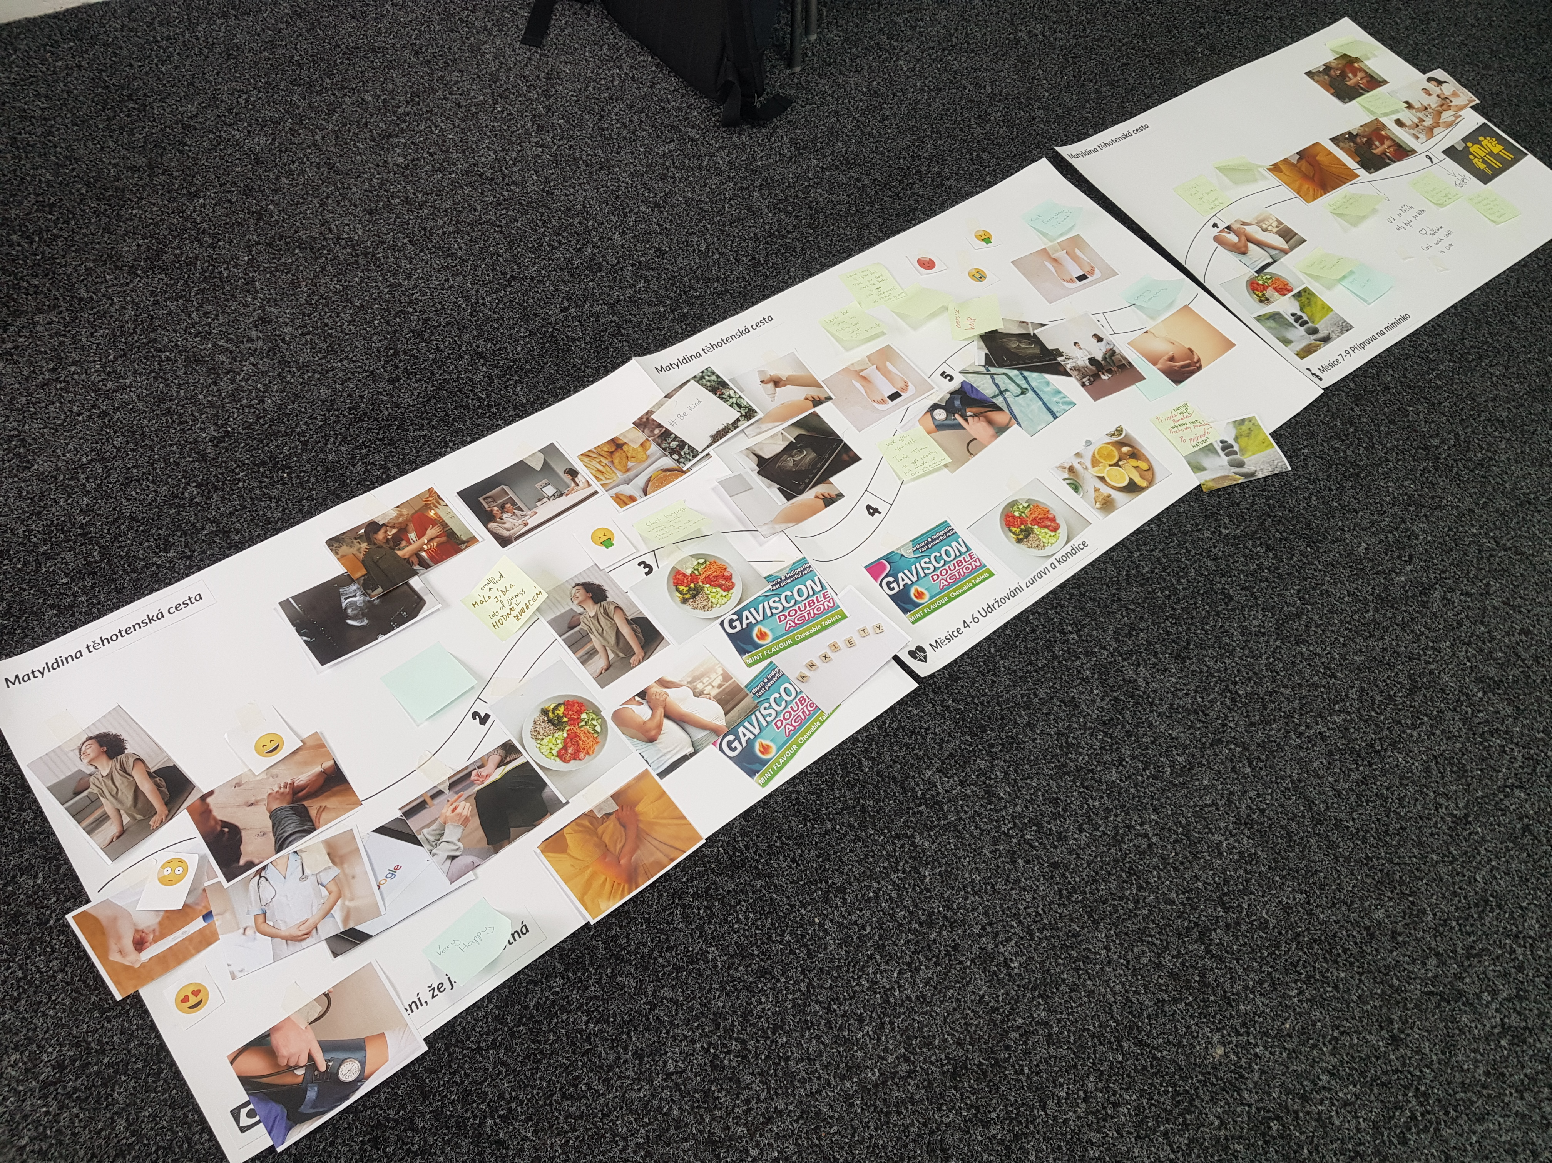
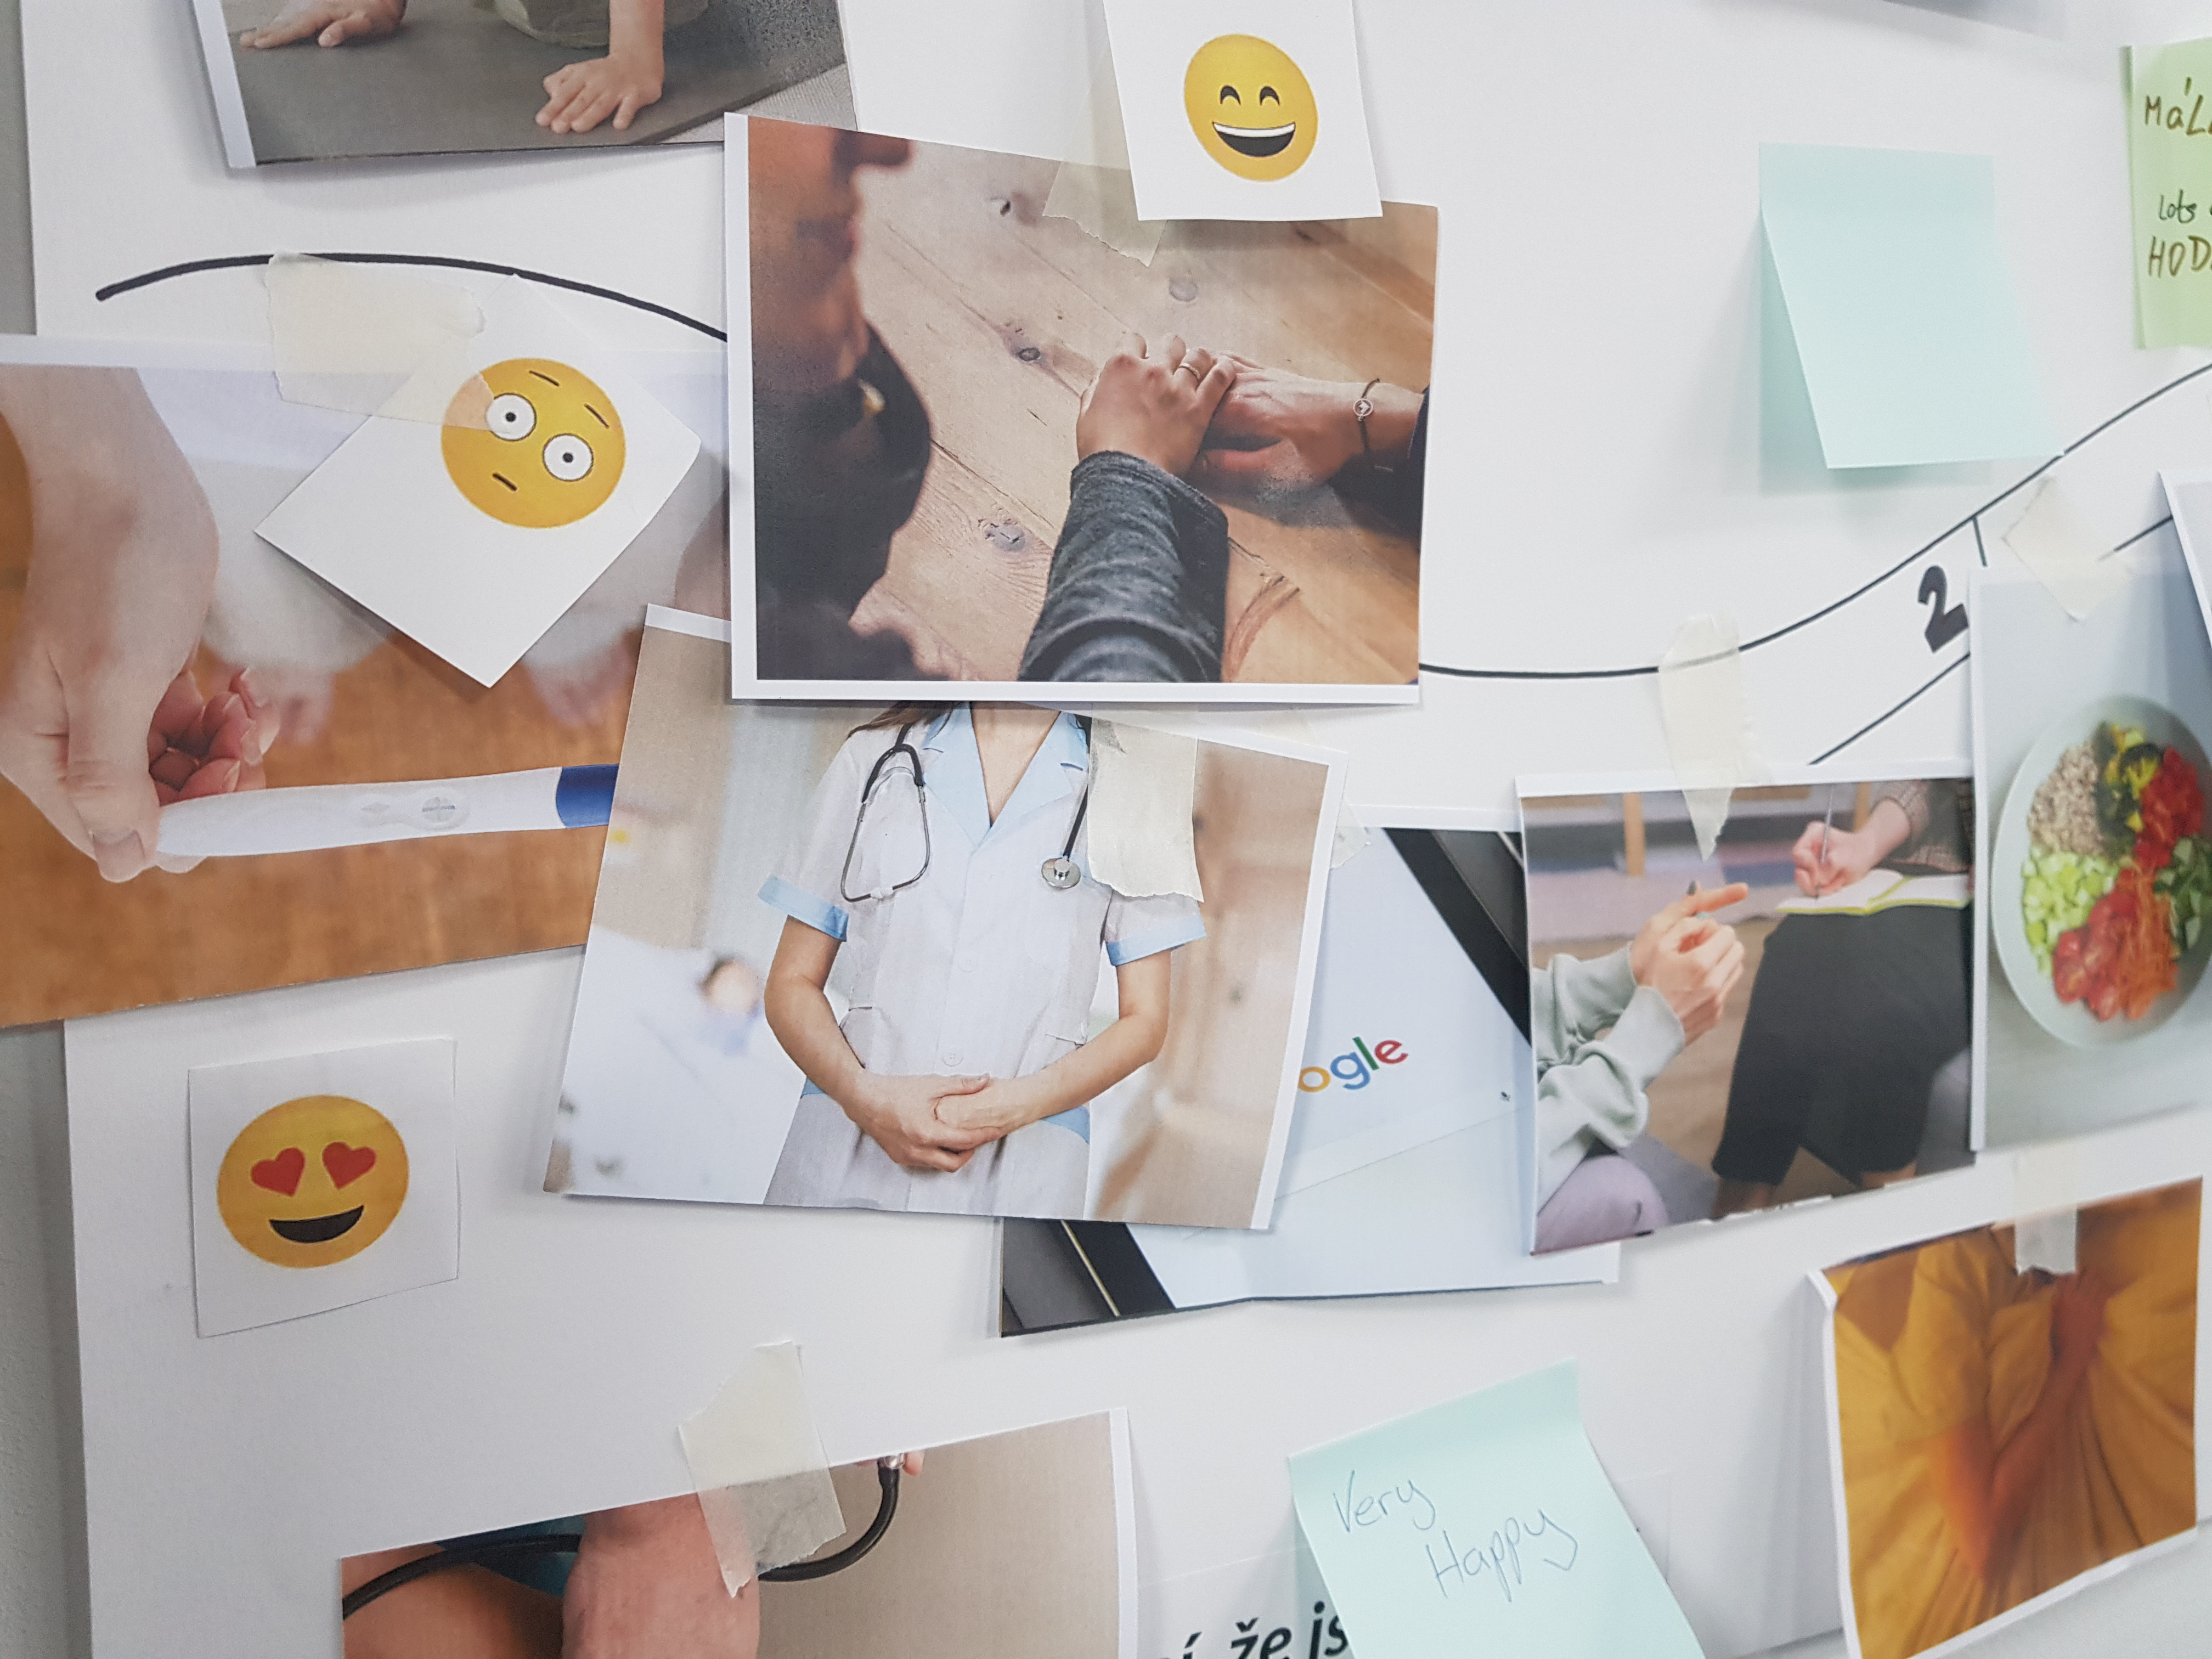
Workshop 4: Iterative co-creation
Summary of women’s stories
Design-based methods:
Mapping the pregnancy journey
Pregnancy journey map co-created in session 4.
ERicar NENC | 19 Oct 2023

Slide 5
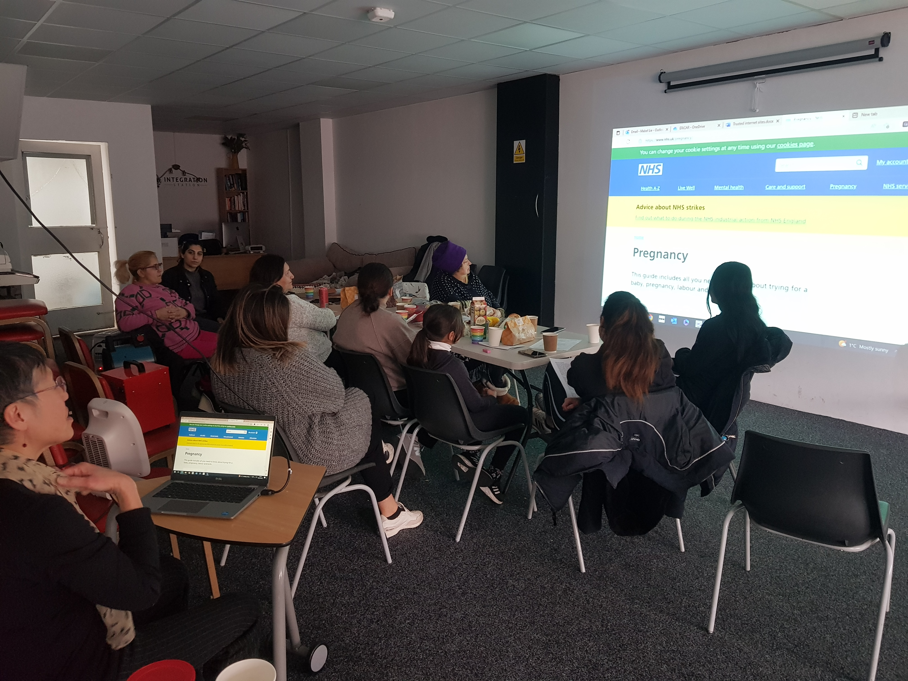
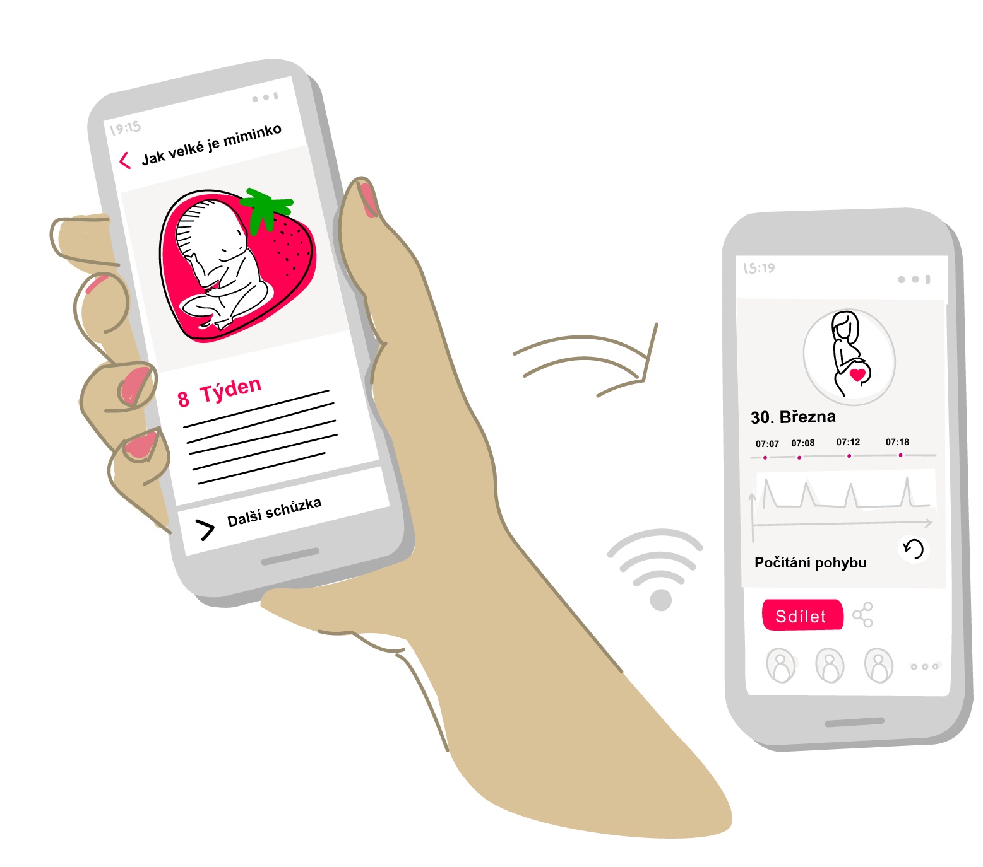
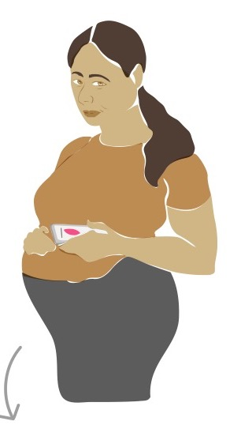
Workshops 5 & 6:
Information sharing
Online resources from e.g., NCT, Tommy’s, start4life, Healthworks
Key topics of importance
Powerpoint presentation featuring screenshots of pregnancy apps, e.g., Baby Buddy, to discuss views on particular features
Scenario featuring Matylda to contextualise our inquiry
Scenario: Matylda downloads a free mobile application developed by a UK charity that supports women and their family throughout their pregnancy and parenting journey.
Workshops 5-6: on online information and digital tools
ERicar NENC | 19 Oct 2023

Slide 6
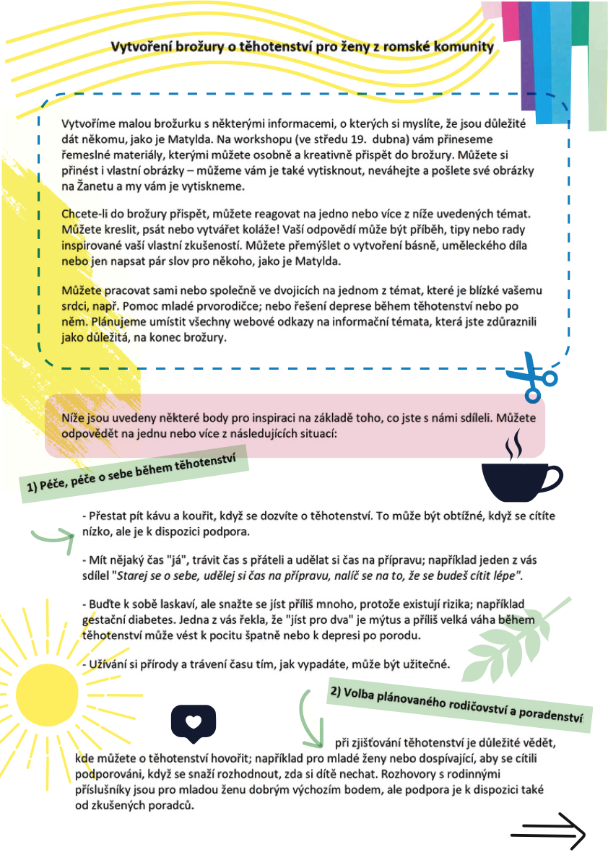
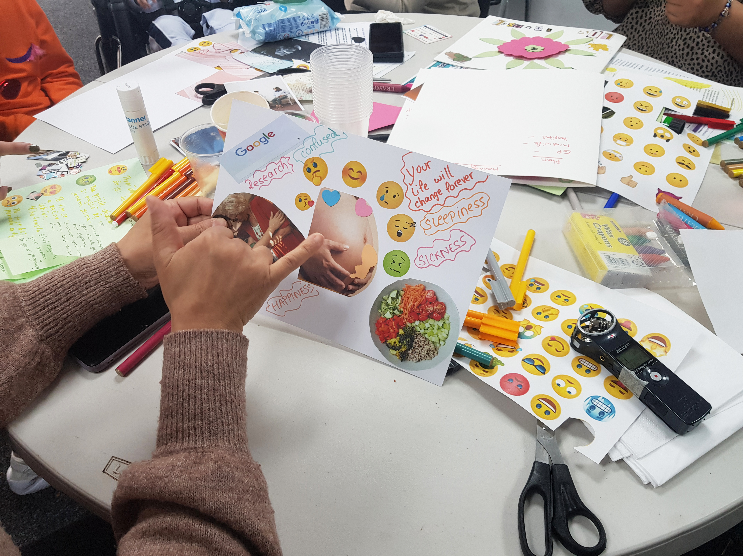
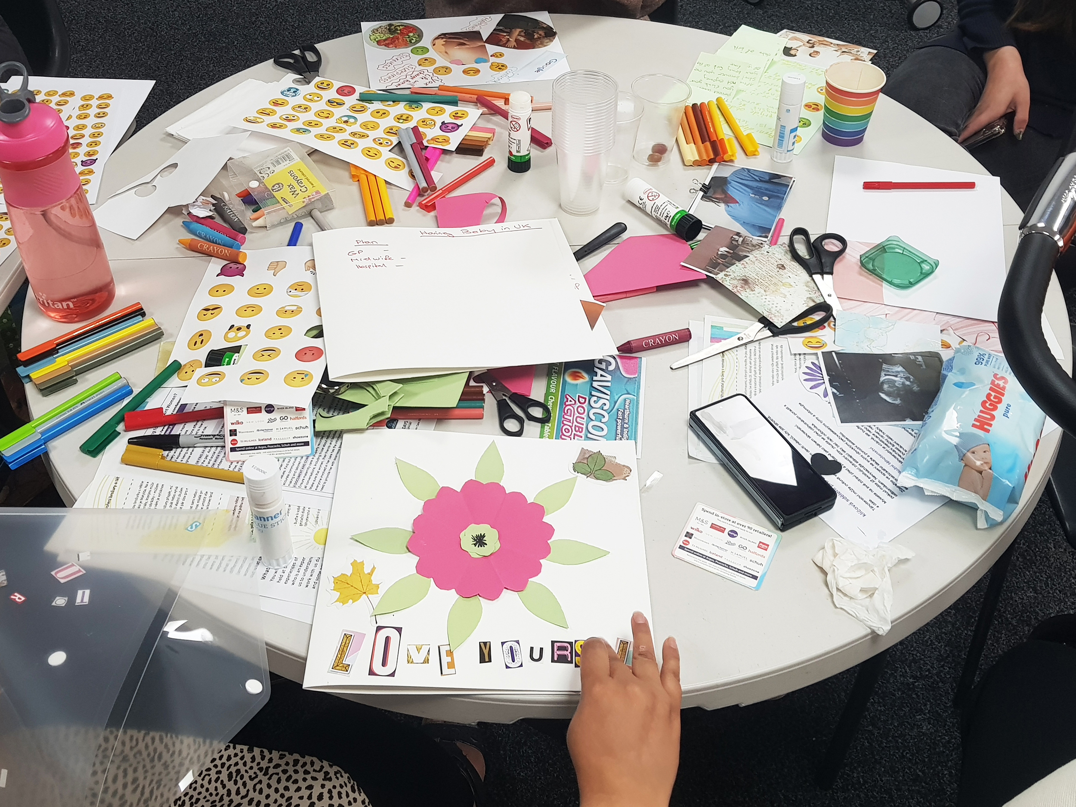
Workshops 7&8 Iterative co-creation
Design-based methods: Exploring ideas and zine making
Zine making activity and activity sheet translated featuring thematic insights for inspiration.
ERicar NENC | 19 Oct 2023

Slide 7
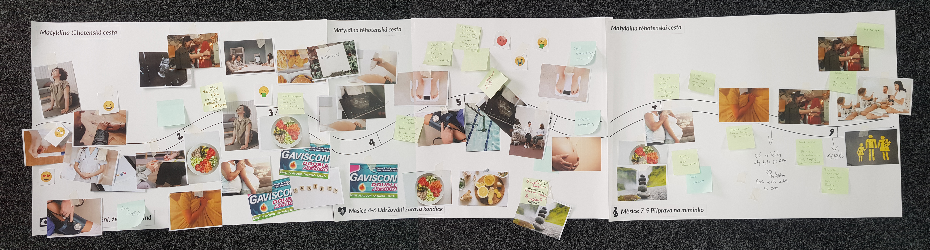
Findings
Women’s support network
The role of partners or husbands
Self-management
Self-care
1 – Pregnancy Journey
‘Look after yourself, take time to get ready, put make-up on it will make you feel better’ (Ruzena*, aged 36).
*Pseudonym
Pregnancy journey co-created in workshop 4.
ERicar NENC | 19 Oct 2023

Slide 8
Findings from women’s stories
2 – Migration and stigma | Experiences in EU country of origin
Older participants
Lack of compassionate care​
[…] The doctor was forcing her to go for an abortion, with the fourth child, because she was not allowed to get pregnant anymore (Marta, aged 49)​
Medically interventionist – hospitalisation and planned C-sections
Younger participants
Direct access to specialist care such as Gynaecology and Paediatricians ​
Easy access to private healthcare
    And you just pay a little bit extra. So, the baby will have extra support (Petra, aged 41)
ERicar NENC | 19 Oct 2023

Slide 9
Findings
2 – Migration and stigma | Experiences in the UK
Primary care can be confusing for them​
    You go to (GP), and every time, different doctor… in Czech Republic you have one doctor,
    and he knows everything for years and years...So you coming here, every time,
    ‘what’s your name?’ (Petra, aged 41)
Less strict care regimes, greater patient choice e.g., natural birth methods
Compassionate care and good facilities
    But the care that I received, was amazing, I had two midwives… And they both were so nice.
    And I could not fault them, they made me feel very comfortable, very easy to talk to,
    and very helpful (Ruzena, aged 36)
    She was very surprised cos she had her own room, and she had everything there, own bathroom everything, so she was very happy (Petra’s 17-year-old daughter’s maternity care)
ERicar NENC | 19 Oct 2023

Slide 10
Findings
2 – Migration and stigma | Experiences in the UK
Negative experiences
Twin miscarriage, where she lost one tragically when she arrived at the hospital; not offered a bed, or medication; sent home to wait for the second to pass naturally.
Giving birth in vehicle driven by friend; not offered any assistance by reception staff when he ran in desperate to get help.
    She didn’t know where to complain about this, nobody gave her advice, what happened to her,
    how she can deal with it – (Interpreter for Petra)
Staff refused requests for additional scans for her high-risk pregnancy​.
    Coming to the end, I had, she [consultant] gave me another four scans, she said, we need to check you, and they should have been checking you, so she gave me four scans (Ruzena, aged 36)
Racial and age profiling
    I was nearly 30, and the way they talk to me they thought I’m having already 5 children, and it was my first one. They wouldn’t give me enough information (Irma, aged 38)
ERicar NENC | 19 Oct 2023

Slide 11
Findings
3 – Maternity rights and self-care
Not aware of entitlement to free prescriptions regardless of earnings​.
They counted my husband’s wages, my wages, they said it was up to £16 000 a year, which it was,
£16 500 something, and I’m not entitled to, so I buy it, I pay for the prescriptions. (Gabriela, aged 41)
Ruzena was told to get Gaviscon over the counter, but she felt so sick that she
was going through four packs a week.
Not told about parenting classes because of cultural assumptions​
Women embarrassed about needing help for what should be natural to mothers​.
Most relied on practical family help than attending a group for support.​
Main anxiety for the health of the baby and their preparation for motherhood.
ERicar NENC | 19 Oct 2023

Slide 12
Findings
3 – Maternity rights and self-care | Mental Health
Stress and anxiety because of previous experiences of infertility, miscarriage,
or pregnancy loss
    I was crying constantly. Because the pregnancy, every single week I had a like a weekly or every two weeks scan, also like a, they find always something, so I was really worried, for the next one, and the next one, it was very stressful. (Sofia, who experienced a twin miscarriage)
Uncomfortable sharing their feelings with their mothers and discussing their pregnancy.
    They wouldn’t go ask their mothers saying oh, because of the respect and being embarrassed and shy. … Just they couldn’t have the conversation. (interpreter)
Fear of being judged as unfit mothers and reported to social services​
    They’ll take their children away, they’ll just like leave it, avoid it, not mention it, and then just hide it​
Established need to focus on mental health​
    Every woman, different ages in the group we had, said, it’s important to talk about mental health (Irma, aged 39)
ERicar NENC | 19 Oct 2023

Slide 13
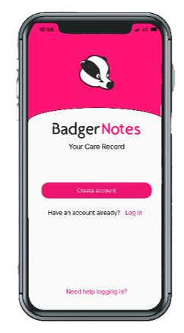
Findings on digital resources
4 – Opportunities for sharing information via digital tools
Younger generation who are familiar with apps and digital savvy
Pregnancy apps (i.e., NHS Badger app) as a good alternative to notes or booklets used at the clinic; reminder feature appreciated.
To support self-management by enabling women to seek information outside of the clinic (in a timely manner)
To support body awareness with features that allow for visualisation
To provide emotional support
So, the app enables you to take it everywhere with you, even if I don’t take my phone, they [healthcare professionals] still have my information and they can edit, and look at it before I turn up they know who it is and what they need to know (Ruzena, aged 36).
BadgerNotes app via NHS
ERicar NENC | 19 Oct 2023

Slide 14
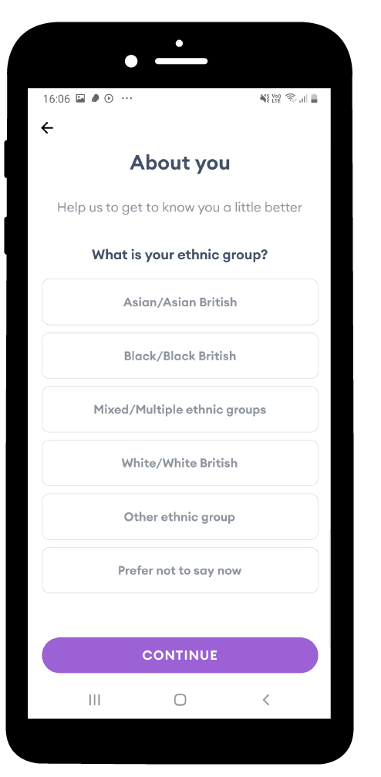
Findings
4 –Barriers for sharing information via digital tools
Sharing personal and health information: Knowing the purpose; Preferred it if the app is affiliated with a trusted party (i.e., NHS).
Privacy concerns: not wanting to share information about themselves or their families online
Participating in online community (lurking); not wanting to share their own information with strangers.
Sharing about their identity and ethnic background is complex.
  Fear of discrimination and stigma towards Roma groups
  Women were uncomfortable with the term Gypsy-Roma-Traveller
Having choice and control over their information was important, e.g., partners
Screenshots of app features were translated and presented to the women for discussion. Examples included the Baby buddy app.
ERicar NENC | 19 Oct 2023

Slide 15
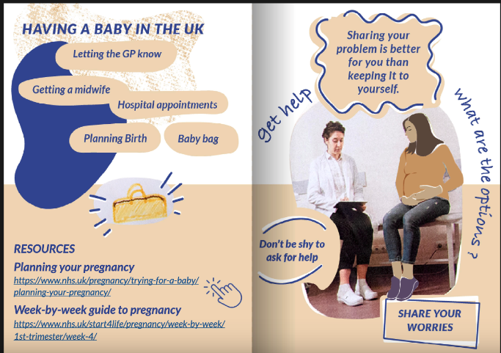
Co-creation: what women wanted to share in the resource
Key steps for having a baby in the UK
  Help to navigate the healthcare system in the new host country.
Snapshots from the Zine, available via https://issuu.com/caroclaisse/docs/ericar-zine_cocreated-english
ERicar NENC | 19 Oct 2023

Slide 16
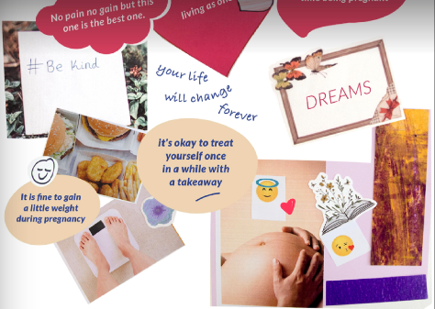
Women’s voices: what they wanted to share in the resource
Key steps for having a baby in the UK
  Help to navigate the healthcare system in the new host country.
Advice about asserting their rights as women
to be caring for themselves
Snapshots from the Zine, available via https://issuu.com/caroclaisse/docs/ericar-zine_cocreated-english
ERicar NENC | 19 Oct 2023

Slide 17
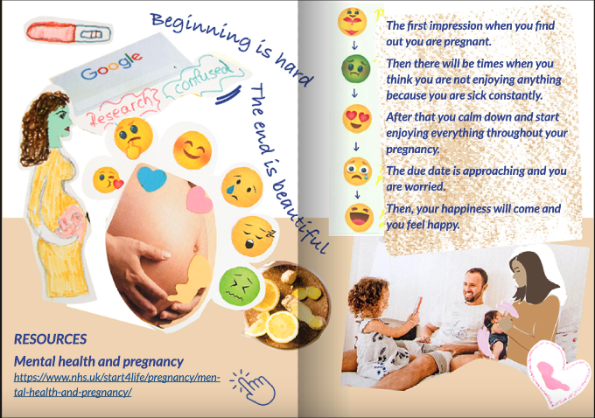
Women’s voices: what they wanted to share in the resource
Key steps for having a baby in the UK
  Help to navigate the healthcare system in the new host country.
Advice about asserting their rights as women to be caring for themselves
Preparation for the emotional up and downs of the pregnancy journey
Snapshots from the Zine, available via https://issuu.com/caroclaisse/docs/ericar-zine_cocreated-english
ERicar NENC | 19 Oct 2023

Slide 18
Women’s voices: what they wanted to share in the resource
Key steps for having a baby in the UK
  Help to navigate the healthcare system in the new host country.
Advice about asserting their rights as women
to be caring for themselves
Preparation for the emotional up and downs of the pregnancy journey
Encouragement to share about their mental health
  The taboo in their community against seeking professional help particularly for mental health issues.
Snapshots from the Zine, available via https://issuu.com/caroclaisse/docs/ericar-zine_cocreated-english
ERicar NENC | 19 Oct 2023

Slide 19

Women’s voices: what they wanted to share in the resource
Key steps for having a baby in the UK
  Challenges for immigrant women to navigate the healthcare system in the new host country.
Share advice about asserting their rights as women
to be caring for themselves
Preparation for the emotional up and downs of the pregnancy journey
Encouragement to share about their mental health
  The taboo in their community against seeking professional heal particularly for mental health issues.
Positive tone, encouraging and compassionate messages fueled with hope.
Snapshots from the Zine, available via https://issuu.com/caroclaisse/docs/ericar-zine_cocreated-english
ERicar NENC | 19 Oct 2023

Slide 20
Feedback, reflections, and applications
Women’s voices: what they have gained
More informed about publicly available resources and support​
  I learned lots of information, not for me, because I won’t get pregnant again, but for my kids, I will be support them to have more information, so I can help them, (Gabriela, aged 41)​
Raised awareness of their need to care for oneself​
  If I would be like pregnant again, I would think about myself, how to look after myself, the mental health, and even how I feel, in my body and stuff like that (Sofia, aged 45)​
Raised concern for the younger generation​
Pregnancy experiences developed empathy and common bond among women​
  I was very surprised with this project, that everybody opened up about their mental health. It was not taboo, which in our community, it’s a big taboo. But everybody was so supportive of each other…(Irma, aged 39)​
Raised awareness of their rights​
  For me, it reminded me that I was mistreated
  (Ruzena, aged 36)​
  We were talking a lot about this prescription that it’s free for pregnant women. I had to pay for all the prescriptions, so I didn’t know (Irma, aged 39)
ERicar NENC | 19 Oct 2023

Slide 21
“How would you use the study methods or resource in your research/practice”?
As a conversational starter?
As a digital downloadable resource?​
Replicate study methods with other groups? ​
More work with Roma e.g., postnatal care? Supporting fathers?​
ERicar NENC | 19 Oct 2023

Slide 22

Public Health Intervention
Development Scheme
MR/X503046/1
EP/T022582/1
Thank you
for listening!
Mabel Lie: mabel.lie@newcastle.ac.uk
Caro Claisse: caroline.claisse@newcastle.ac.uk
Acknowledgments: Thanks to all the women who took part in this research; to Zaneta Karchnakova (peer researcher) and Irma Karchnakova (interpreter); and to our expert advisory panel.
ERicar NENC | 19 Oct 2023

