Slide 1
Developing a Community Based Menopause Service for Women in Stockton and Hartlepool using a Holistic Approach
Dr Lucy Newton & Lin Greenfield
Notes:
Introduction
Introduce as individuals
Introduce H&SH as Federation
Introduce project (high level)

Slide 2
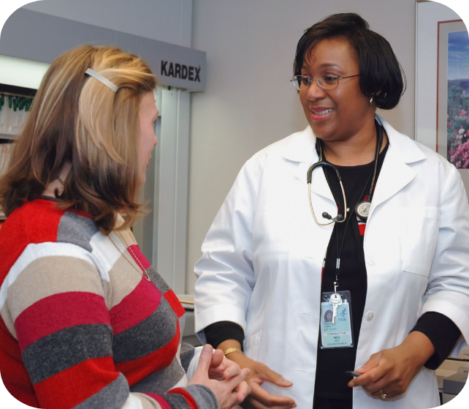
The Need for Change
Appointment Requests
Media Interest
Time Constraints
Variations in Care
Notes:
Need for Change
Media coverage has increased – Women’s Health Strategy 2022 & Davina McCall
Appointments are only 10 minutes – Rushed
Variation in HCP knowledge
Discrepancies lead to inconsistent standards of care

Slide 3
Planning Stage One
Concept
Atmosphere
Location
Confidentiality
Resources
Advertising
Notes:
Stage One - Planning (Pilot Drop-In Cafés)
Concept
Safe space for women to feel listened to about their experiences of menopause in our community
Atmosphere
Non-clinical safe environment
Warm, friendly, inviting
Location
Working with local small businesses in the heart of our communities
Access – Ensuring good parking and public transport routes, as well as walkable
Confidentiality
Discussions with local business to close to the public to maintain confidentiality
Resources
Reliable evidence shared in the café
Support Pack – Symptom tracker
Advertising
Promoted via posters / leaflets in practices
Flyers & posters sent to Practice Managers
Shared with Personalised Care Team
Shared with Council, Healthwatch, Public Health
Accurx Texting out - added later

Slide 4
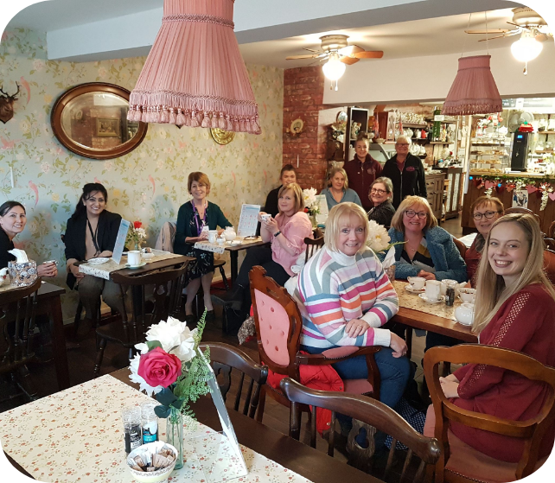
Menopause Drop-In Café
Nurse Facilitated
Reliable Resources
Supportive
Forming Connections
Notes:
Menopause Drop-In Cafés
Nurse facilitated with support from the Personalised Care Team
Resources
British Menopause Society
Women's Health Concern
Balance
Supportive
Encourage a conversation
Power of connection between women sharing experiences and e.g. Fiona

Slide 5
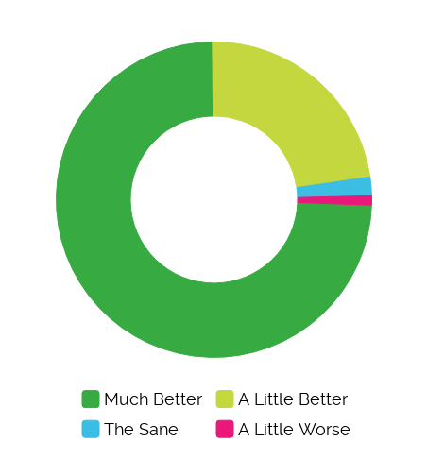
Evidence of Success
How do you feel after the session?
Just thank you. It's a breath of fresh air to speak to other women who are going through the same thing <3
It’s a vital service and much valued
It's good to chat to ladies in the same situation
Something so simple can have such a huge impact. How can we make this available to everyone all the time… so it becomes normal. Thank you ! X
A magical & empowering experience
Validation of symptoms helps so much
Notes:
Evidence of Success
97% Better (74% Much Better)
People have so many positive things to say about the drop-in cafés

Slide 6
Planning Stage Two
Recruitment
Standardise
Data
Notes:
Stage Two - Planning (Clinics - Pilot)
Recruitment
Finding nurse prescribers with relevant training and recent experience in managing menopause in Primary Care
Standardise
Creating a well-led team to include:
Standard Operating Procedure to ensure consistency, guidance and standards within the clinic
Use for Q&Q if required
Completed a menopause competency self assessment – with support of GP Lead
Clinical supervision
Clinical governance – note review
How to work with complex issues / breast cancer history
1:1s if required
WhatsApp group
Sending a task back to the registered practice
Data
Ongoing data collection is carried out to prove the concept, to include:
Number of appointments
HRT prescribing rates
Referrals on
Patient satisfaction and comments

Slide 7
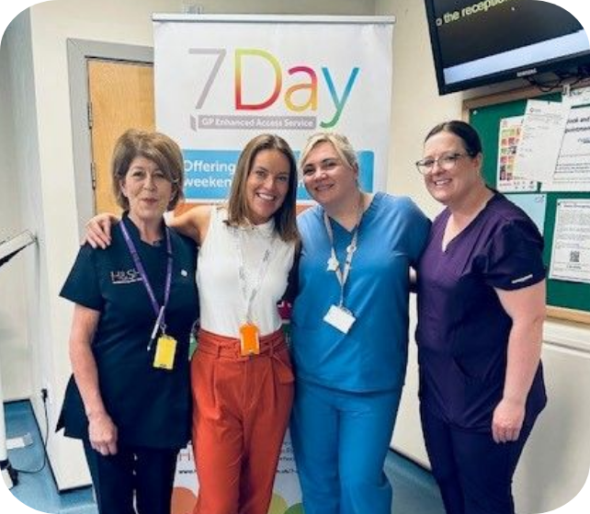
Menopause Clinic
30 Minute Appointments
Holistic Assessment
Referrals / Safety-Netting
7 Day Admin Support
Resources
Notes:
Menopause Clinic
Located within our 7 Day Enhanced Access Service
Initial 30 minute appointments
Holistic assessment – looking at the woman as a whole
What we are not. Refer to secondary care / specialist menopause as needed. Safety net back to GP
Working within our existing 7 Day Service, the admin team can do ref letters / task GP Practices and ensure any bloods are reviewed by a GP within the 7 Day Team

Slide 8
Case Study
Name: Susan
Age: 51
History:
Mother had breast cancer in her 70s
Readings:
BMI - 31 BP - 148/80
Unsatisfactory outcome from GP consultation
Received a text and attended Drop-In Café
Booked an appointment at Menopause Clinic
Achieved the outcome she was looking for
Notes:
Case Stud
GP Consultation
Susan went to her GP with Hot Flushes and Poor Sleep
GP said she was "too high risk" for HRT due to FH and PMH
GP prescribed Sertraline
Café
Received a text telling them about our drop-in café sessions
At café – listened to / Sx tracker / resource pack given
Then booked men. clinic appt. via own GP
Appointment
30 minute face to face appointment pre-loaded with info from drop-in café
Discussed the risk and benefits of HRT
Discussed the risk and benefits of breast cancer specifically
Outcome
We met Susan’s needs
HRT prescribed and a follow up review appointment given there & then to pt.
BP taken (and raised) so signposted to own GP
BMI explored so referred to Health and Wellbeing Coach for follow-up
Task was then set with all the above info to her own GP

Slide 9
Challenges
Timings
Training
Criteria
Notes:
Challenges
Timings
Trial and error getting the time right for as many women as possible
Training
Many courses are oversubscribed - long waiting times – and expensive
Criteria
Over 45s only - means people who need more complex care aren't seeing multiple professionals

Slide 10
The Future
Expand
Upskill
Group Clinics
Broaden Scope
Notes:
The Future
Expand
Cover Billingham and Norton PCN as well
Upskill
Developing our skills in discussing the menopause with groups that we are not seeing consult. These include LD / physical disabilities / other demographic groups
Group Clinics
? Provided virtually
Broaden Scope
The aim is for the clinics to be part of a women’s health hub offering a number of different services.
Consider providing
Cytology
Family Planning (inc. LARCs)
Psychosexual clinics
Ultrasound scanning (reduce wait for HRT)
Endometrial sampling (reduce wait for HRT)
Outreach team
Education for local teams

Slide 11
info.hash@nhs.net | 01642 061047 | hartlepoolandstocktonhealth.co.uk
Notes:
Type your notes

