Slide 1
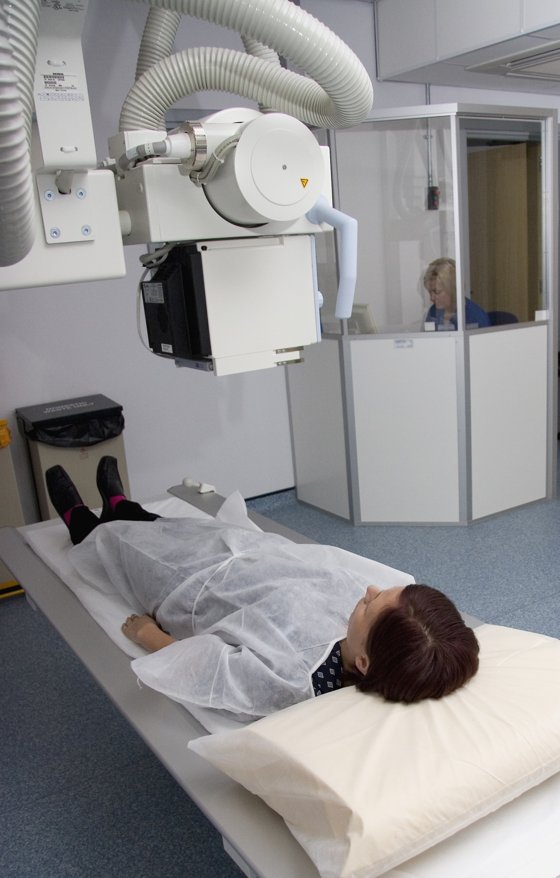
Mini Scrubs NHS – Lesson 4
The role of the Radiologist

Slide 2
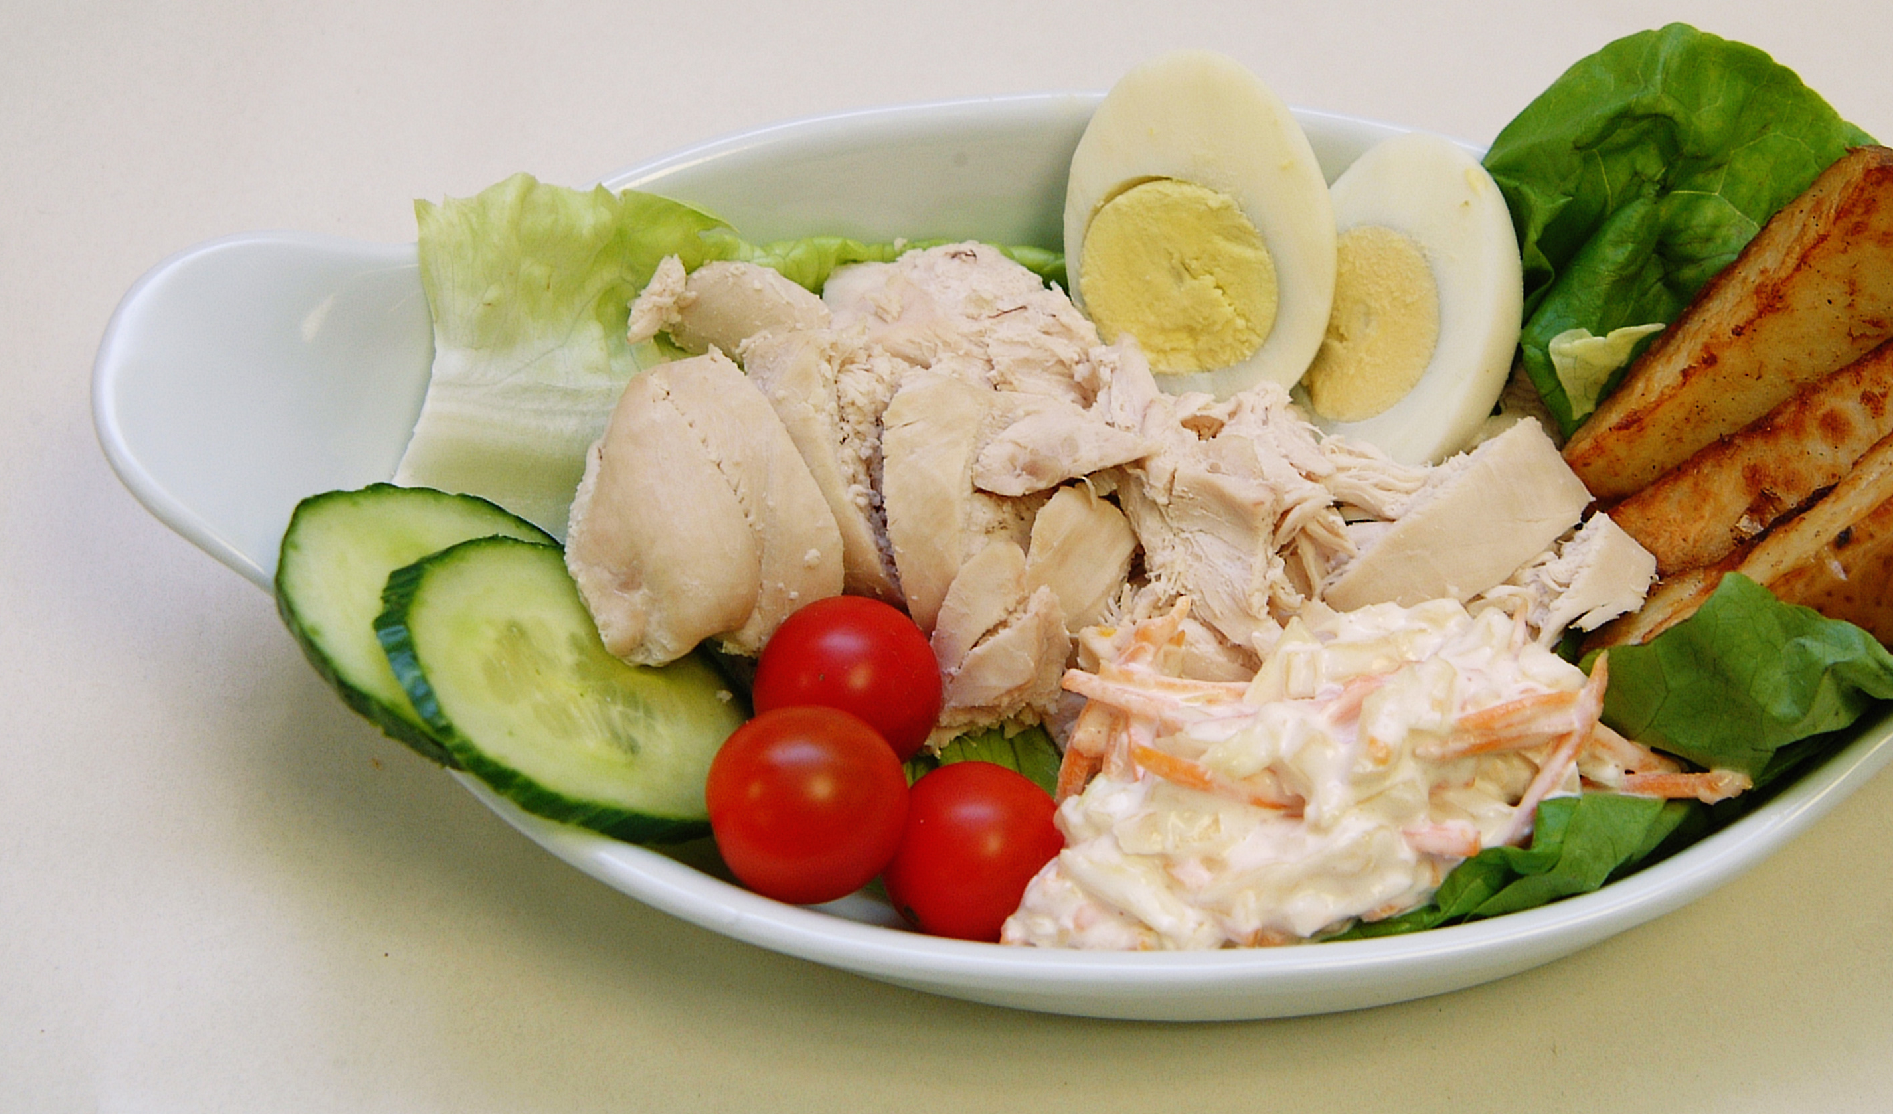
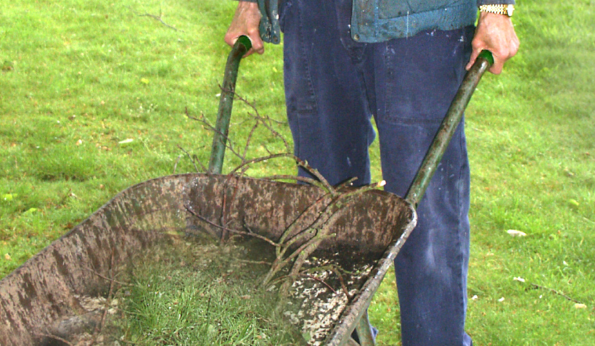
Quick recap:
Who helps us eat healthy?
Who helps gardens grow?

Slide 3
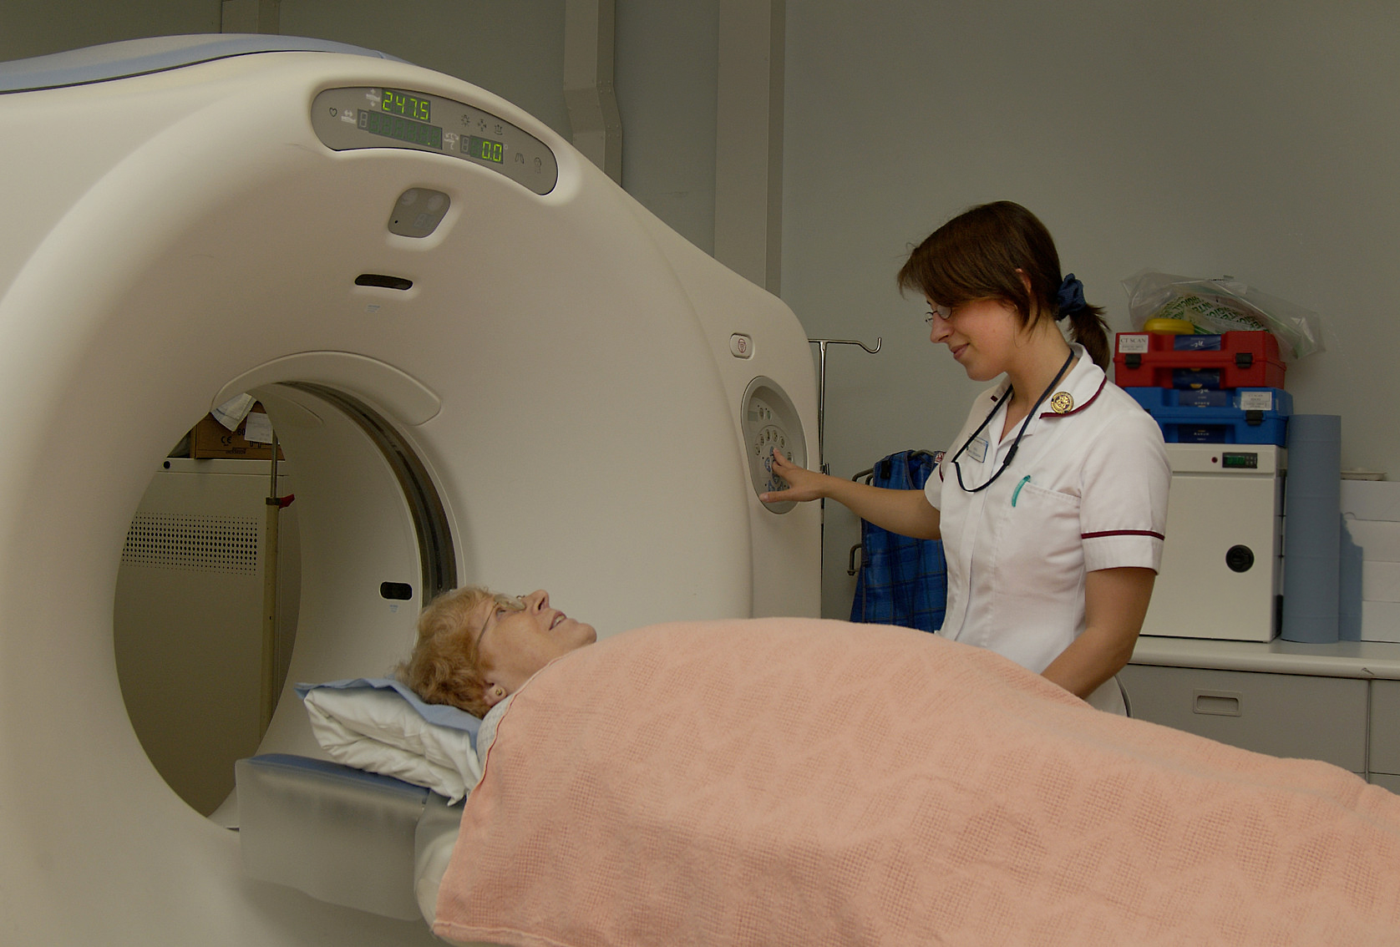
Learning objective
I can describe the role of a radiologist working in the NHS.

Slide 4
Success criteria
By the end of this lesson, I will be able to:
Explain who a radiologist is and what they do
Recognise basic types of medical images (e.g. x-rays, ultrasounds)
Understand why taking pictures inside the body is helpful for doctors
Create their own version of an x-ray using art materials

Slide 5
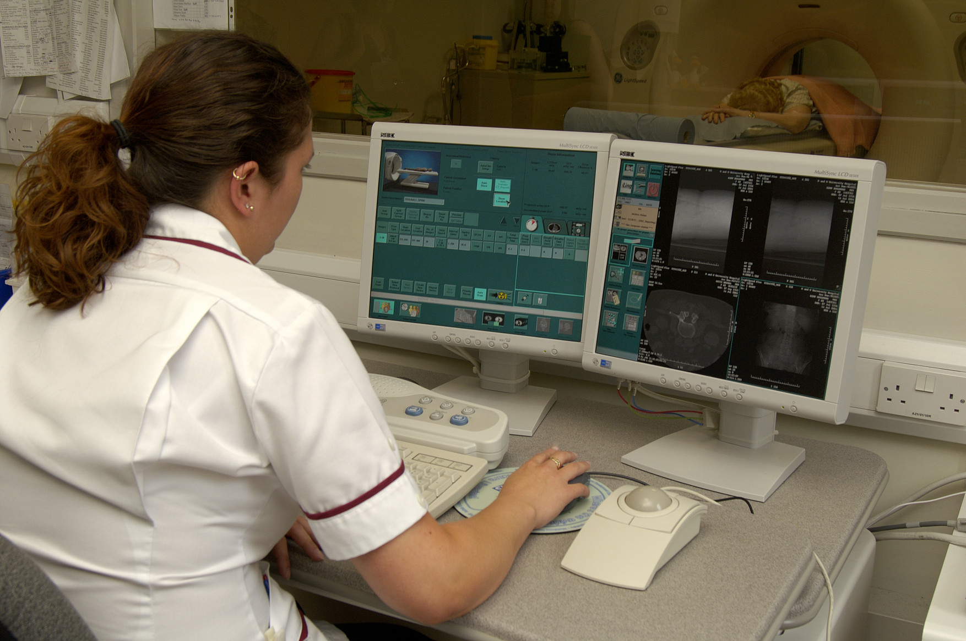
Who is a radiologist?
A radiologist is a special doctor who takes pictures of the inside of our body.

Slide 6
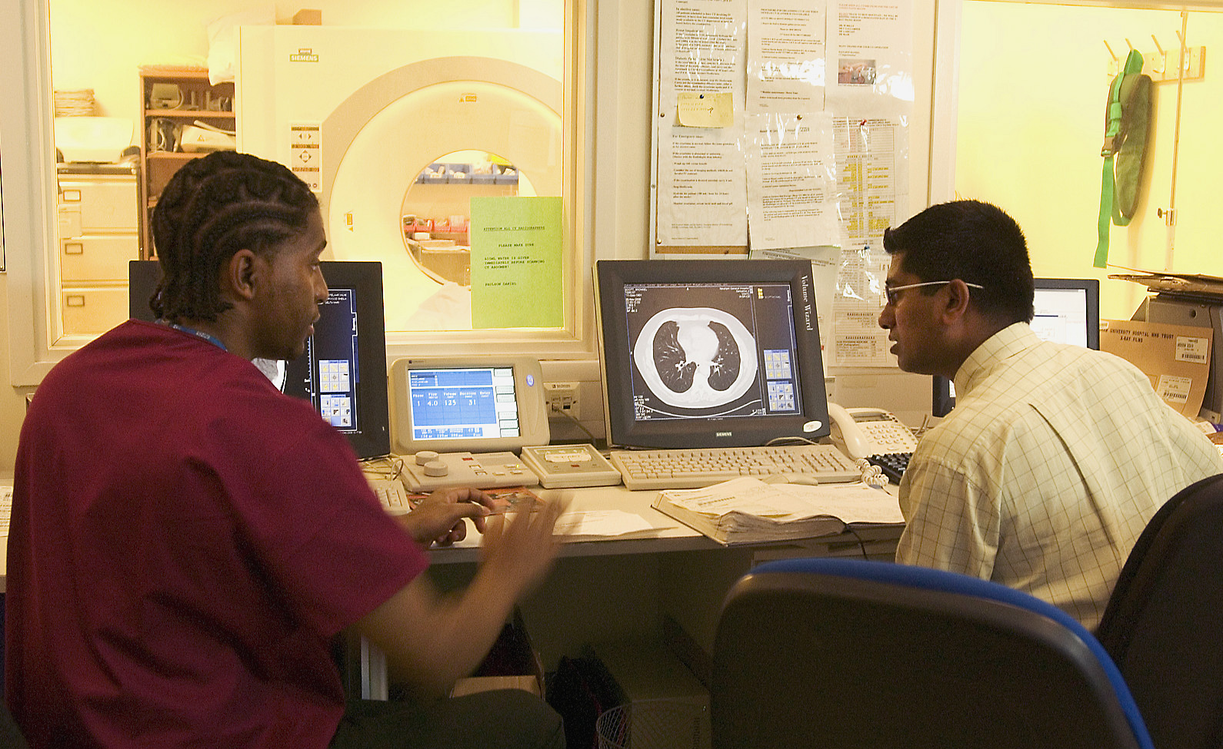
Why do we need pictures?
To check for broken bones or illness
So doctors can find out what’s wrong
To help us get the right treatment!

Slide 7
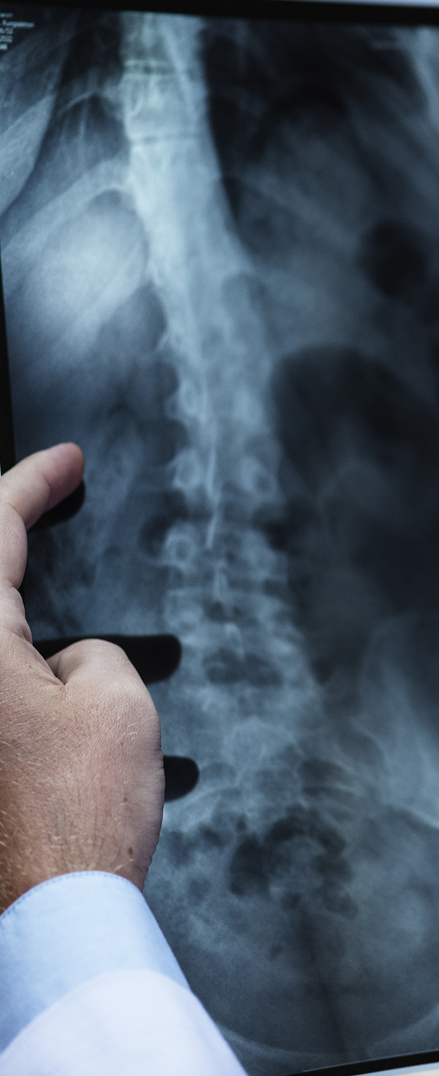
Guess the body part!
Can you guess the body part in the x-ray?

Slide 8
Tools of the trade
Radiologists use: x-rays, ultrasound machines, scanners
They work safely to help doctors understand the body
https://www.bbc.co.uk/cbbc/watch/op-ouch-pov-patient-x-ray

Slide 9
Let’s get creative!
Draw your own x-ray using black paper and white chalk or paint
Trace your hand or foot and draw the bones inside

Slide 10
Share your work
Show your x-ray to the class!
What bones did you draw?
What did you learn?

Slide 11
Mini Scrubs reflection
🧠 Radiologists are picture detectives for doctors!
💬 How do they help people feel better?
🎖️ Great job, Mini Scrubs!

