Slide 1
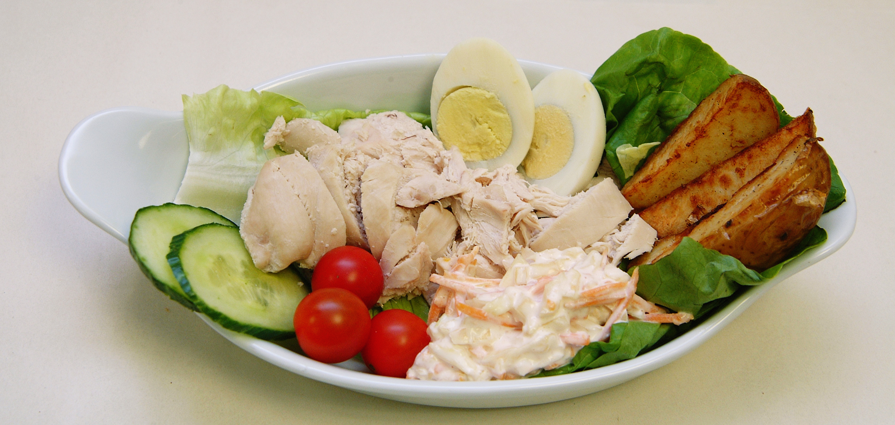
Mini Scrubs NHS –
Lesson 2
How do NHS chefs help to keep people healthy?

Slide 2
Starter – let’s recap
What is the NHS?
What jobs did we learn about
last time?
Today we’ll learn about NHS Chefs!

Slide 3
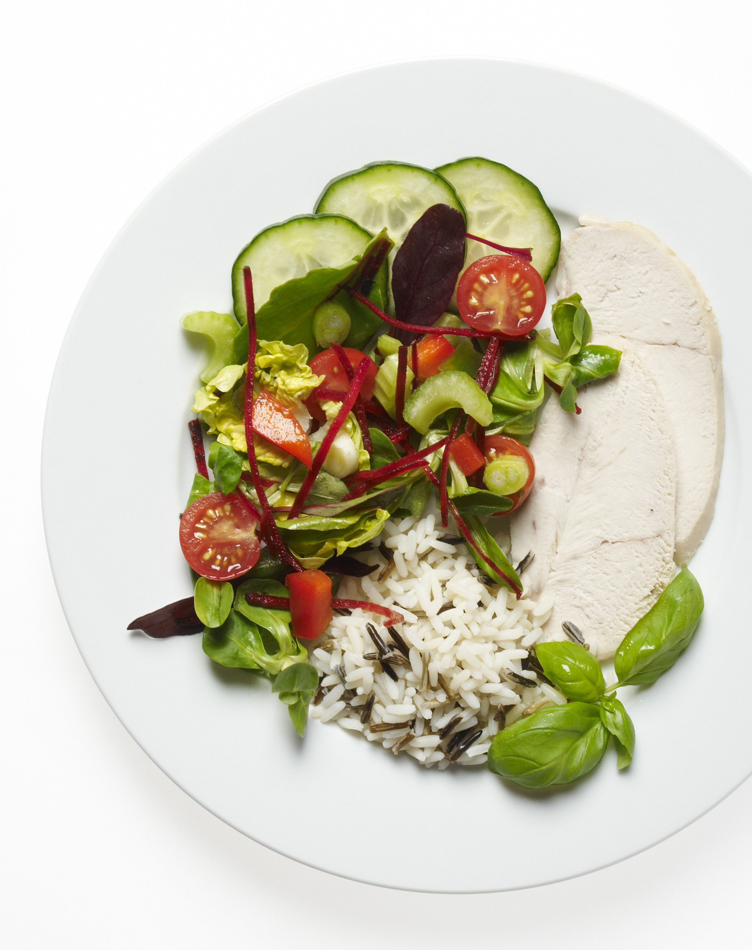
Learning objective
I can understand the role of a chef in the NHS and the importance of healthy eating.

Slide 4
Success criteria
By the end of this lesson, I will be able to:
Describe the role of an NHS Chef
Explain why healthy eating is important, especially in hospitals

Slide 5
What do we eat to stay healthy?
Let’s explore the five main food groups:
Fruits
Vegetables
Proteins
Dairy
Carbohydrates
Each group helps our body in a special way!

Slide 6
Why healthy eating matters in hospital
Healthy food helps people heal and
feel better
Chefs prepare balanced meals for patients
Proteins help the body repair itself
Vitamins from fruits and vegetables keep us strong
Carbs give us energy!

Slide 7
Video Time –
NHS Chef of the Year
Watch the video to learn about NHS chefs:
https://www.youtube.com/@NHSEngland-ChefoftheYearCo-k1n
This video needs to be cut to show the main points

Slide 8

Time to make a healthy snack!

Slide 9
NHS Chefs in action
How did you work as a team?
What foods did you choose and why?
How do these help your body?
Optional: Create a face with your food!

Slide 10
Plenary – let’s reflect
Why is healthy food important in hospitals?
Share one healthy food you’d like to try this week
Remember: Healthy eating helps everyone feel their best!

Slide 11
Take-home reminder
Healthy eating is essential for everyone, especially in hospital
Share what you learned with your family!
Can you help make a healthy snack at home this week?

