Slide 1



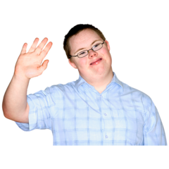
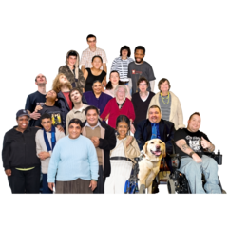
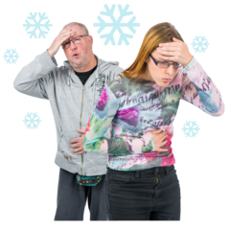
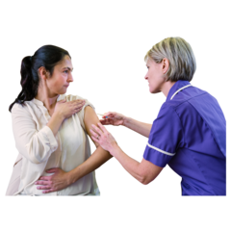
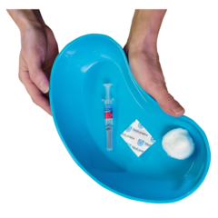
Ref:
Date:
INSERT PATIENT INFO:
INSERT GP PRACTICE INFO:
Dear
People with a learning disability are in the at risk group of getting flu.
This means if they get flu they may be more at risk of getting complications and feeling very unwell.
To help keep you well this winter it’s important you have your flu jabs. This will help protect you.
We would like to invite you for your flu vaccine.

Slide 2


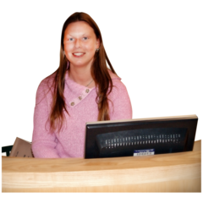
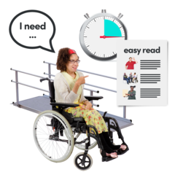
Please come to your GP surgery on:
[INSERT DATE DD/MONTH/YEAR
[TIME: 12 hour clock]
The address is
[PRACTICE NAME AND ADDRESS]
If you can’t come on this day we can arrange a different appointment for you. Please phone reception on INSERT PHONE NUMBER
.
If you need some reasonable adjustments then please let us know by phoning reception on INSERT PHONE NUMBER.
We want to support you really well. You can find out more about reasonable adjustments at www.necldnetwork.co.uk/work-programmes/reasonableadjustments

Slide 3
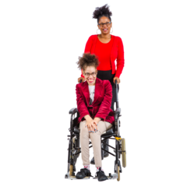
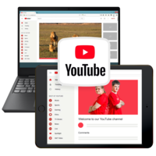
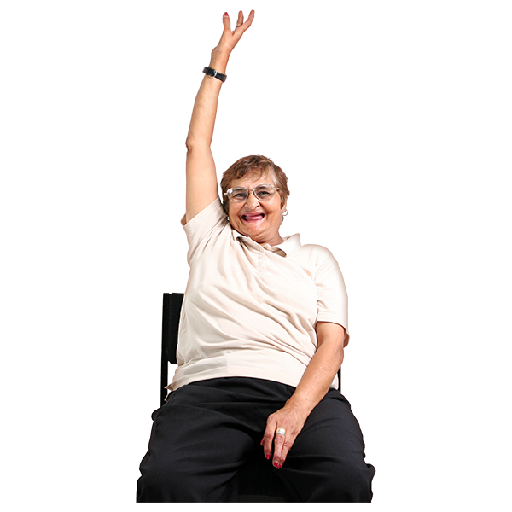
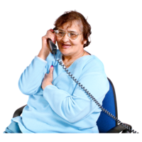
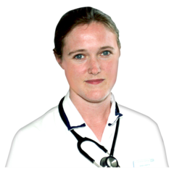
If you have a carer they can also have a free flu jab which will help protect them and the people they care for.
Ask them to contact their GP or local pharmacy to arrange this.
The North East & Cumbria Learning Disability Network have made some short films about getting your flu jab they can be found at: www.necldnetwork.co.uk/flu
If you have any questions please contact us on the phone number below. We are here to help you.
We look forward to seeing you.
If you don’t want to have your flu jab please phone and tell us.
INSERT GP PRACTICE DETAILS

