Slide 1
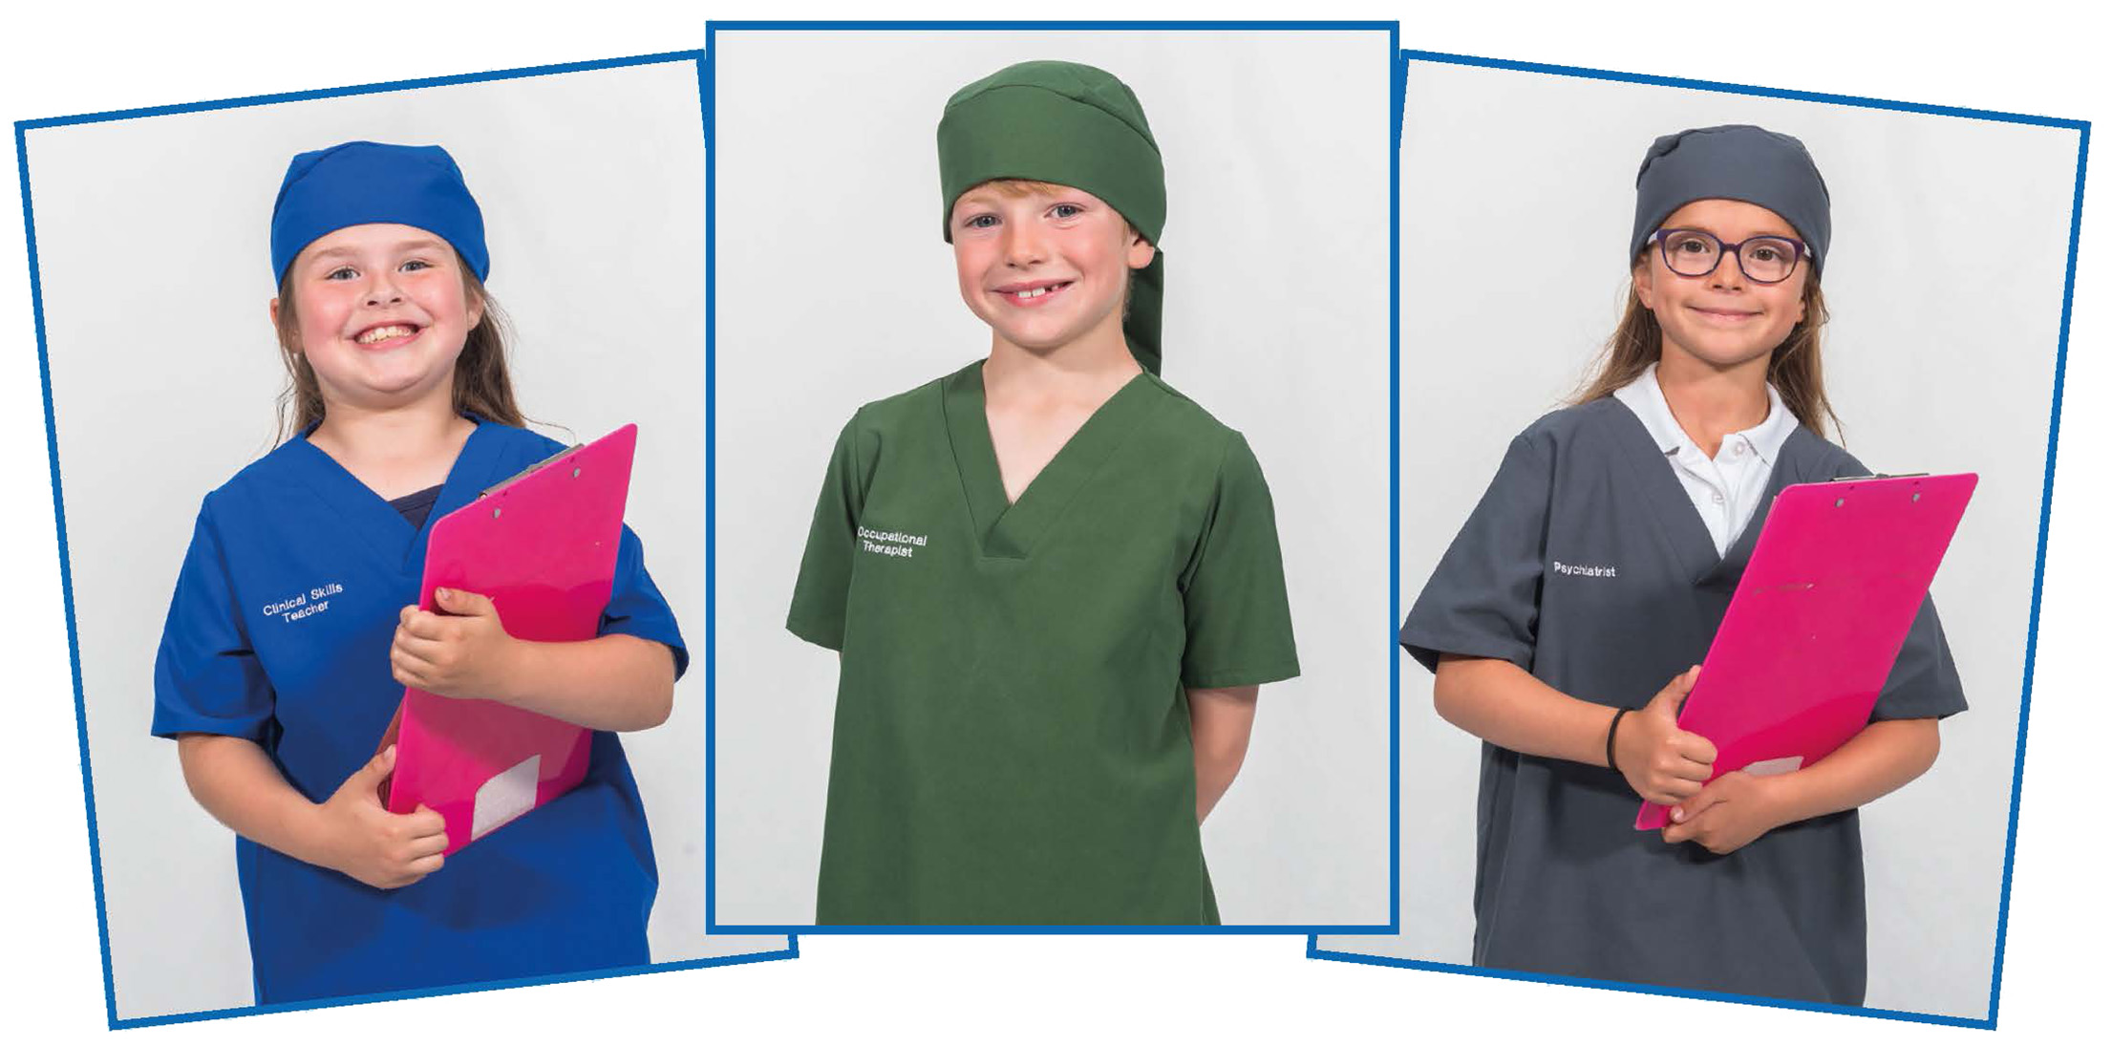
Mini Scrubs NHS – Lesson 6
Assessment – let’s look back at what we’ve learned about NHS jobs!

Slide 2
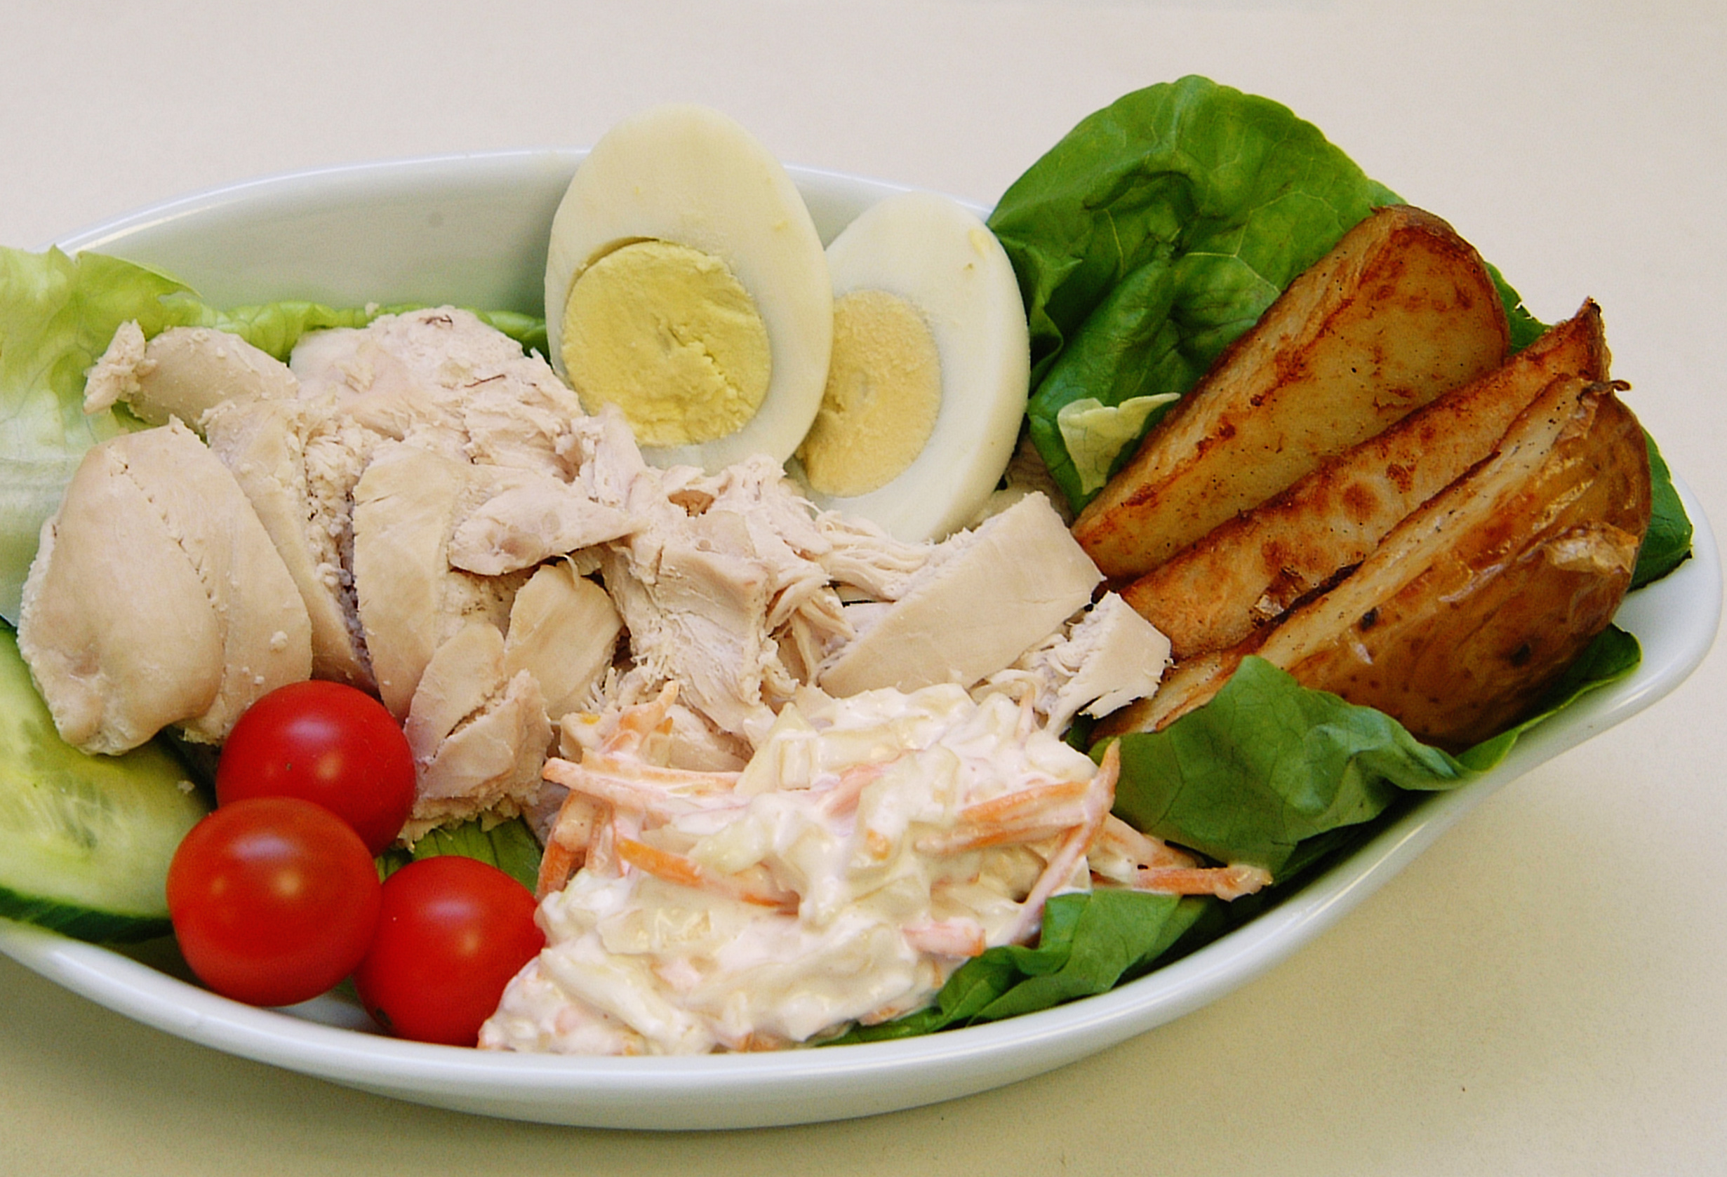
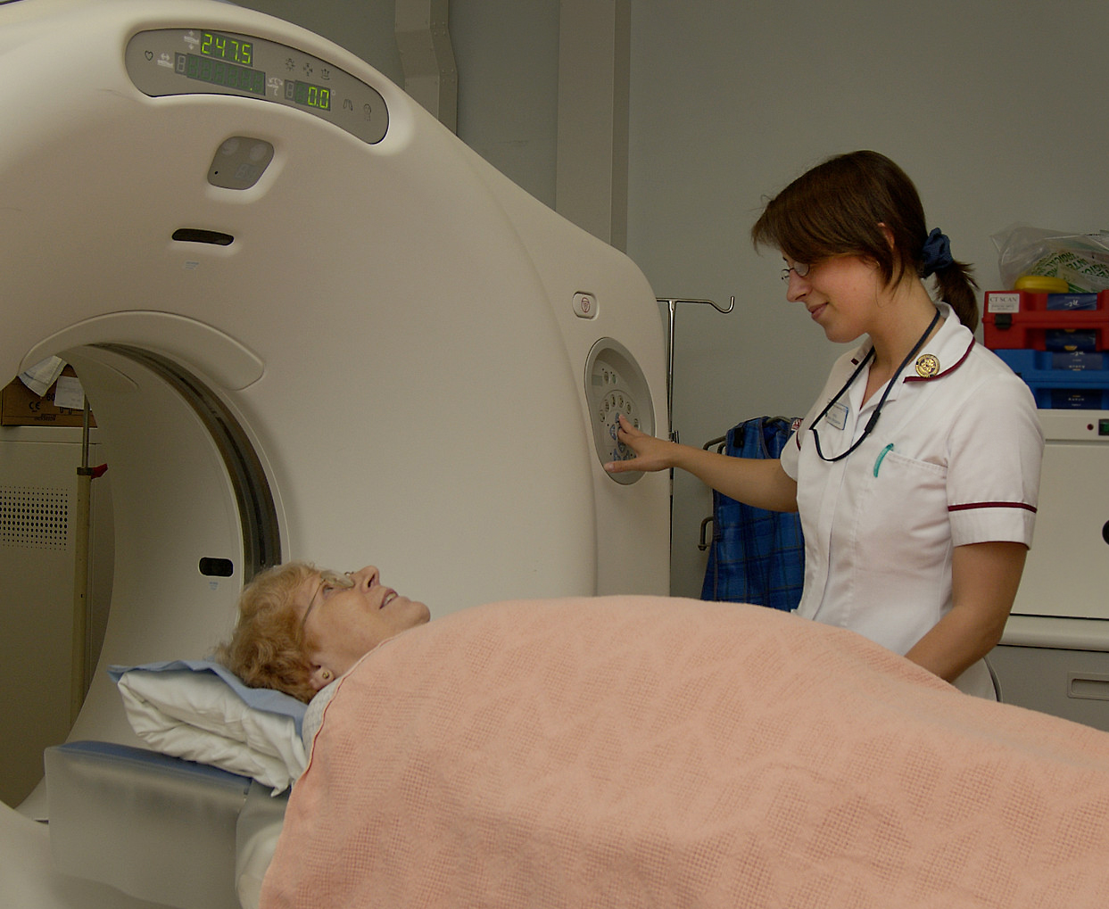
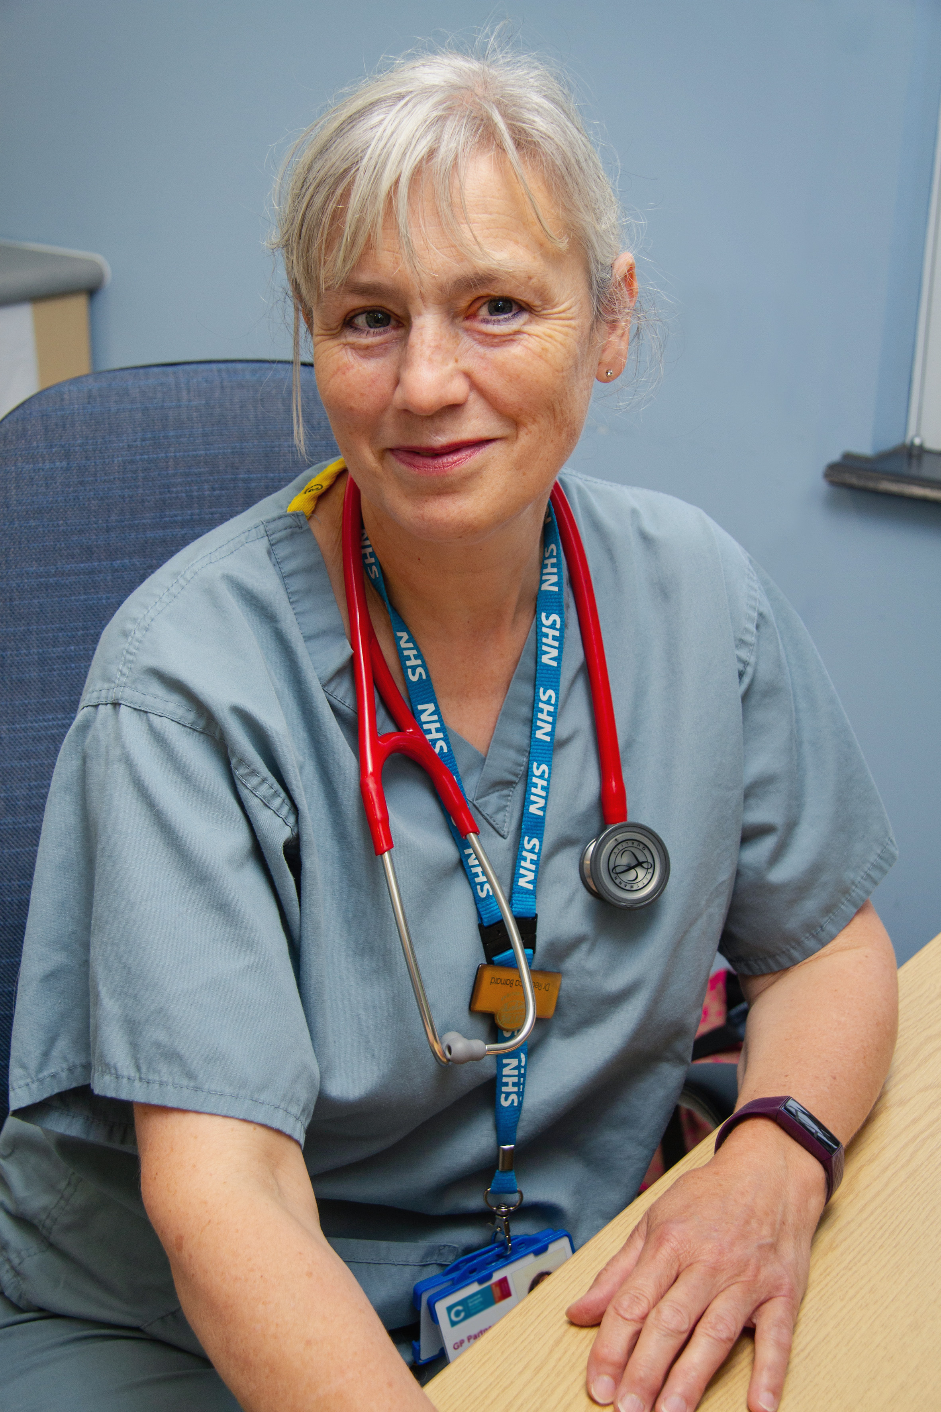
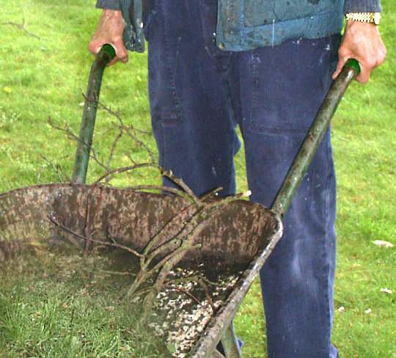
Learning objective
I can describe different job roles within the NHS.

Slide 3
Success criteria
• Name at least three NHS job roles we've learned
• Describe how NHS workers care for patients together
• Draw or write about a job you’d like to do
• Understand why teamwork matters in the NHS

Slide 4
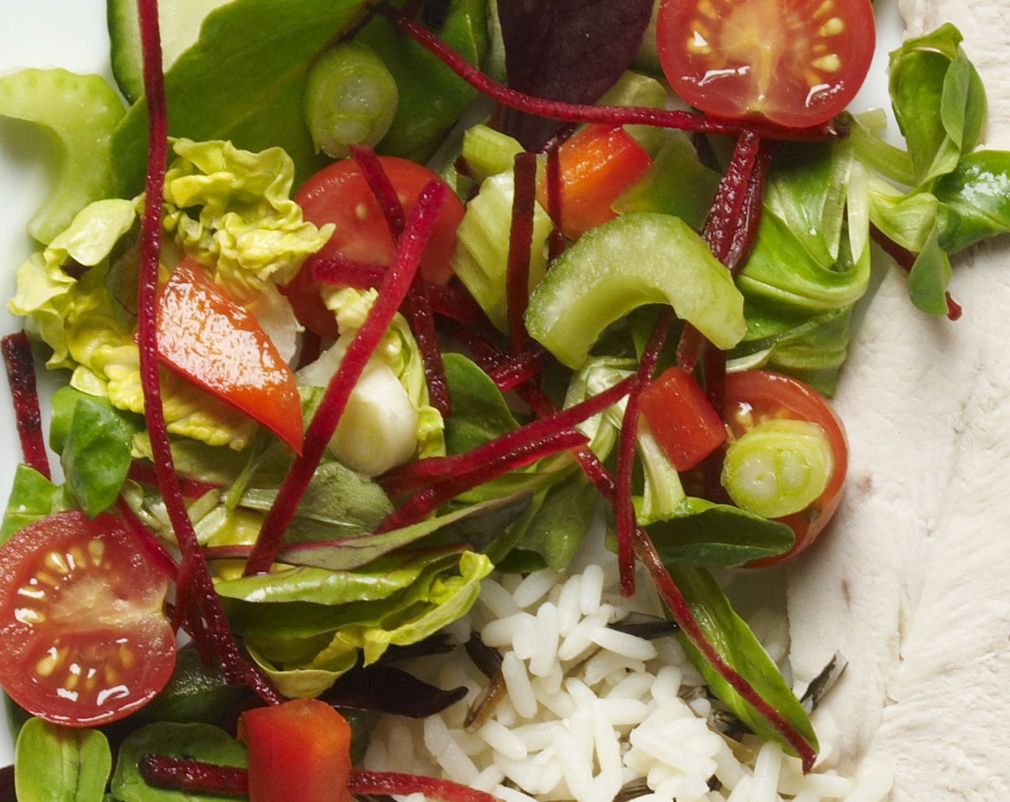

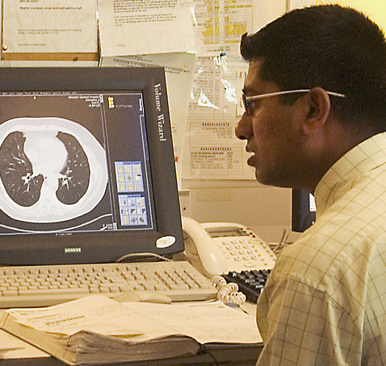
Let’s review!
What does a hospital chef do?
How does a gardener help patients?
What does a radiologist use to help doctors?
How does a doctor care for patients?

Slide 5
Mini Scrubs quiz time!
Let’s play a quick quiz!
Use flashcards or pictures to match jobs and tasks!
?
0

Slide 6
Choose your NHS job!
Draw yourself doing one NHS job you liked most
Or write a few sentences explaining why you chose it
Think: What did you enjoy about that role?

Slide 7

Label or explain
Add labels to your drawing Or…
Write a short sentence about what you’d do in that job

Slide 8
Let’s reflect together
Why is teamwork important in the NHS?
What happens if a job is missing?
How do these roles all work together to help us feel better?

Slide 9



Congratulations, Mini Scrubs!
You've completed your NHS learning journey!
Receive your 'My NHS Mini Scrubs Certificate'!
Optional: Let’s take a photo with our certificates!

