Slide 1
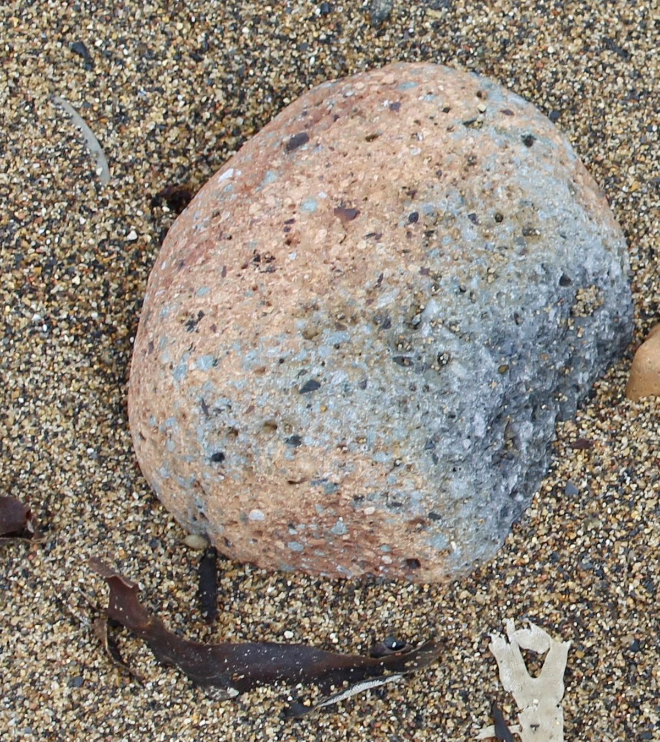
In Love & Anger: Evaluation of Tina’s Haven pilot project with twenty-one women/birthmothers in East Durham
Dr Sue Robson, Founder & Evaluator and Sheelagh Fraser, Volunteer Co-ordinator

Slide 2
About Tina’s Haven pilot project 2022/2023
Developing a replicable model of holistic and integrated practice for birthmothers severed from their children by trauma-based addiction.
Authentic - born out of lived experience.

Slide 3
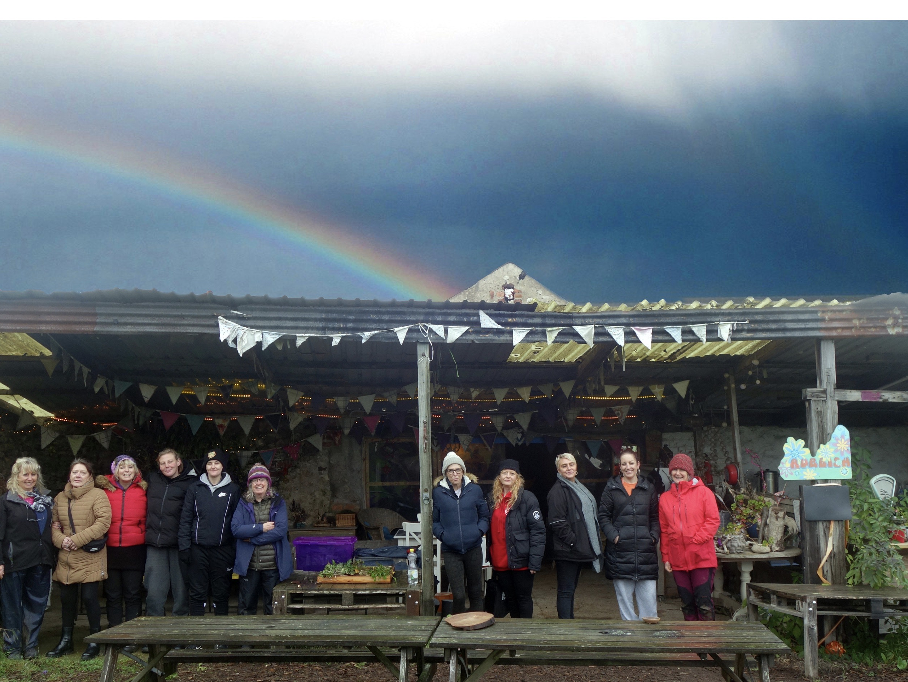
Partners in the pilot project
Addictions North-East - ‘The 12-Steps’ to addiction recovery.
The Barn at Easington – ‘Immersive nature experiences.’
The Women's Liberation Collective, - ‘The Own My Life’ psycho-education programme.
A freelance trauma therapy practitioner and trainer with social work background.

Slide 4
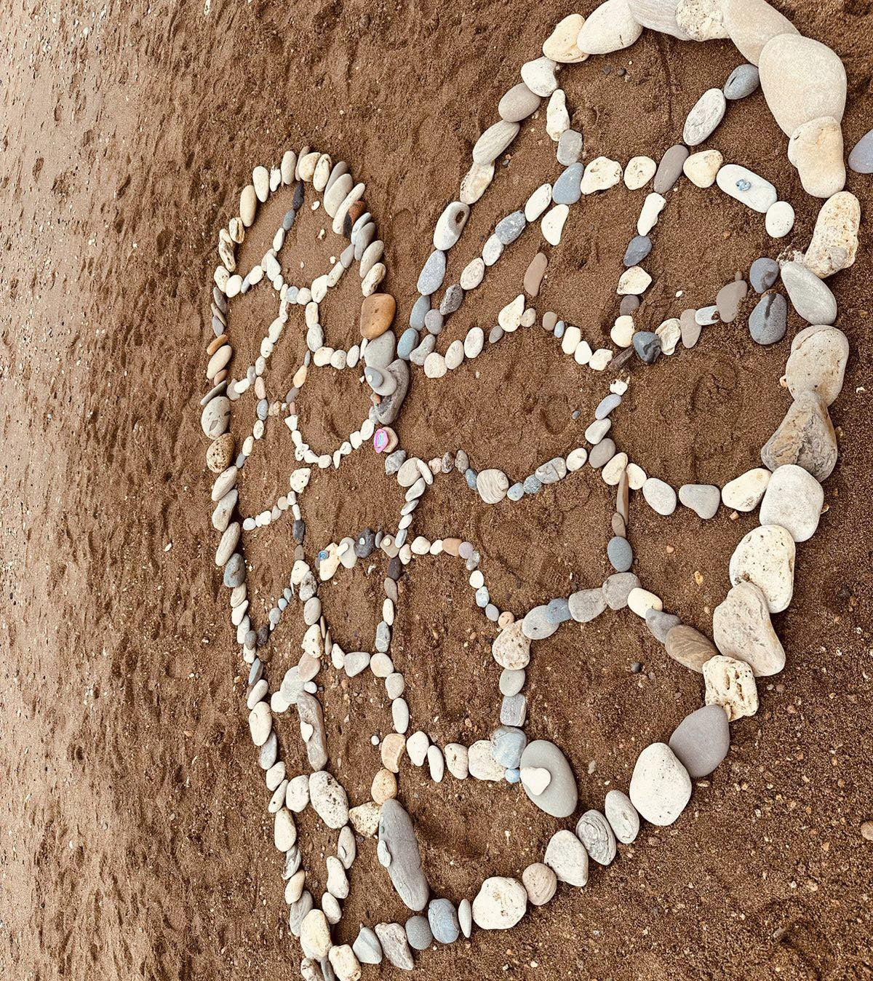
Women experience violence and abuse from those who are “supposed to love and care for them”
Childhood abuse-trauma.
Subjected to sexual abuse in teenage years.
Reliance on substances to self-soothe.
Subjected to domestic violence from male partners as adults.
State intervention– devoid of help & support for women.
Ultimate punishment of severance from children.
Notes:
The common trajectory of women, replicated in “Just a Mam” conducted by REFORM
Parallels Stephanie Covington (2012) – studies
Women’s trauma is DIFFERENT from men’s, more complex.

Slide 5
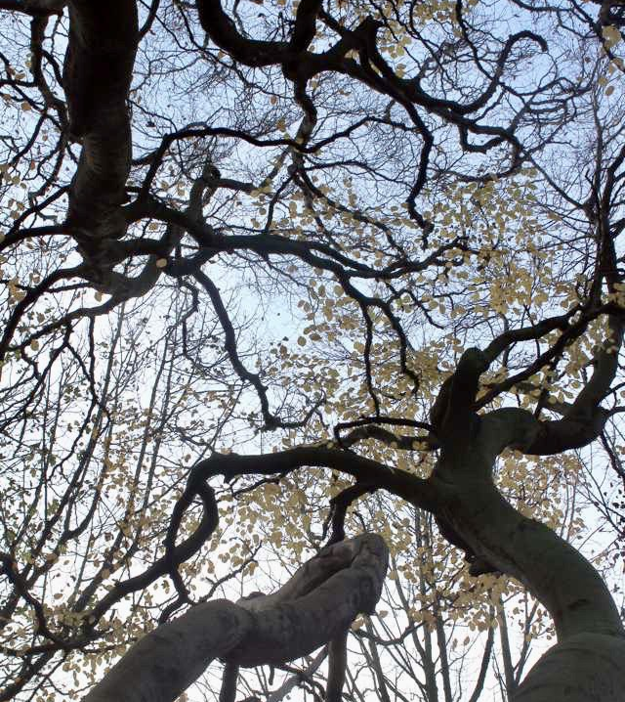
Evaluation findings: Matrix of domination & empowerment (Patricia Hill-Collins 2000)
Interpersonal level
Community level
Organisational level
Structural level
Notes:
Not just about women’s self-empowerment and development, about making changes at every level surrounding birthmothers experience

Slide 6
Outputs - two months after the end of the pilot project
ZERO women who completed the Own My Life course element of the pilot project relapsed (33%, n=7), all remain in recovery.
Notes:
Zero (0%) of women who completed the “Own my Life” course relapsed.

Slide 7
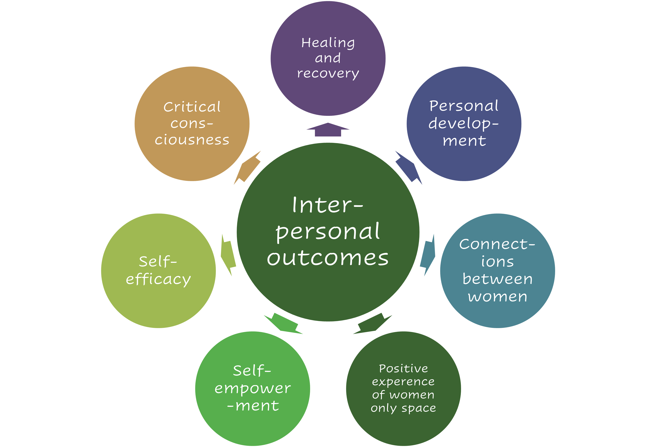
Interpersonal outcomes
Notes:
A whole spectrum of interpersonal outcomes emerging from women’s positive experiences of being in women only space

Slide 8
Notes:
Positive experiences of female only space wasn’t something that the women were used to – with other women in addictions, with female family members or with female practitioners

Slide 9
Community outcomes
Notes:
Centered upon solidarity building and mutual identifications between female participants and practitioners – through this started to gain different perspectives upon the abuse women are subjected to, and systems of opression

Slide 10
Notes:
“I was untrusting full stop due to the things I have been through with both women and men in services. I was rock-bottom. I was told that I would not be signposted into health services and recovery until I stopped drinking. I was kicked out of my doctors (GP), I felt abandoned.”
3 minutes
Background/ past, untrusting
How trust was built, going to The Barn, getting to know the women, hearing other stories, realising “it’s not just me” and letting go of guilt and shame (safe and forgiving spaces)
Now volunteer co-ordinator – supporting next phase of Tina’s Haven project

Slide 11
Women’s self-empowerment journeys
Sharing experiences in a forgiving safe space
Situating experiences in wider societal framework
Making sense of experiences, letting go of guilt and shame
Applying boundaries, taking control of lives
Speaking out about experiences, collectively

Slide 12
Organisational outcomes
Notes:
Blending of different practice models – overarching learning was an alternative feminist model of professional practice based upon mutual identification and solidarity building with women

Slide 13
Towards a replicable model
Notes:
This is the Tina’s Haven model that we will be applying to the second pilot project – hopefully in Newcastle
Ongoing work in East Durham – volunteering and an arts-based storytelling project at The Barn and embedding the OML programme at A-NE
‘There was this one sentence of Freire’s that became a revolutionary mantra for me: “We cannot enter the struggle as objects in order to later become subjects”.’ (hooks 1994, pp-46)

Slide 14
Incremental Structural Changes
Notes:
Upskilling Social Workers and Early Help workers through Own My Life training.
Improving how they and their organisation respond to women who have been subjected to abuse.
Embedding OML methodology and theory of change.

Slide 15
Challenges
Women in early recovery need a sensitive approach.
Reconciling pathological approaches to trauma with feminist consciousness raising and solidarity building.
Resistance to overcoming dominant conceptions of objective/ detached professionalism.
Local and national resistance to applying the Single Sex Equality Duty.
Lack of state support when birthmothers and children are reunited.
Notes:
Lack of state support, in parallel with adopters and special guardians, when birthmothers and children are reunited.

Slide 16
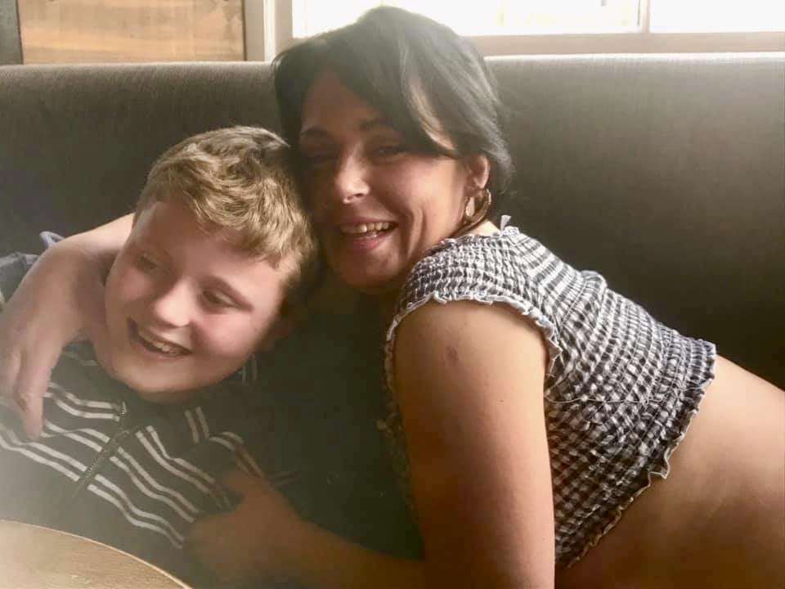
“Love is an act of will, both an intention and an action.” (bell hooks 2000)
Tina’s Haven is in memory of my beloved daughter Tina Robson, who died age 35 in temporary homeless accommodation having suffered trauma and addiction for most of her life.
Tina left behind her adored son Vinnie for whom this project exists.

Slide 17
Thank you for listening. Any questions?

Slide 18
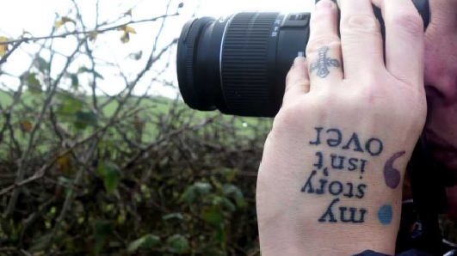
Contacts for #TinasHaven
Dr Sue Robson Founder:
Email - sue@suerobson.co.uk
Facebook - Truth and Justice for Tina
Twitter - @TruthJustice4T1
Sheelagh Fraser:
Email sheelagh.bright@gmail.com

