Slide 1

Mini Scrubs NHS – Lesson 5
Meet the doctor!
Let’s explore how doctors help us feel better…

Slide 2
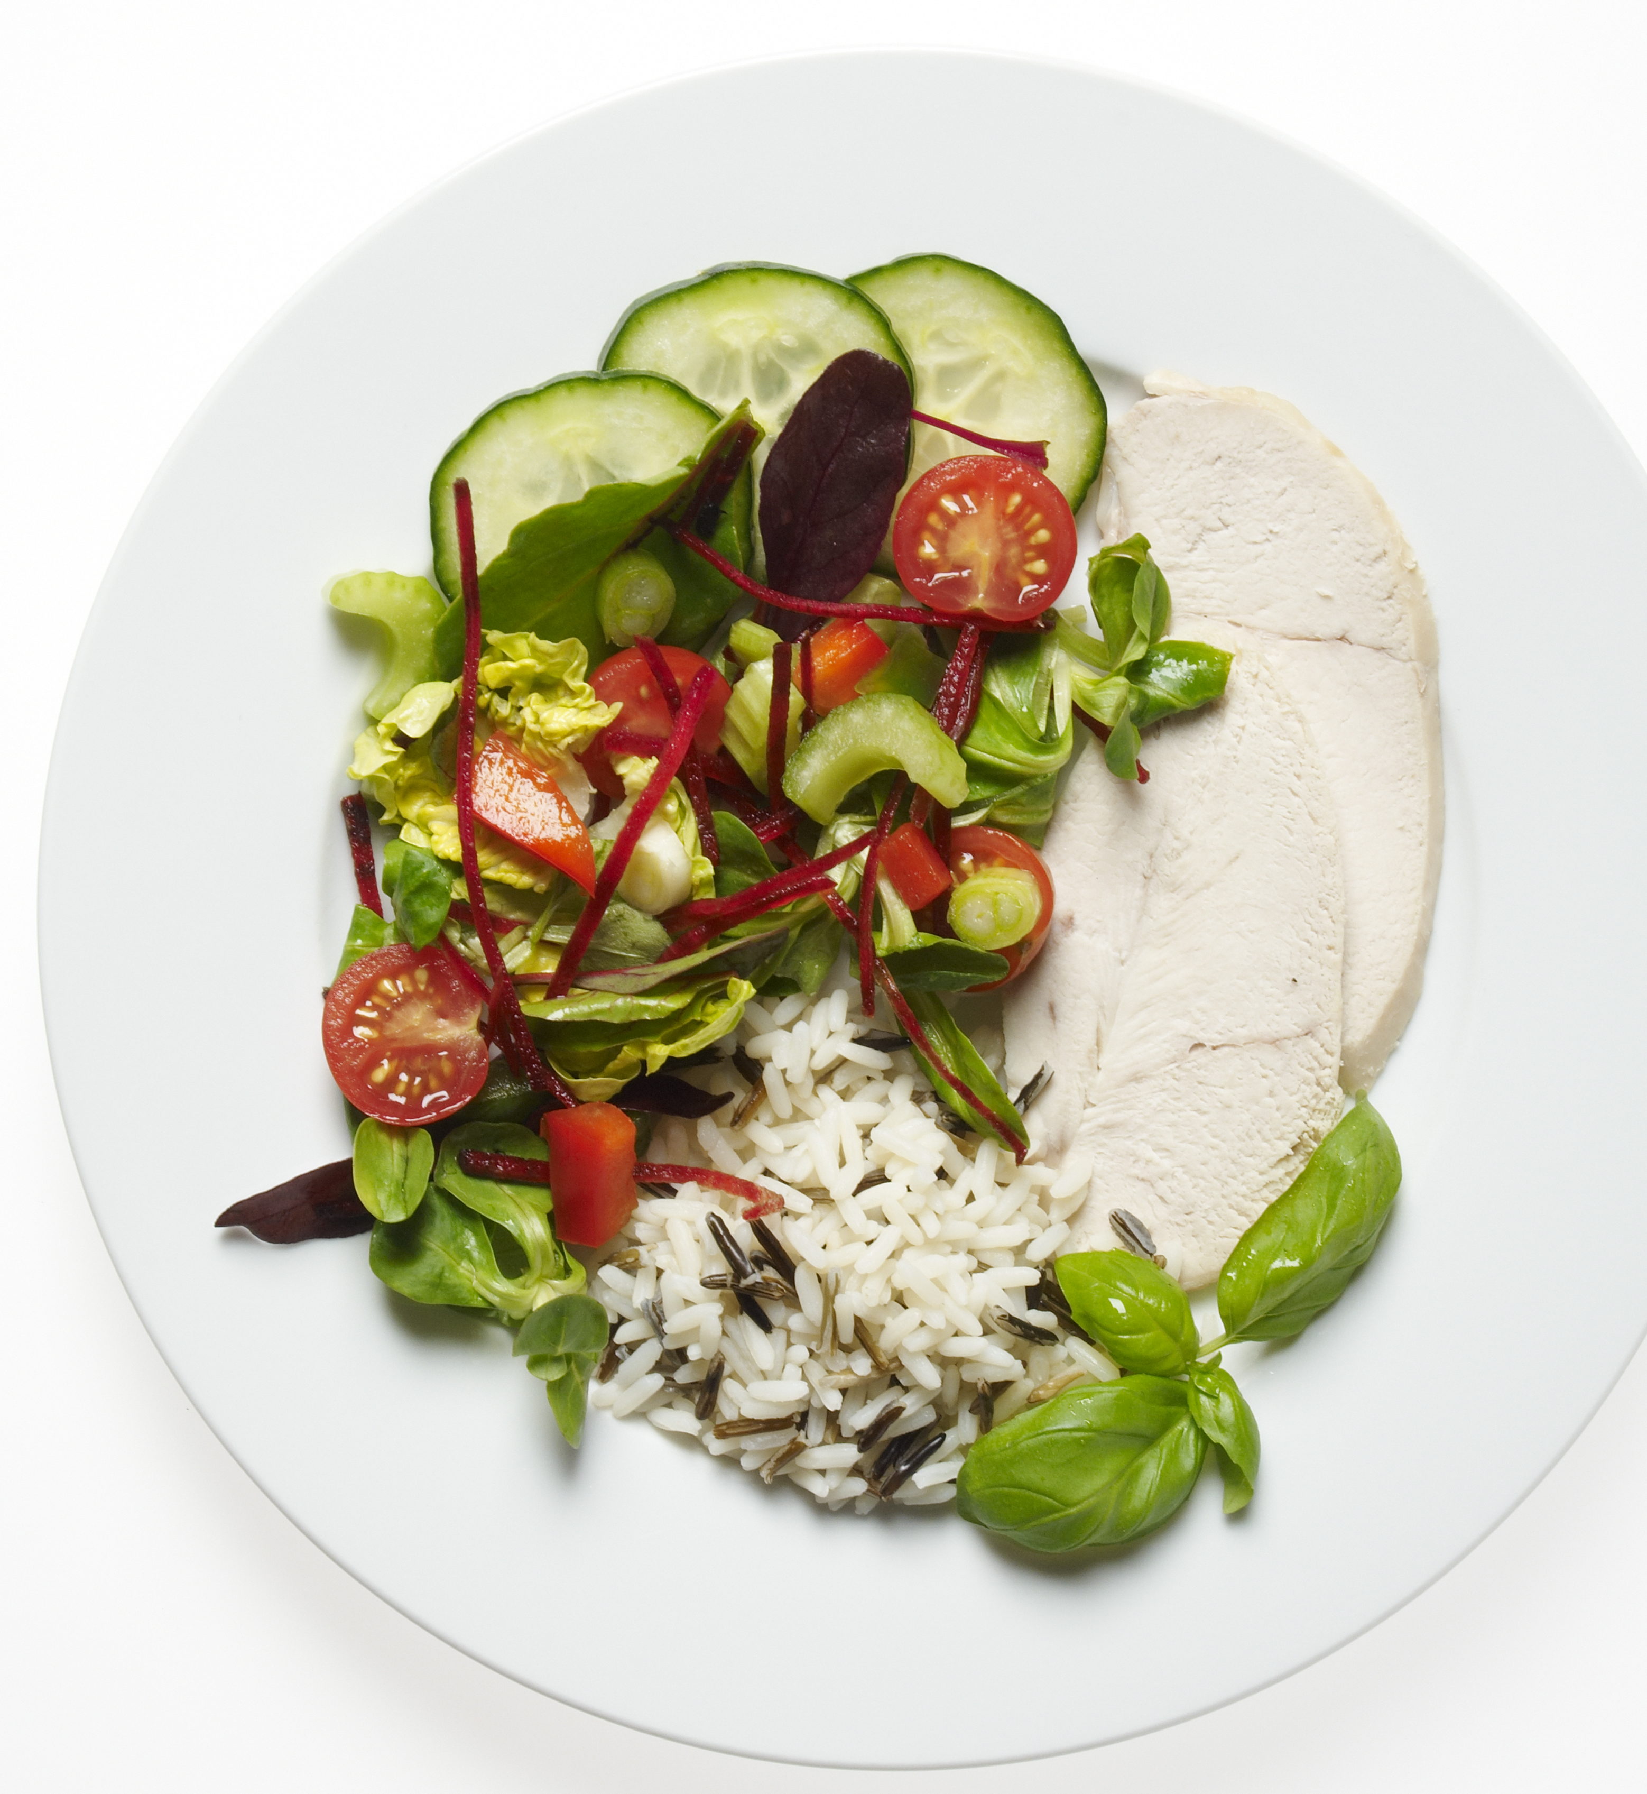
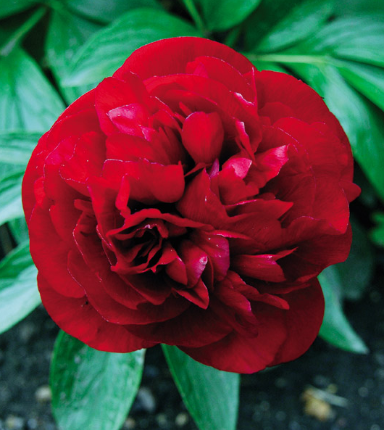
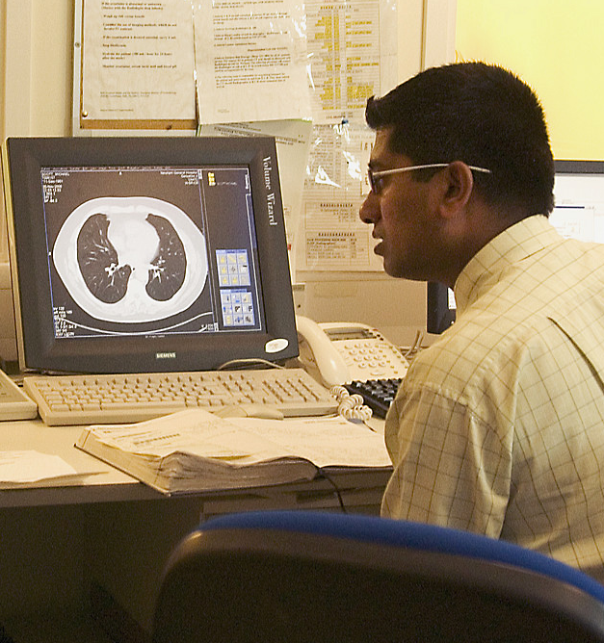
Quick recap
How does a chef help patients in hospital?
Why is a hospital garden important?
How does a radiologist help a doctor?

Slide 3
Learning objective
I can describe the role of a doctor working in the NHS.

Slide 4
Success criteria
By the end of this lesson, I will be able to:
Describe at least two key tasks a doctor performs
Role-play a check-up, showing an understanding of how doctors care for patients
Identify how doctors work with other NHS roles to care for patients
Share one way they could help someone feel better if they were a doctor

Slide 5
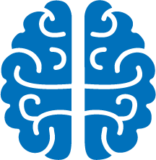
Mind map time
Let’s link NHS roles to how they care for patients!
Notes:
• What do we already know about healthcare workers?
• Create a class mind map.
• Highlight key roles: Doctor, Nurse, Paramedic.

Slide 6
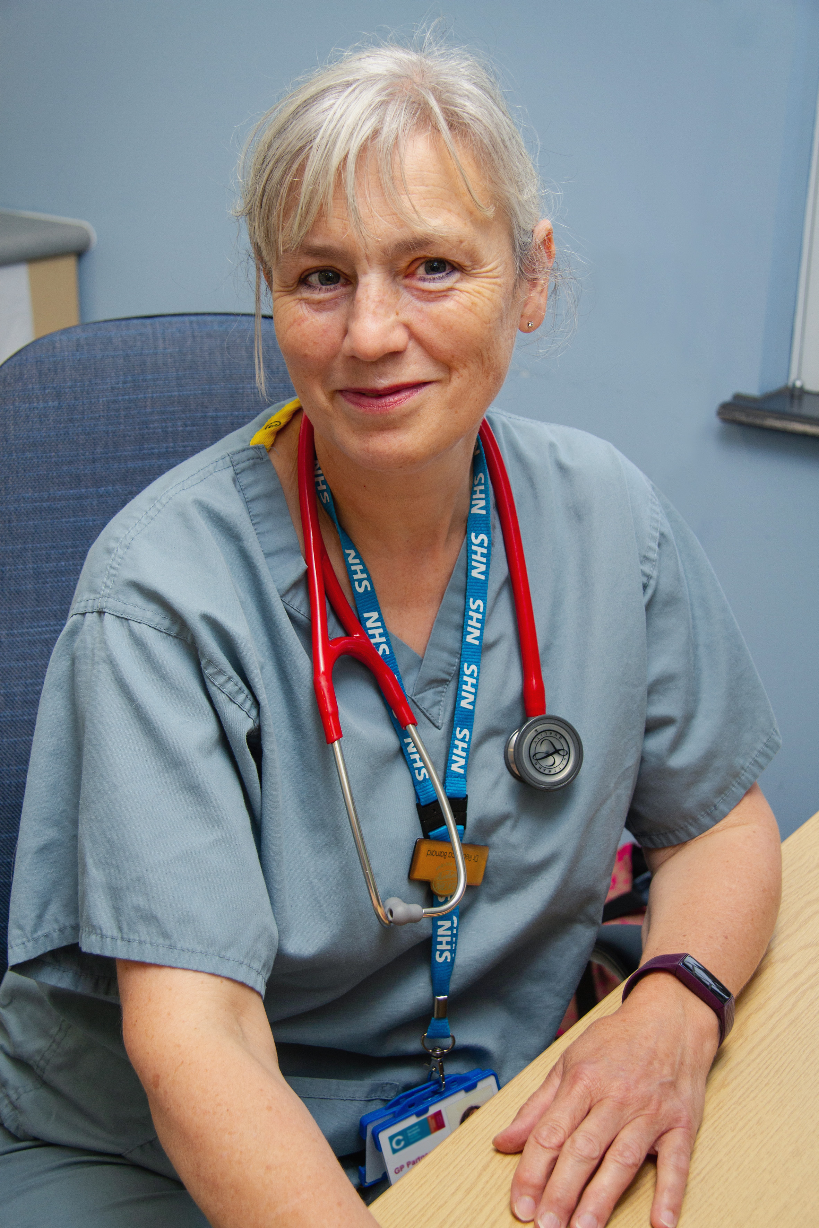
What do doctors do??
Check patients’ health
Diagnose illnesses
Prescribe medicine
Work with other NHS staff

Slide 7
Real doctors at work
Let’s watch Dr Caesar talk about his job
We will hear how an interest in the human body and people led him to choose medicine as a career
https://www.bbc.co.uk/teach/class-clips-video/articles/z7kfbdm

Slide 8
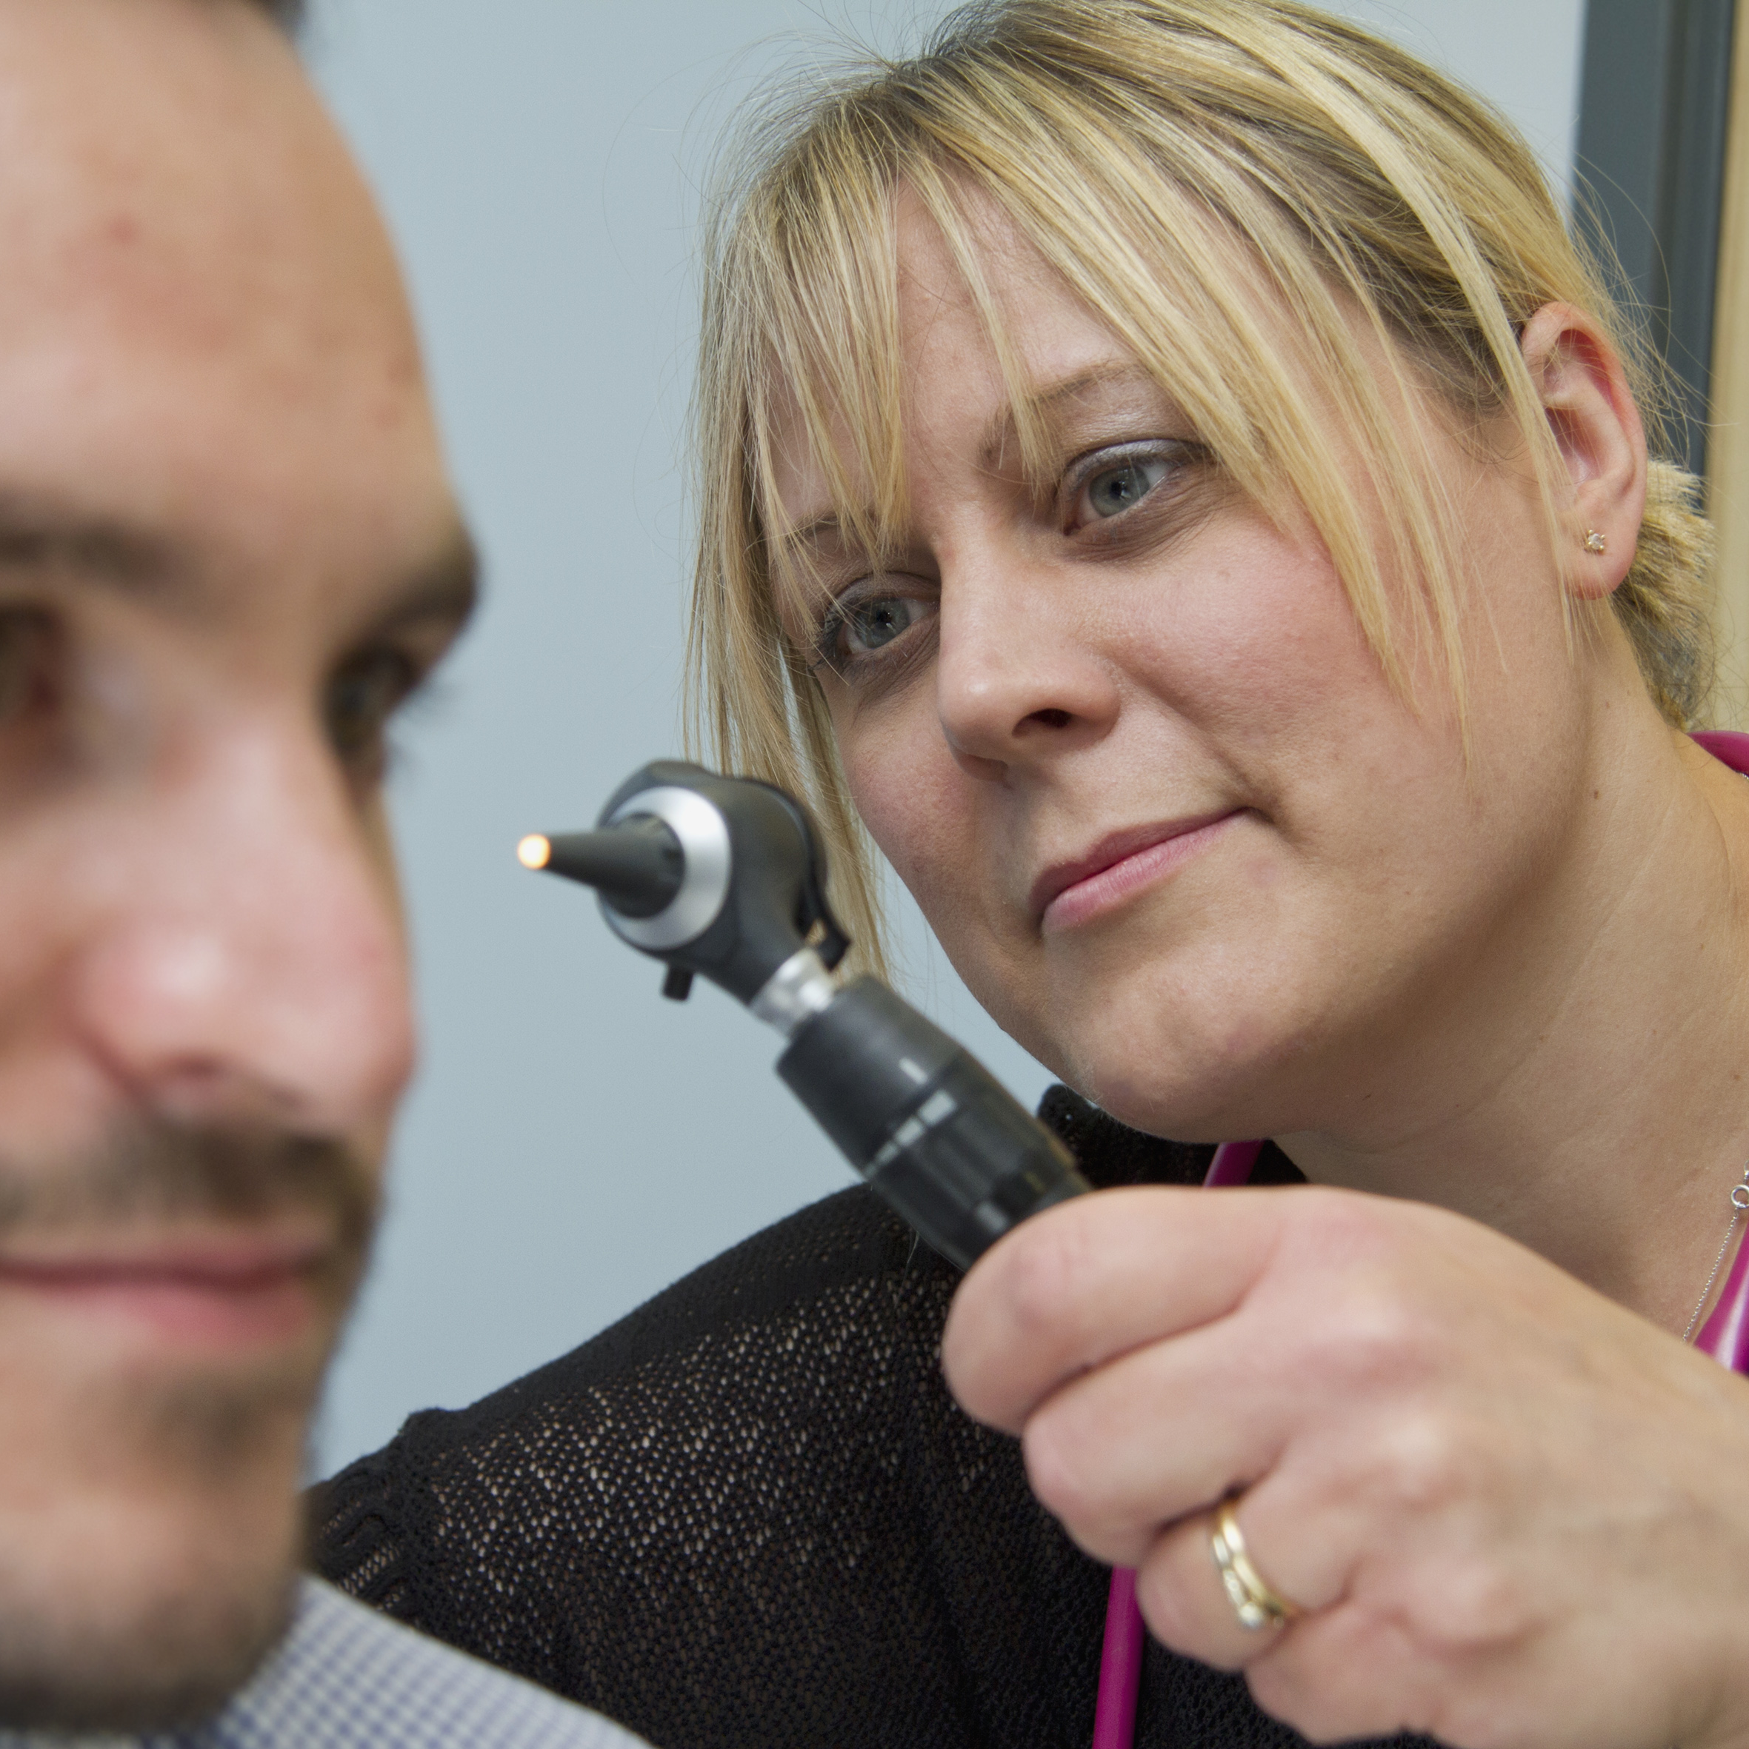
Let’s role-play!
Be a doctor using toy kits!
Check heartbeat, look in ears, take temperature
Ask: "How are you feeling today?"
Take turns as doctor and patient

Slide 9
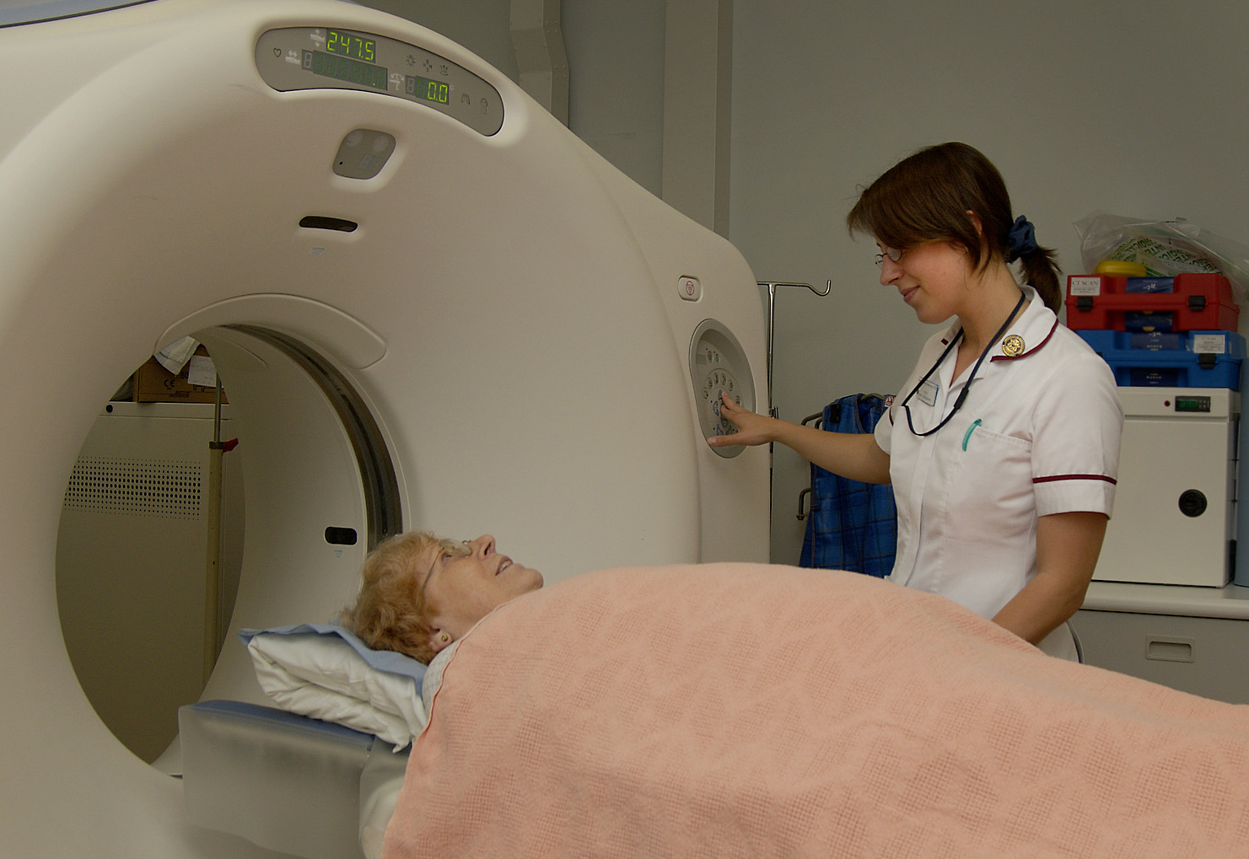
Doctors work as a team!
Doctors work with chefs, gardeners, and radiologists
They make sure patients get meals, calm spaces and helpful scans

Slide 10
What would YOU do?
If you were a doctor...
What would you do to help someone feel better?
Share or draw your idea

Slide 11
What did you learn today?
What does a doctor do?
How do they work with others in the NHS?
How can YOU help someone feel better?

