Slide 1
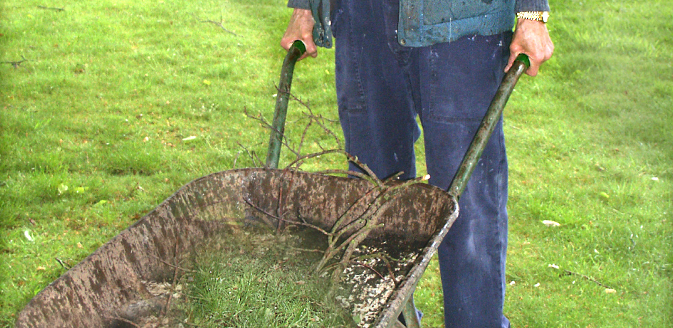
Mini Scrubs NHS – Lesson 3
The role of an NHS Gardener (KS1)

Slide 2
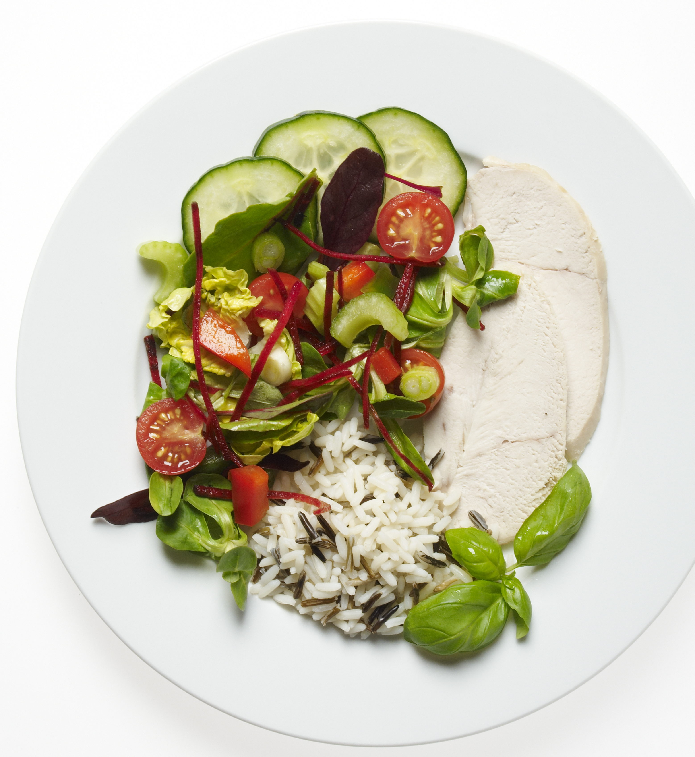
Can you remember?
Last lesson we talked about the role of an NHS Chef
What does the NHS chef do?
What foods did we discuss?

Slide 3
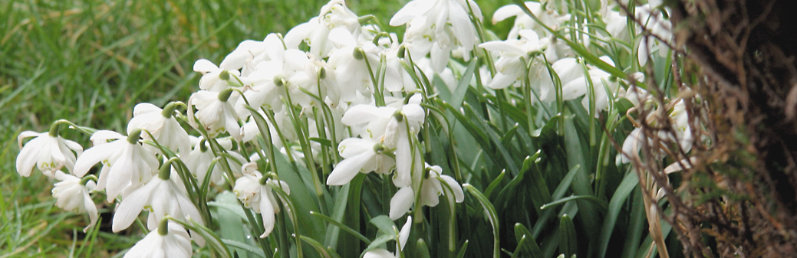
Learning objective
I can describe the role of a gardener working in the NHS.

Slide 4
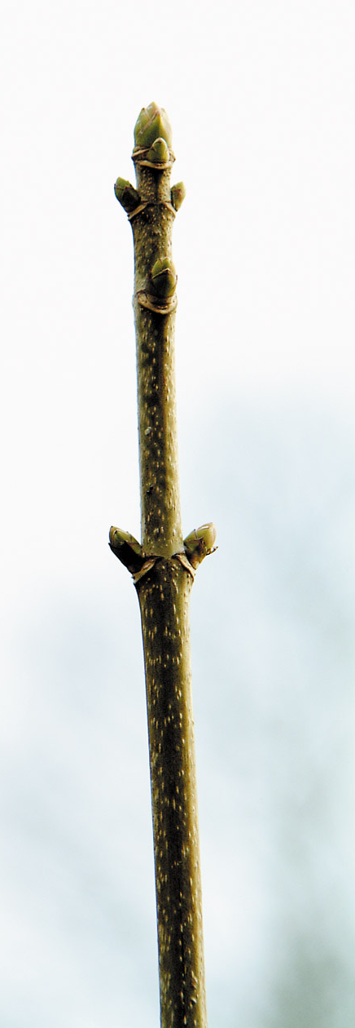
Success Criteria
By the end of this lesson, I will be able to:
Describe the role of an NHS gardener
Explain how gardens and plants can help people feel better
Participate in planting seeds and understand basic plant care

Slide 5
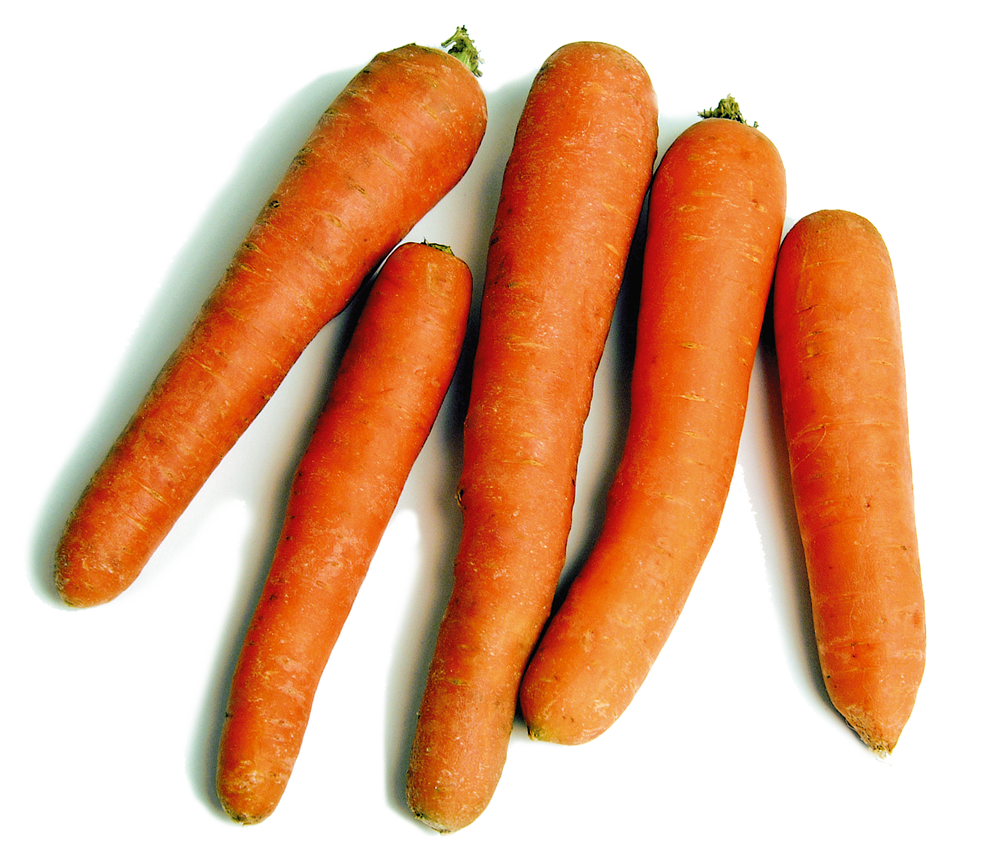
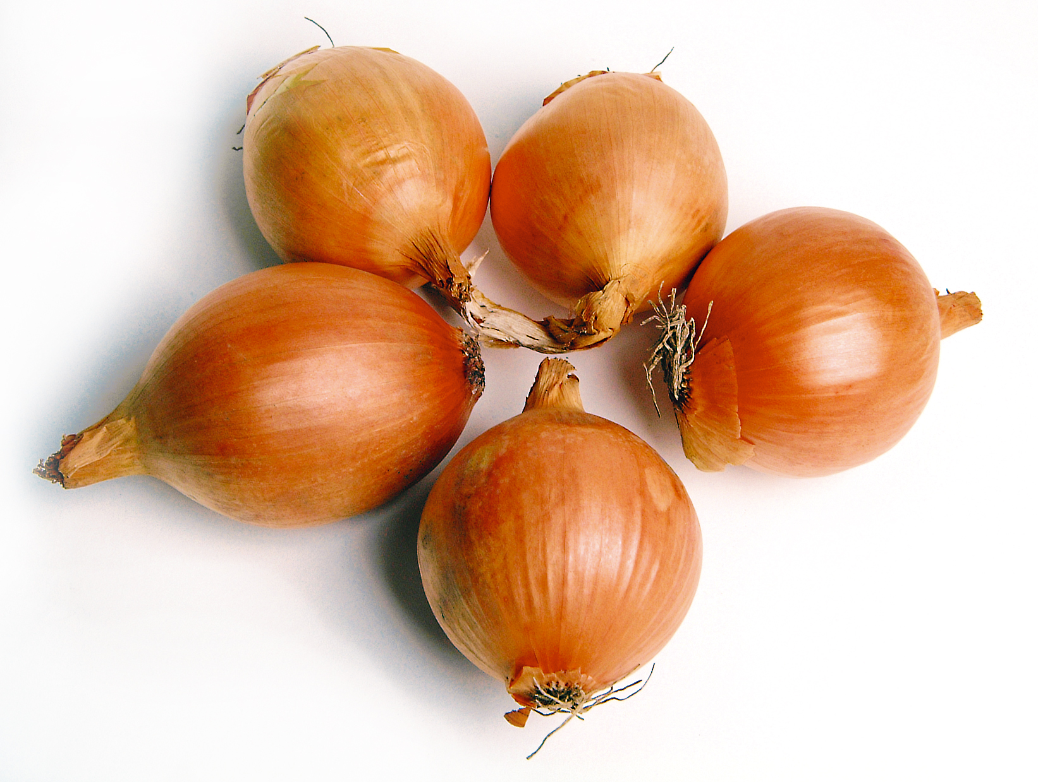
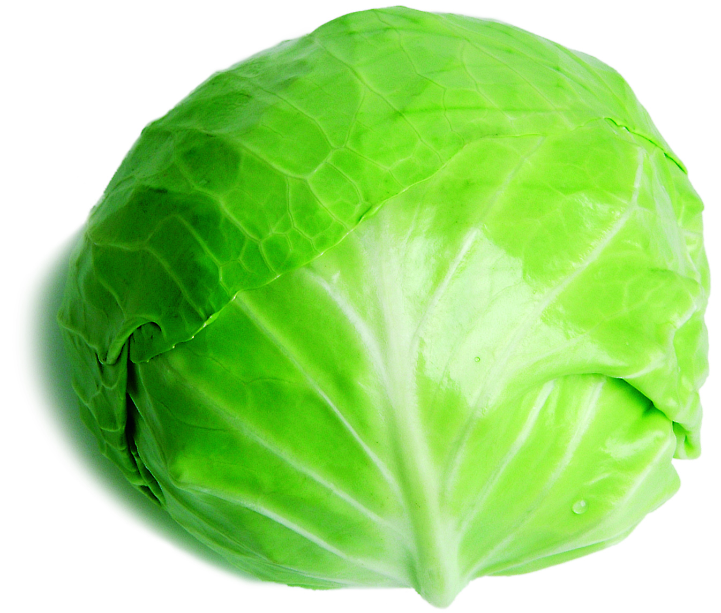
Why are hospital gardens important?
Provide fresh produce for meals
Help people feel calm and relaxed
Support mental and physical health
Have you ever visited or grown something in a garden?

Slide 6
We must remain safe by…
Washing our hands after touching the soil
Check for any allergies related to soil, plants, or seeds
Wear protective clothing to prevent mess
Make sure my teacher is supervising my use of any gardening tools

Slide 7
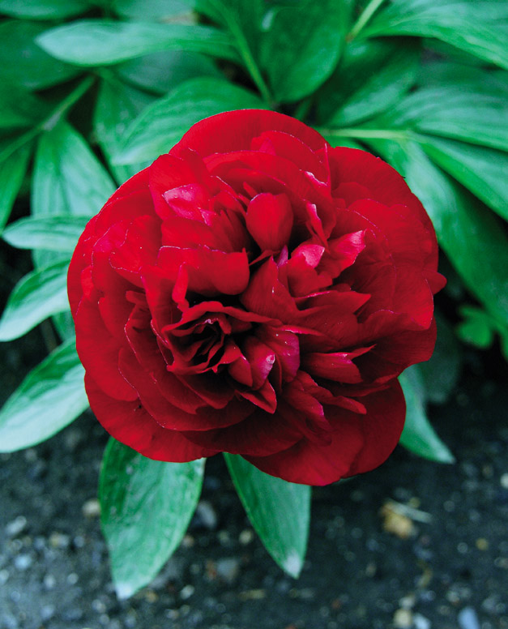
Planting seeds
Steps:
Fill pot with soil
Make hole with finger or spoon
Place seed, cover with soil
Lightly water
What do plants need to grow?

Slide 8
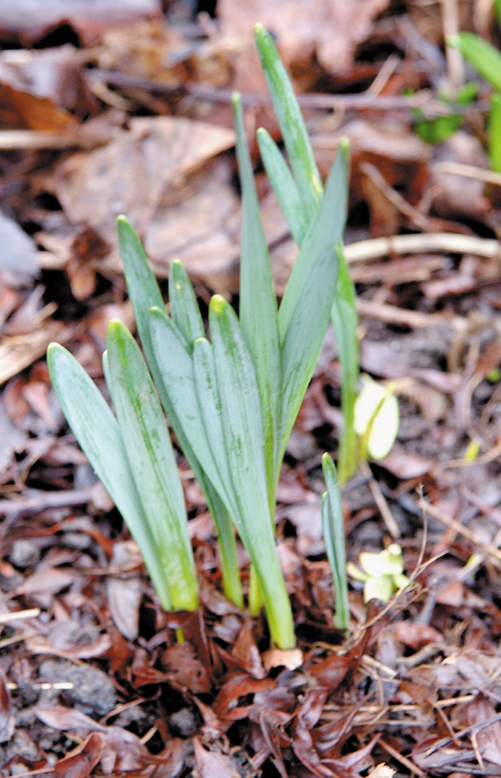
Check my understanding
How did planting feel?
Why are gardens calming?
What does your plant need to grow?
Challenge: Observe and care for your plant at home or in the classroom

Slide 9
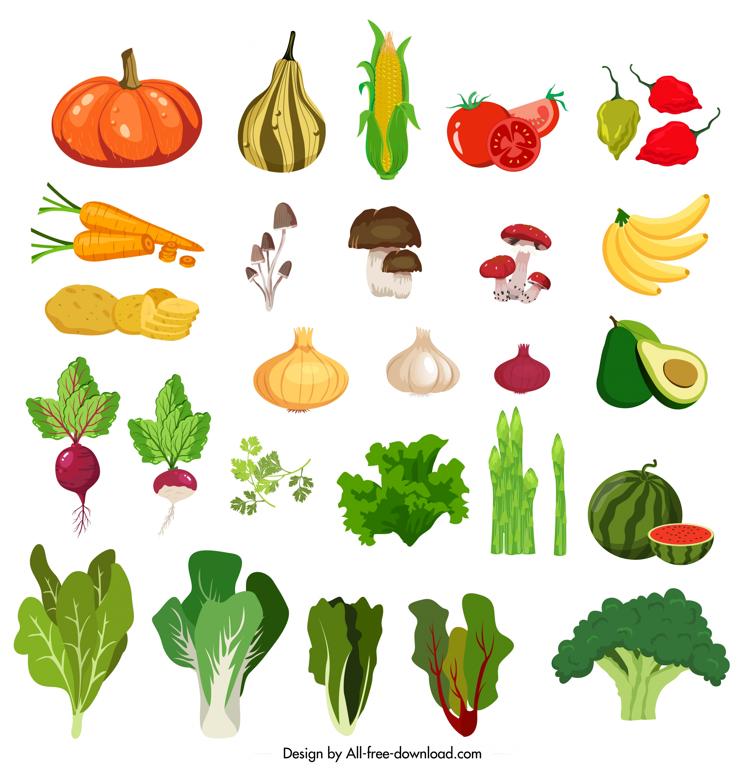

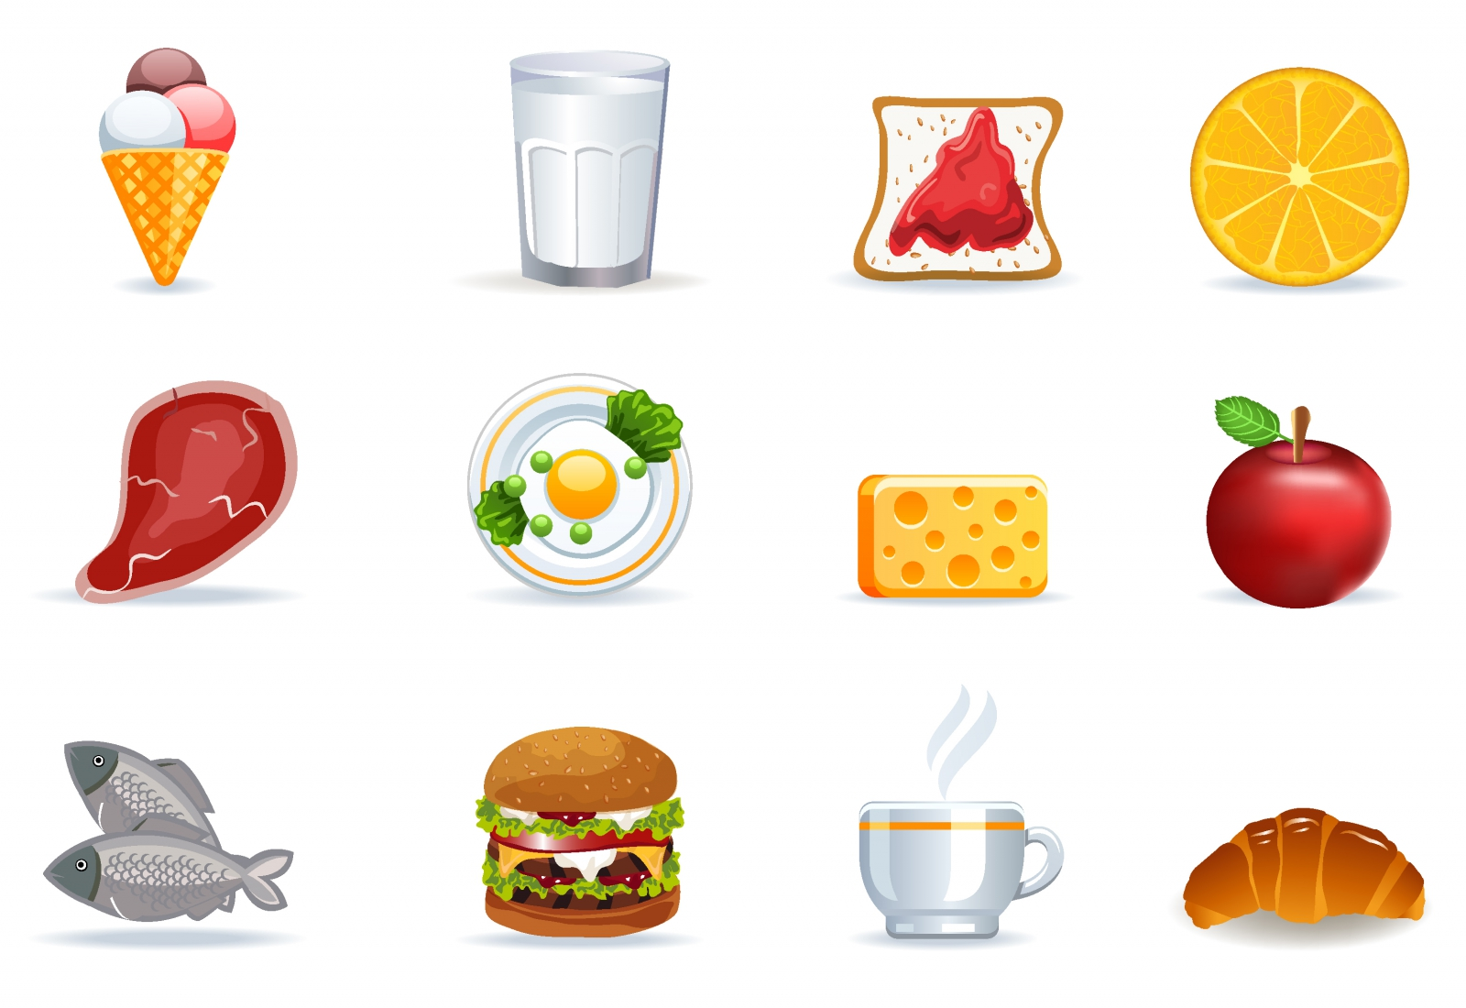
Optional activity: Sorting food that can be grown, from food that is not grown
Food icons by All-free-download.com under Creative Commons attribution license

