Slide 1
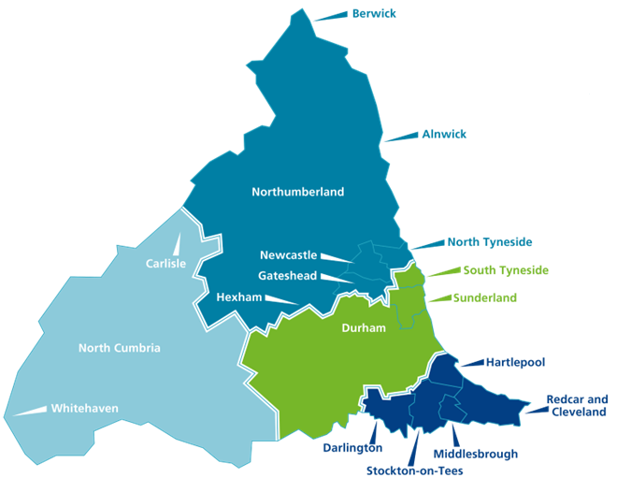

















Slide 2
Alice House www.alicehousehospice.co.uk/
Butterwick www.butterwick.org.uk/
Eden Valley Hospice and Jigsaw (x2) www.edenvalleyhospice.org/ https://www.jigsawhospice.org/
Hospice at Home Carlisle and North Lakeland www.hospiceathome.co.uk/
Hospice at Home West Cumbria www.hospiceathomewestcumbria.org.uk/
HospiceCare North Northumberland www.hospicecare-nn.org.uk/
Teesside Hospice www.teessidehospice.org/
Tynedale Hospice at Home www.tynedalehospice.com/
St Cuthbert’s www.stcuthbertshospice.com/
St Oswald’s www.stoswaldsuk.org
St Teresa’s www.darlingtonhospice.org.uk/
Willow Burn www.willow-burn.co.uk/
Zoe’s Place https://www.zoes-place.org.uk/
St Benedicts https://www.stbenedicts.co.uk/
Marie Curie Newcastle Hospice https://www.mariecurie.org.uk/services/hospices/newcastle

