Slide 1
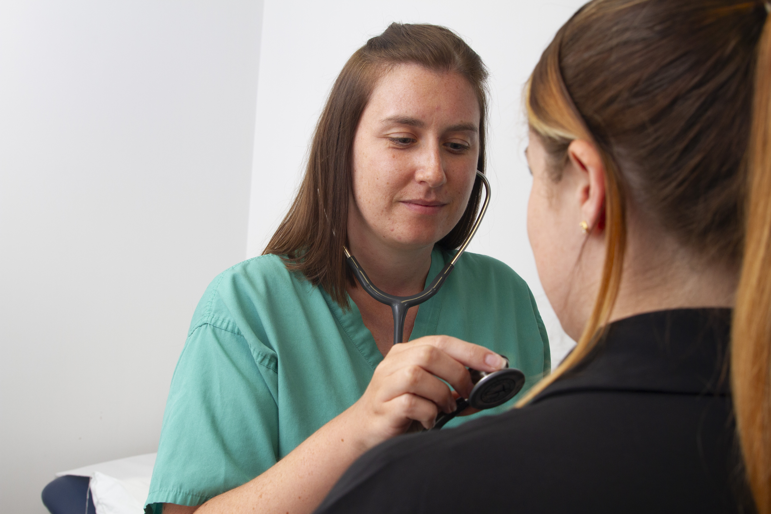
Mini Scrubs NHS – what is the NHS?
Let’s explore the team that helps keep us healthy!

Slide 2
Learning objective
I can describe the NHS and identify some key job roles.

Slide 3

Do you know this logo?
Notes:
• Have you seen this before?
• Where have you seen it?
• What do you think it means?
• Create a mind map of guesses for what NHS might stand for.

Slide 4
What is the NHS?
NHS = National Health Service

Slide 5
The NHS is a team of people who help us stay healthy
They include:
Doctors
Nurses
Chefs
IT workers
Scientists
Paramedics
Cleaners
Maintenance staff

Slide 6
Let’s learn more!
Watch: BBC Bitesize – What is the NHS?
http://www.bbc.co.uk/teach/class-clips-video/articles/zwhf3j6

Slide 7
Danny’s story
https://www.youtube.com/watch?v=OKsJQ93dxCw
Notes:
Discuss: Who helped Danny?
• What different jobs did you spot?
• Create a class job list from the video.

Slide 8
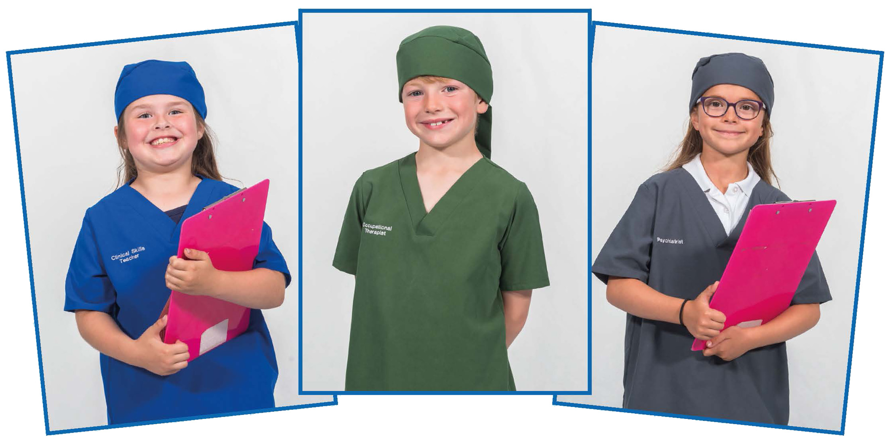
Let’s dress up!
Meet the NHS team!
Notes:
Use scrubs and props.
Children dress up and act out different NHS roles.

Slide 9

Mind Map Time
Notes:
• What do we already know about healthcare workers?
• Create a class mind map.
• Highlight key roles: Doctor, Nurse, Paramedic.

Slide 10
What did you learn today?
• Share one thing you learned today
• What do you want to learn next time?

Slide 11

Thank you, NHS!
Thank you
Let’s give a big THANK YOU to our NHS heroes!
Use rainbow colours or clapping imagery

