Slide 1



Slide 2
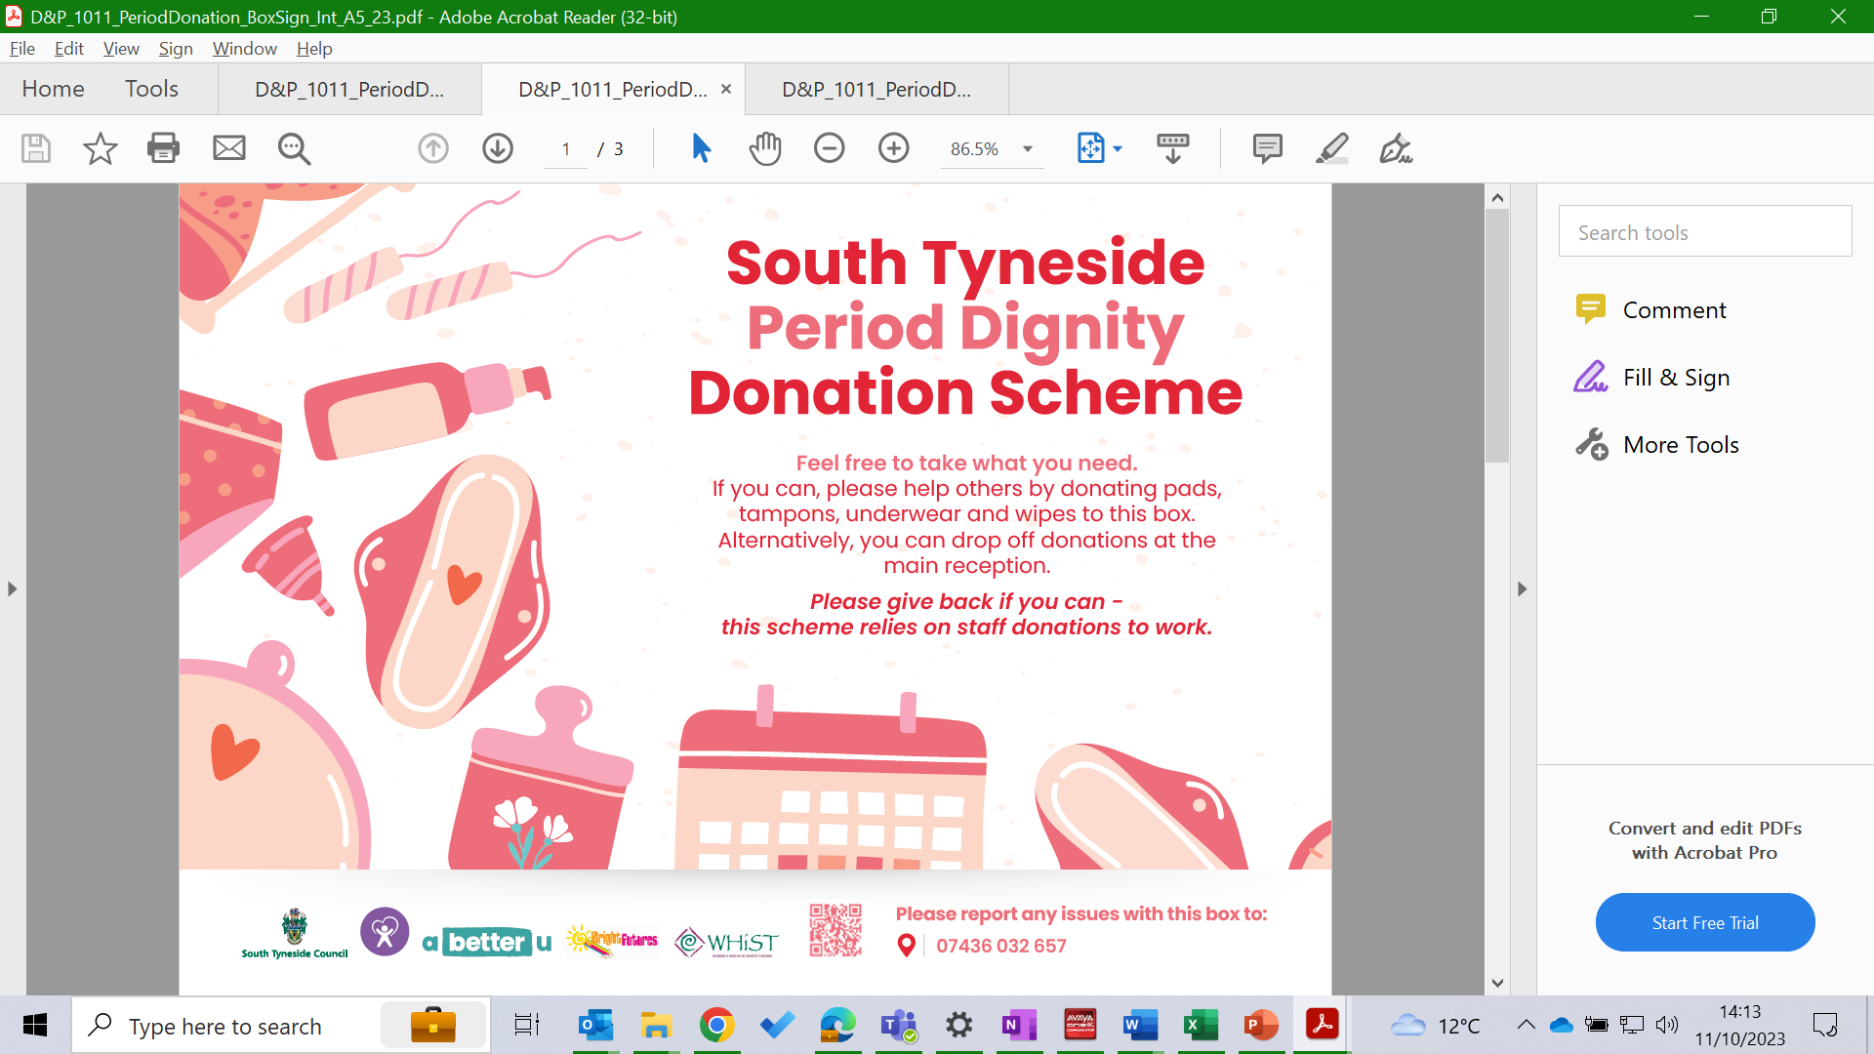


South Tyneside
Period Dignity
Donation Scheme

Slide 3
A self-sustaining, community model of support for people that menstruate
in South Tyneside
via a ‘take what you need’, ‘give what you can’ box of period products

Slide 4
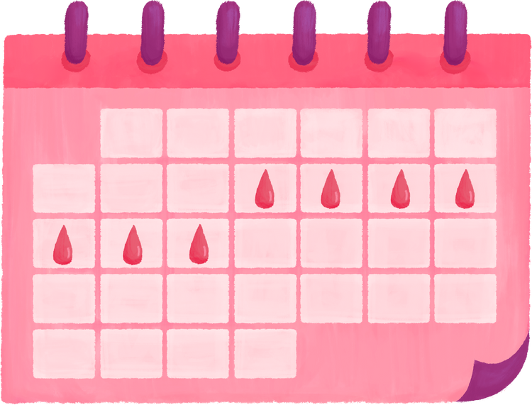
Project Rationale
Period products can cost an average of £10 a month
- that’s £120 a year
Bloody Good Period (2022)

Slide 5

Project Rationale
Close to one in eight people in Britain who menstruate were worried about how they would afford period products in 2023
-this is TWICE AS MANY as the previous year
YouGov (2023)

Slide 6

Project Rationale
In the UK, an estimated
2 MILLION PEOPLE
who menstruate have avoided or missed work due to their period
ActionAid (2022)

Slide 7

Project Rationale
NORMALISING conversations on taboo topics, such as
periods and the menopause, can ensure menstruating staff members are able to remain productive and be supported in the workplace
Women’s Health Strategy for England (2022)

Slide 8
Project Aim
Provision of accessible period products to all.
Promotion of a ‘box project’ providing free products.
Encourage donations, resulting in a self-sustaining, light touch support.

Slide 9

Project Aim
Ensure that our community is supported to understand ‘normal’ menstruation and access products for a healthy period linking with
South Tyneside Council’s
‘Healthy and Well’ ambition

Slide 10

Project Aim
South Tyneside Joint Health and Wellbeing Strategy

Slide 11

What Was Done
Mapping exercise and formation of working group to assess level of need in local community

Slide 12
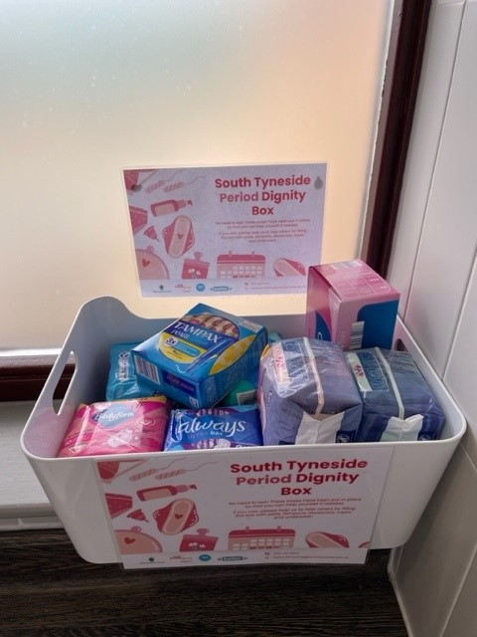
What Was Done
Pilot scheme launched on one floor of the Town Hall in February 2023, for International Women’s Day on 8th March, with the support of the employee Women’s Network.

Slide 13
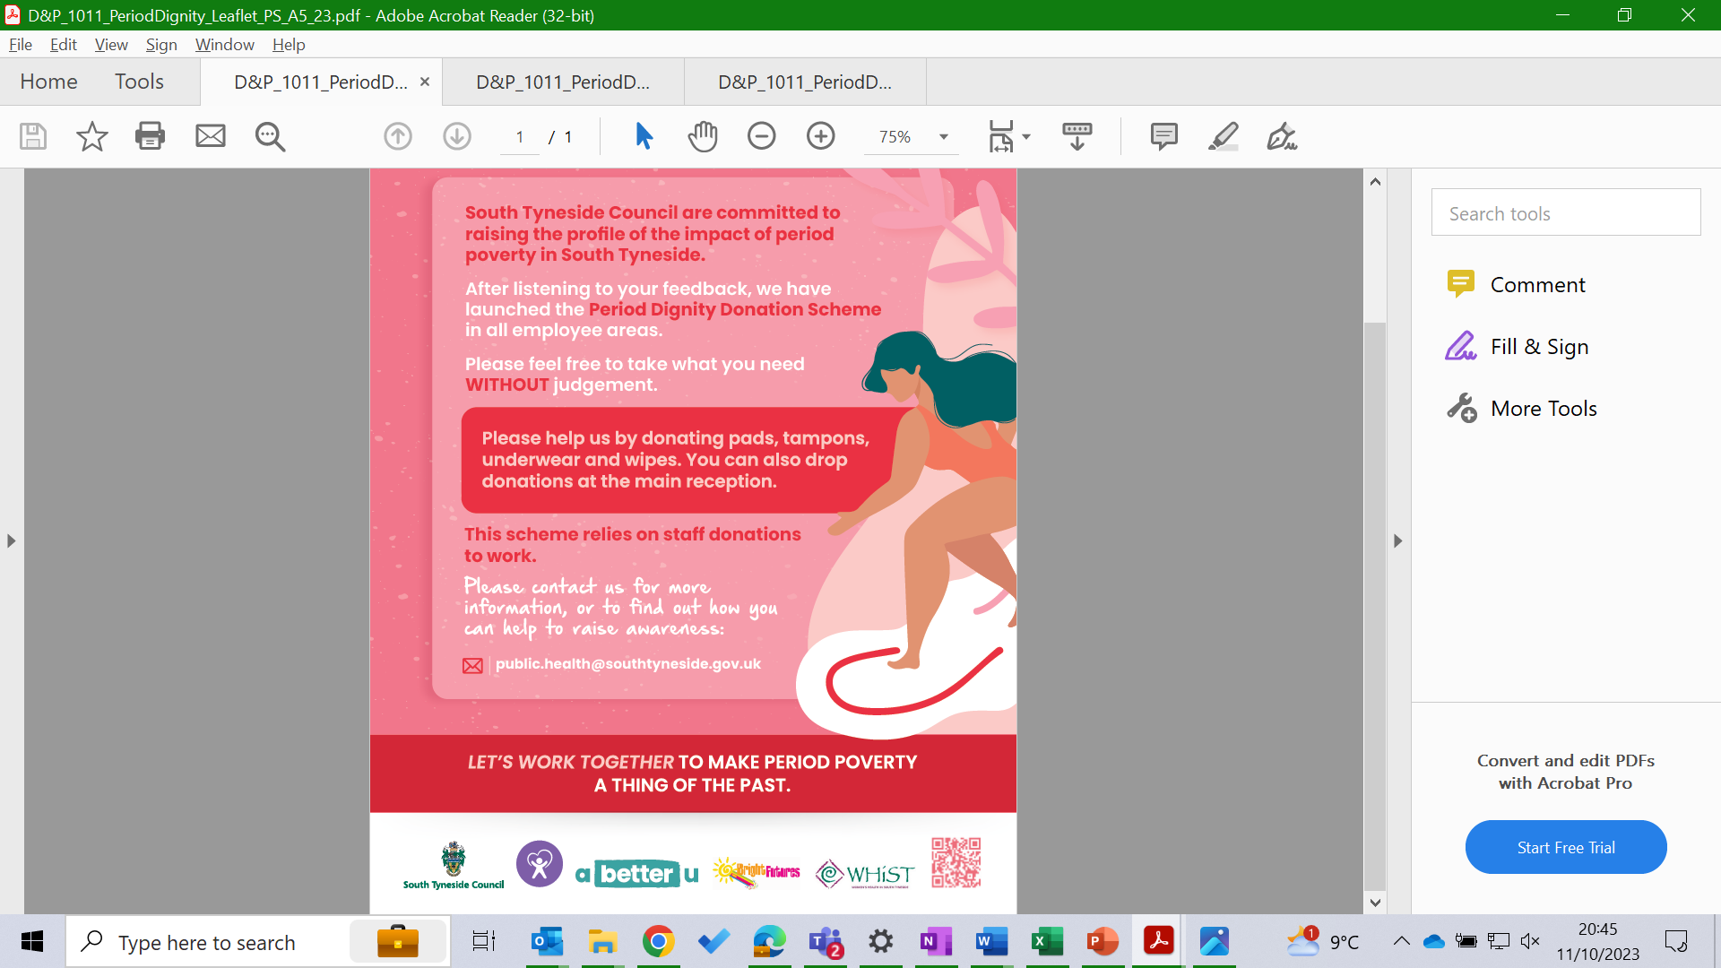
What Was Done
Following evaluation,
start-up boxes of period products for STC employees in Council buildings and leisure facilities.

Slide 14



What Was Done
Partners

Slide 15
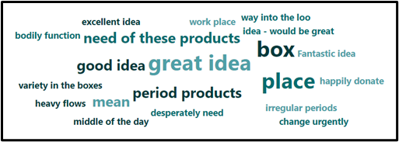
Evaluation

Slide 16
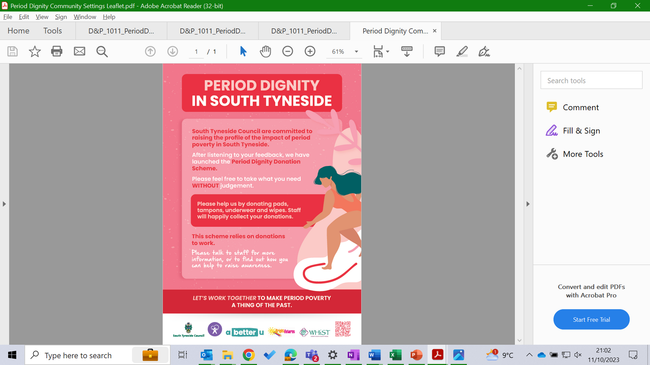
Current Picture and Impact
Replication of the model in community settings and NHS services

Slide 17

Next Steps
Promotion of the scheme widely across the borough
Incorporation of menstrual health and sustainable product information

Slide 18

Karen Armstrong
Public Health Practitioner
South Tyneside Council
karen.armstrong@southtyneside.gov.uk

