Slide 2
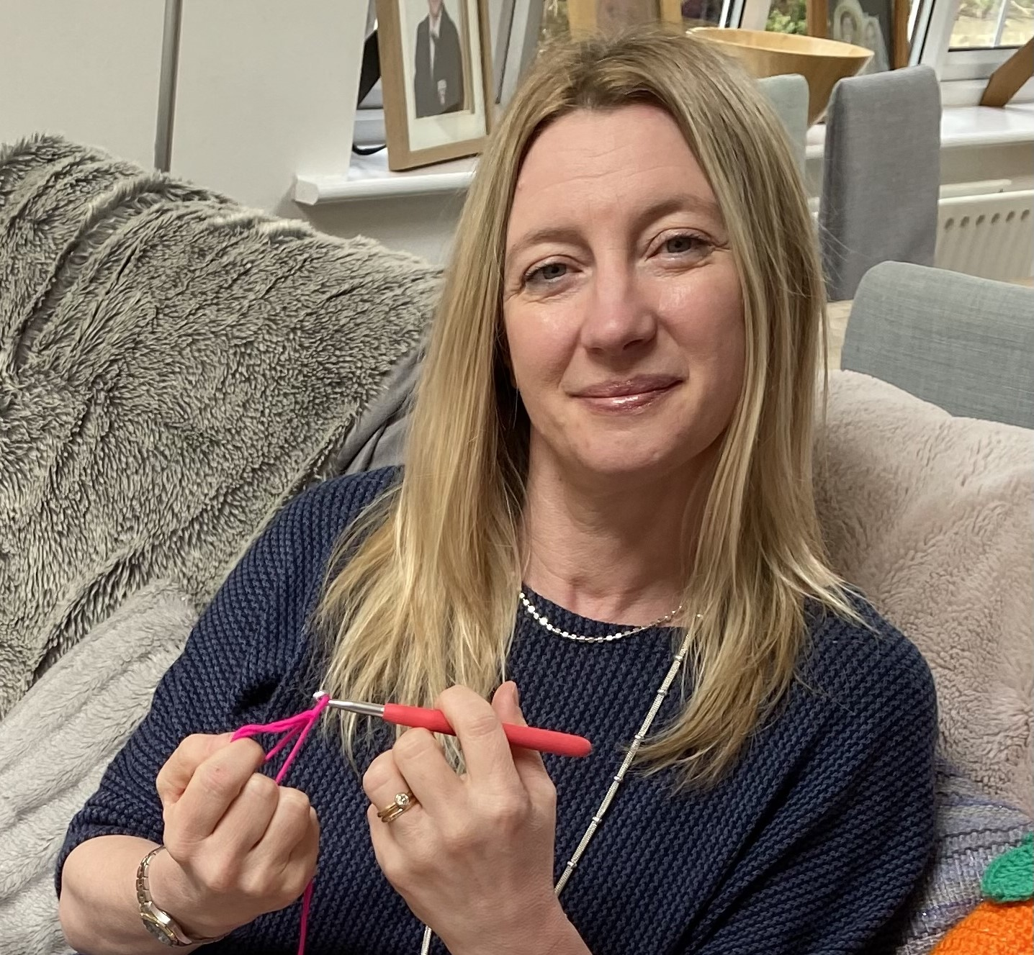
Dr Julie Oliver
GP Lanchester Medical Centre
Special interest womens health
Thanks to Dr Sam English and Gillian
Webster for delivering this talk on my
behalf

Slide 3
2002 – the idea of setting up a community Womens health clinic

Slide 4
Provider driven
Model – bottom up

Slide 5
Step 1 – get qualified 2007☑
Step 2 – get a job ☒
Step 3 – get commissioned 2009 – bottom up approach☑
Step 4 – set up Durham Gynae 2009

Slide 6
Step 2 – get a job

Slide 7
Step 3 – get commissioned 2009

Slide 8
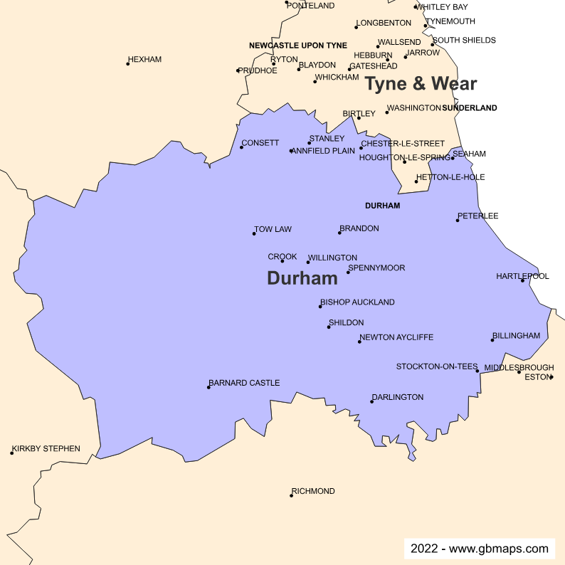

Slide 9
North Durham CCG area
Populations Co Durham 434000
North Durham CCG area 256000
PCN – Derwentside, Chester-Le-Street, Durham West, Durham East, Claypath and university

Slide 10
Community Gynae service specification covered
Complex contraception – supporting GPs fitting difficult coils or removing with lost threads
Heavy periods – offering IUS fitting when medical management failed
Cervical polyps – removing symptomatic polyps found on routine smears
Painful periods – offering IUS fitting when medical management failed
Menopause – complex cases and IUS fitting for endometrial protection
Prolapse – assessment, advice and fitting ring/shelf/gelhorn pessaries

Slide 11
One-stop shop model | Management | Outcome
Lost coil threads | Ultrasound scan - remove | Discharged
Complex coil fits | LA blocks/scan after fitting | Discharged
Heavy periods | Scan/endometrial sampling/IUS fit | Discharged
Cervical polyps | Remove polyp | Discharged
Painful periods | Scan, fit IUS | Discharged
Menopause | IUS fits for HRT | Discharged
Menopause | Complex cases - advice | Review x1 and discharged
Prolapse | Advice, PFE, fit ring Shelf/gelhorn | Discharged to GP –LES Review 6montly – no LES

Slide 12
Benefits
Low risk gynae patients -
Quick assess to clinics
Long appointments – 30 mins
One-stop shop – no routine follow up for most women
Supporting local GPs who already fit LARC
Provide training for new LARC fitters, education for local colleagues, set up LARC updates, write local clinical guidelines for GPs to follow

Slide 13
Thursday am clinic alternate weeks
NOW
Thursday am and pm weekly – 4 week waiting list currently

Slide 14
Changes during and after 2021
Telephone triage resulted in all women having 2 appointments – waiting list developed
GP retirement – those with interest in women’s health and LARC fitting – very few left fitting IUC
GPs totally snowed under – simple referrals escalated
GPs no capacity to deliver extended work – ring pessary, IUC
Davina – demand for menopause work exploded

Slide 15
Why?
Retirement
Staff moving on - cytology
Ring pessary bottleneck
Waiting list for non-complex

Slide 16
Derwentside PCN developed WHH
LARC fitting for contraception only – LA monies
Two GPs delivering LARC from 2 GP surgeries for 2 hours a week each – cross referrals using S1
Dr Sam English and Dr Julie Oliver

Slide 17
Derwentside has 13 GP practices
4 offer all LARCs in house
NOW all 13 practices can refer women for LARC for contraception

Slide 19
Teething problems?

Slide 20
Chester-Le-Street PCN
Menopause clinic with extended access money
2 local GPs – Dr Sarah Leese and Dr Ruth Tompson
Support to CLS GPs by taking up some of the menopause explosion

Slide 22
Evolving services
CLS menopause clinic refers to DG – IUS fits for HRT and complex cases
Dr Julie Oliver is mentoring the CLS GP through the menopause skills course
Derwentside clinic is reducing the simple IUC referrals to DG clinic
PCN is looking to find money to add in IUC for non-contraceptive needs
and simple ring pessaries.
Durham Gynae is bidding for training money to be able to deliver more services out of the existing hubs – like ring pessaries. To ensure continuity so others who want to work in the hubs can deliver LARC and provide local updates to those already fitting can continue.

Slide 23
Questions?
julieoliver@durhamgynae.co.uk

