Slide 1
Healthwatch Sunderland
Making breast care easy

Slide 2
Summary of the aims and outcomes of the project
The aim
For easy read letters to be available to patients who need them when being recalled to hospital after mammogram.
The Outcome
Thanks to patient feedback highlighting the gap in provision, easy read recall letters are now available to patients who need them.

Slide 3
The service this work relates to
Services we worked with
Sunderland People First
Breast Care Services
Public Health England
NHS Improvement & NHS England

Slide 4
We would like you to watch a short video we have produced, which demonstrates:
What change was needed and how we identified this
What we did to achieve change
How will people’s experiences of the service now be better, and why is that important
Sharon Video.mov (sharepoint.com)
Notes:
During our regular feedback session with Sunderland People First, we heard from self-advocate Sharon.
What change was needed?
Sharon, who has a learning disability explained following a routine mammogram she received a recall letter, which she couldn’t understand leaving her feeling her independence had been taken away, as she then had to rely on someone explaining the contents of the letter.
How we did this
In response we spoke with several NHS teams, in particular those at the local Breast Care Clinic and the PHE Screening services and discovered that there are 3 standardised recall letters after a mammogram, however none were available to patients in easy read.

Slide 5
Sharon said;
“People need easy read information at the start to understand what is involved. This can help you feel confident to ask any questions and think about what would make your appointments easier for you.”

Slide 6
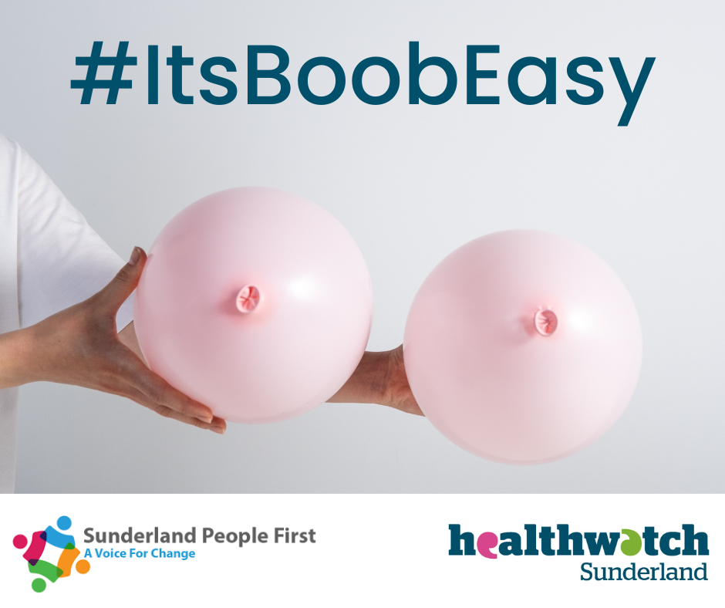
Look out for the launch of our social media campaign on

Slide 7
Beast care made easy for everyone!

Slide 8
Healthwatch Sunderland

