Slide 1
Engaging with minority groups to improve access to fertility services
Sophie Jewitt, Laboratory Manager
Gateshead Fertility

Slide 2
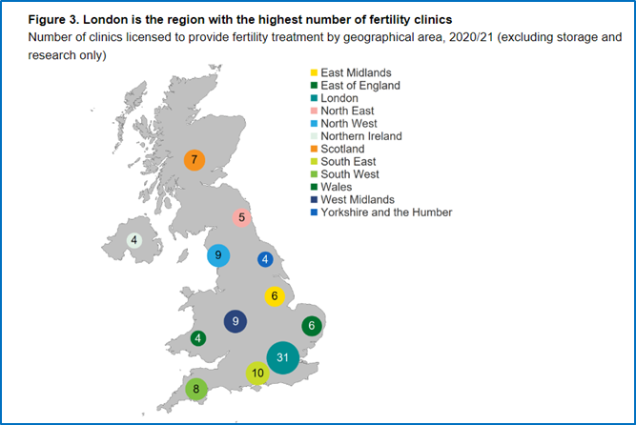
About
Providing specialist fertility treatment at QEH since 1996
NHS and private-patients, from the whole northern region
Other regional units are Newcastle, Middlesbrough, Darlington (pp)
Expansion from 60 IVF cycles/year to providing 600 treatment cycles to a diverse range of patients.
Ambition: to proactively seek patient groups who are not accessing treatment and develop the range of services provided

Slide 3
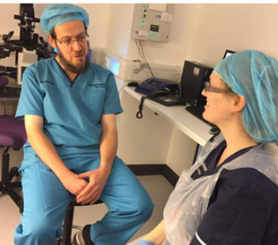
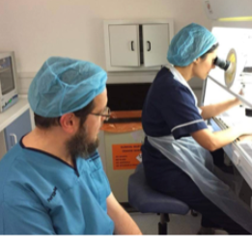
Strict Orthodox Jewish community
Bensham is the 3rd largest community in UK
Historically, patients chose to travel to Manchester or London
Idiosyncratic, faith-related barriers to accessing services
Menstrual timing, sperm production issues, Sabbeth, witnessing IVF
IMPROVE ENGAGEMENT
Period of engagement with local Jewish leaders
Understanding of Halachal laws ie. “code of conduct”
Negotiate an adapted pathway for fertility investigations,
treatment and laboratory procedures

Slide 4
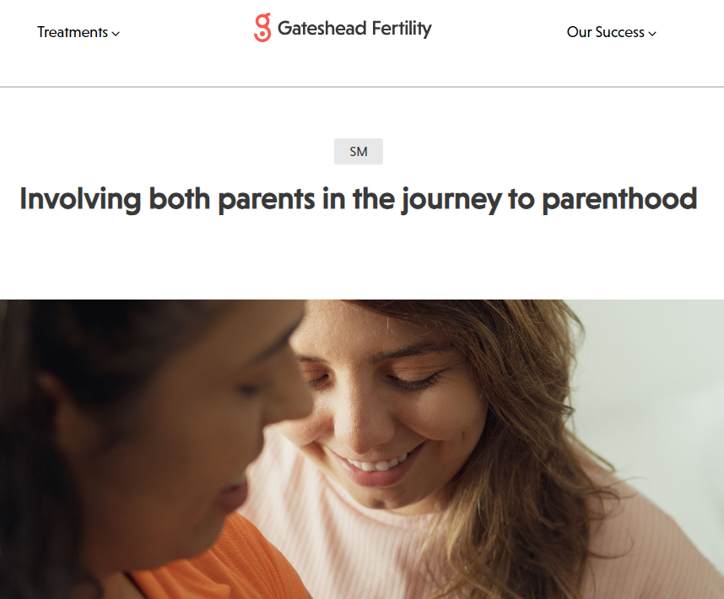
LGBT+ community
Desire to achieve parenthood via regulated fertility clinics
Dramatic increase in demand nationally since 2019
22% increase in donor sperm treatments
Female same-sex couples undergoing IVF has increased by 33%
IMPROVE ENGAGEMENT & EMBRACE DIVERSITY
Via our social media, website + patient recommendations
Understand legal parenthood issues - staff education
Adapt treatment range eg. Shared-motherhood treatment
Inclusive literature + consent, gender-neutral terminology

Slide 5
Evaluation
Increased demand for fertility services
60% increase in donor sperm treatments since 2019
25% of all website enquiries are from LGBT+ people
Increased income generation
£107K donor sperm treatments (£39K in 2018-9)
Enhanced reputation
Recognition from Jewish community
Increased patient recommendations
Patient feedback cloud

Slide 6
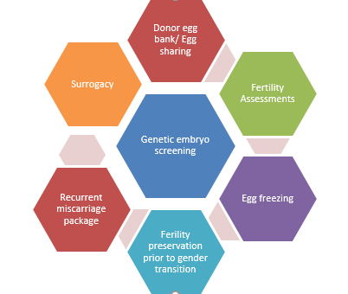
Ambition
To proactively seek patient groups
who are not accessing treatment
& develop the range of services provided

Slide 7
www.gatesheadfertility.com

