Slide 1

Recall Intervals for Dentistry
Comms toolkit for dental practices

Slide 2
Background
The NHS is working hard to make it easier for patients to see a dentist.
Reforms to the dental contract in 2026 aim to improve access to NHS dental services, prioritise patients with the greatest need, and ensure care is delivered in line with evidence-based recall intervals.
Personalised recall intervals, as set out in the 2004 NICE guidelines, mean that patients with good oral health may not need a dental appointment as often as those with poor oral health.
Patients with good oral health may only require a routine check-ups every 12, or up to 24 months.
Dental teams are being asked move away from routine check-ups every six months, to a personalised recall based on risk will free up dentists to focus on more high-needs patients in a timely way.

Slide 3
Background
As the intervals between check-up appointments may change for some patients, there is a need to support dental teams to communicate with patients to help them understand how often they will be asked to come in for a check-up and what to expect from a visit to an NHS dentist.
This toolkit supports dentistry team to have conversations with patients around recall intervals – especially if these differ from previous expectations or experiences around how often they have been used to being recalled for a dental check-up.
The toolkit will also be used by ICB and regional communications teams to support dental practice teams, building confidence in the guidance and help with raising public awareness and understanding.

Slide 4
About the toolkit
This toolkit provides content and templates for practices and ICBs to use with patients to help them understand recall intervals and how often they will be recalled for a check-up.
It includes key messages for staff and patients, a newsletter item, a link to patient facing materials and social media posts for you to customise and use in your comms and engagement work as well as links to two case studies to support with implementation of the recall guidelines.
Patient facing promotional materials
A patient leaflet, easy read leaflet, translations of the leaflet into ten languages, poster, digital display screen, social media graphics, and briefing sheet are available to download from the Campaign Resource Centre website: NHS Dental Practice Recall | NHS Primary Care Services | Campaign Resource Centre
For further information please contact: england.pccscomms@nhs.net

Slide 5

Key messages
Staff
Reforms to the dental contract in 2026 aim to improve access to NHS dental services, prioritise patients with the greatest need, and ensure care is delivered in line with evidence-based recall intervals.
2004 NICE clinical guidelines on risk-based recall intervals for check-ups, outline a timeframe based on personalised risk for every patient.
Risk based recall is a key approach to improve access to NHS dental care for patients.
By following NICE clinical guidelines and personalised recall intervals based on risk, patients with good oral health can be recalled for check-ups less frequently than those with poor oral health.
Shifting practice away from routine six monthly check-ups to follow the NICE guidelines, will free up dentists to focus on people with poor oral health, in a timelier way.
Patients with healthy teeth and gums, who are at low risk of dental disease, may be seen up to every two years.
Children with healthy teeth and gums who are at low risk of having dental disease should be offered a check-up once a year and should have fluoride varnish applied every six months (or every 3 months for those at higher risk).

Slide 6
Key messages
Public/patients
During your check-up, the dental team will work out if you are at risk of having teeth, mouth or gum problems in the future.
The dental team will discuss with you or your carer about when you should have your next check-up, or if you need to come back for any treatment.
For adults with healthy teeth and gums, who are at low risk of dental disease, your next check-up could be up to every 2 years.
Children with healthy teeth and gums who are at low risk of having dental disease will be offered a check-up once a year and fluoride varnish application every 6 months.
You will be seen sooner if you have a dental problem or if you have a higher risk of having dental disease.
Dental teams decide who is the best person to do your check-up and any treatment. You might need to come back for treatment or to be seen by another member of the dental team.
If you need an appointment before a planned check-up please contact your dental practice.

Slide 7
Bulletin/newsletter copy
This can be used for bulletins/websites/press releases, depending on your activity.
Resources published to support dental check-up recall intervals
Materials to help dental teams explain check-up recall intervals to patients, are now available to download from NHS Dental Practice Recall | NHS Primary Care Services | Campaign Resource Centre.
NICE clinical guidelines published in 2004, set out how patients should be seen for a dental check-up depending on their risk, and this could be up to two years for patients with a low risk of dental disease.
Moving practice away from routine six monthly check-ups, following the NICE guidelines, will improve access to dental care for patients and enable dental teams to see more patients with the greatest oral health need.
Two case studies have been produced to support staff with the implementation of the NICE recall guidelines.

Slide 8

Social media posts
Staff facing
Patients should be seen for an NHS dental check-up depending on their individual risk. This could be up to every two years for patients with a low risk of dental disease
#NHSDentistry #NHSDentalContactReform
Recalling patients for their #NHS dental check-up based on their individual risk of dental disease, means more patients with the greatest need can be seen and treated
#NHSDentistry #NHSDentalContactReform
Following the @nicecomms recall guidelines for #NHS dental check-ups will improve access to dental care for patients and enable dental teams to see patients with the greatest oral health need
#NHSDentistry #NHSDentalContactReform

Slide 9
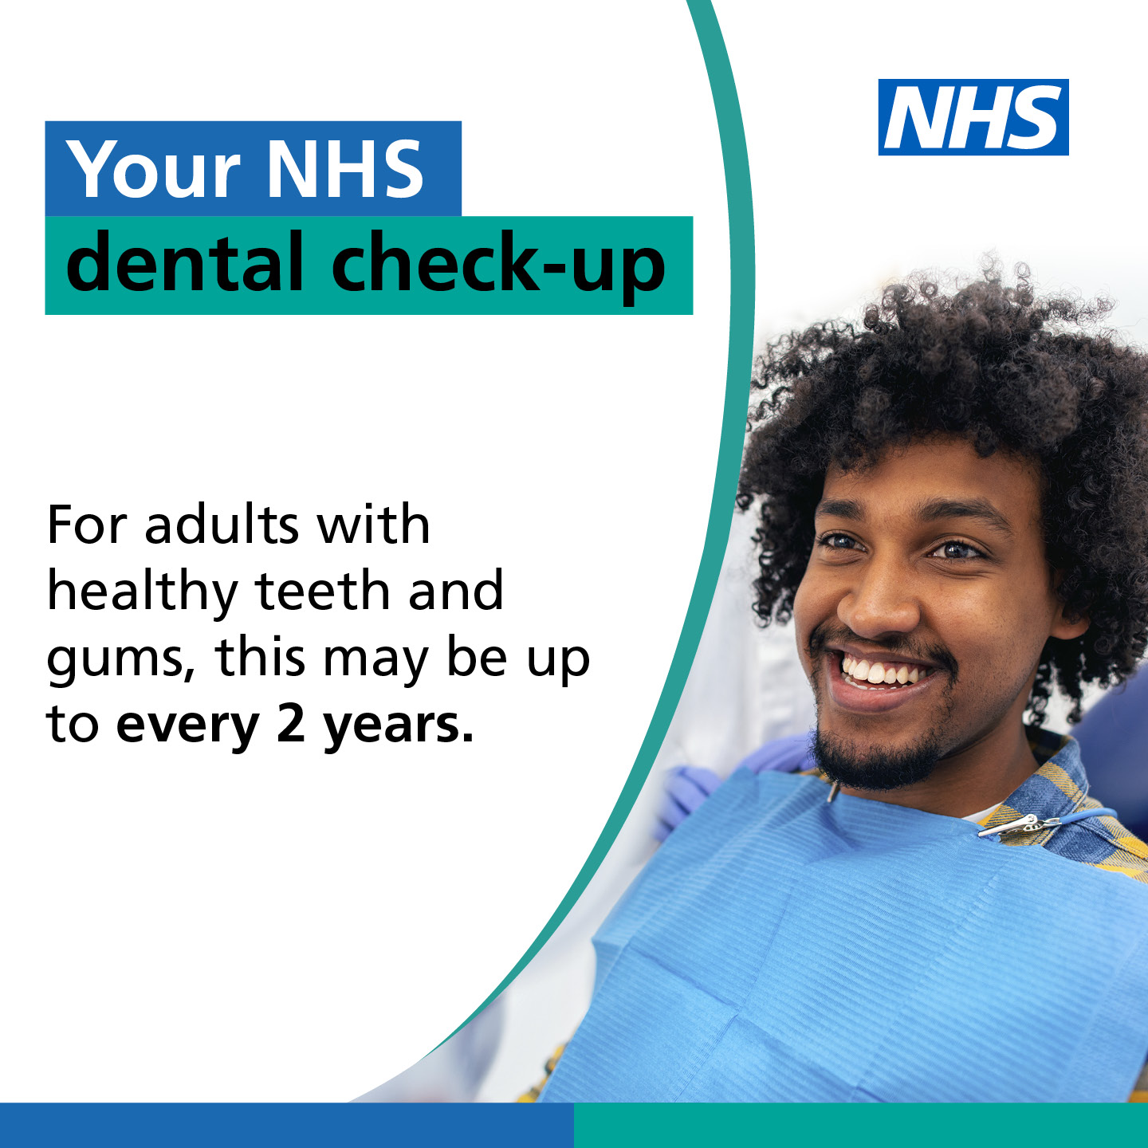
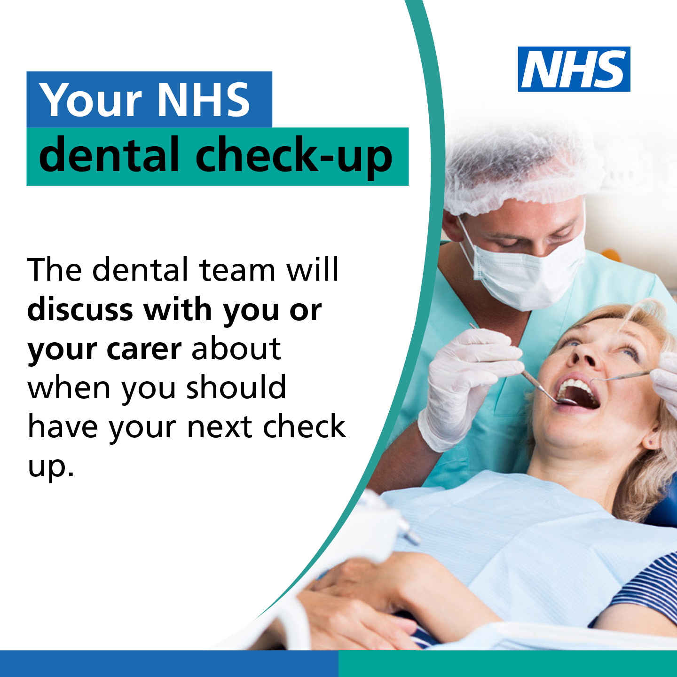
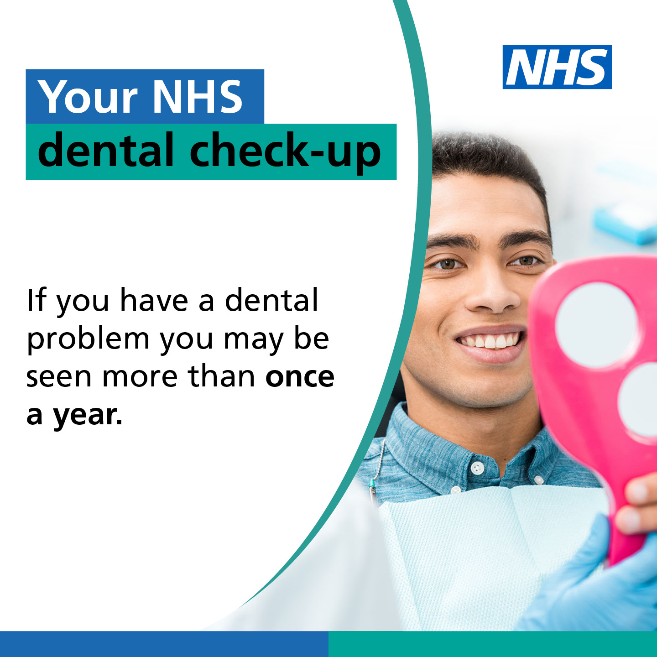
Social media posts
Copy | Asset | Alt text
Patients should be seen for an NHS dental check-up depending on their individual risk. This could be up to every two years for patients with a low risk of dental disease #NHSDentistry #NHSDentalContactReform |  | A person sitting in a chair. Text in image reads: Your NHS dental check-up For adults with healthy teeth and gums, this may be up to every 2 years.
Recalling patients for their #NHS dental check-up based on their individual risk of dental disease, means more patients with the greatest need can be seen and treated #NHSDentistry #NHSDentalContactReform |  | A person having their teeth examined. Text in image reads: Your NHS dental check-up The dental team will discuss with you or your carer about when you should have your next check-up.
Following the @nicecomms recall guidelines for #NHS dental check-ups will improve access to dental care for patients and enable dental teams to see patients with the greatest oral health need #NHSDentistry #NHSDentalContactReform |  | A person holding a mirror. Text in image reads: Your NHS dental check-up If you have a dental problem, you may be seen more than once a year.

Slide 10
Social media posts
Patient facing
Your #DentalTeam will talk to you about when you should come for your next #NHS check-up. This could be up to two years for people with low risk of dental disease
#NHSDentistry
People with healthy teeth and gums may only need an #NHS dental check-up every two years. Your #DentalTeam will talk to you about when you should come for your next check-up
#NHSDentistry
Children with healthy teeth and gums will be offered an #NHS dental check-up every 12 months. Your #DentalTeam will talk to you about when your child should have their next check-up
#NHSDentistry
Your #DentalTeam will ask you to come back for an #NHS check-up more often if you have dental disease or risk of a dental problem
#NHSDentistry

Slide 11
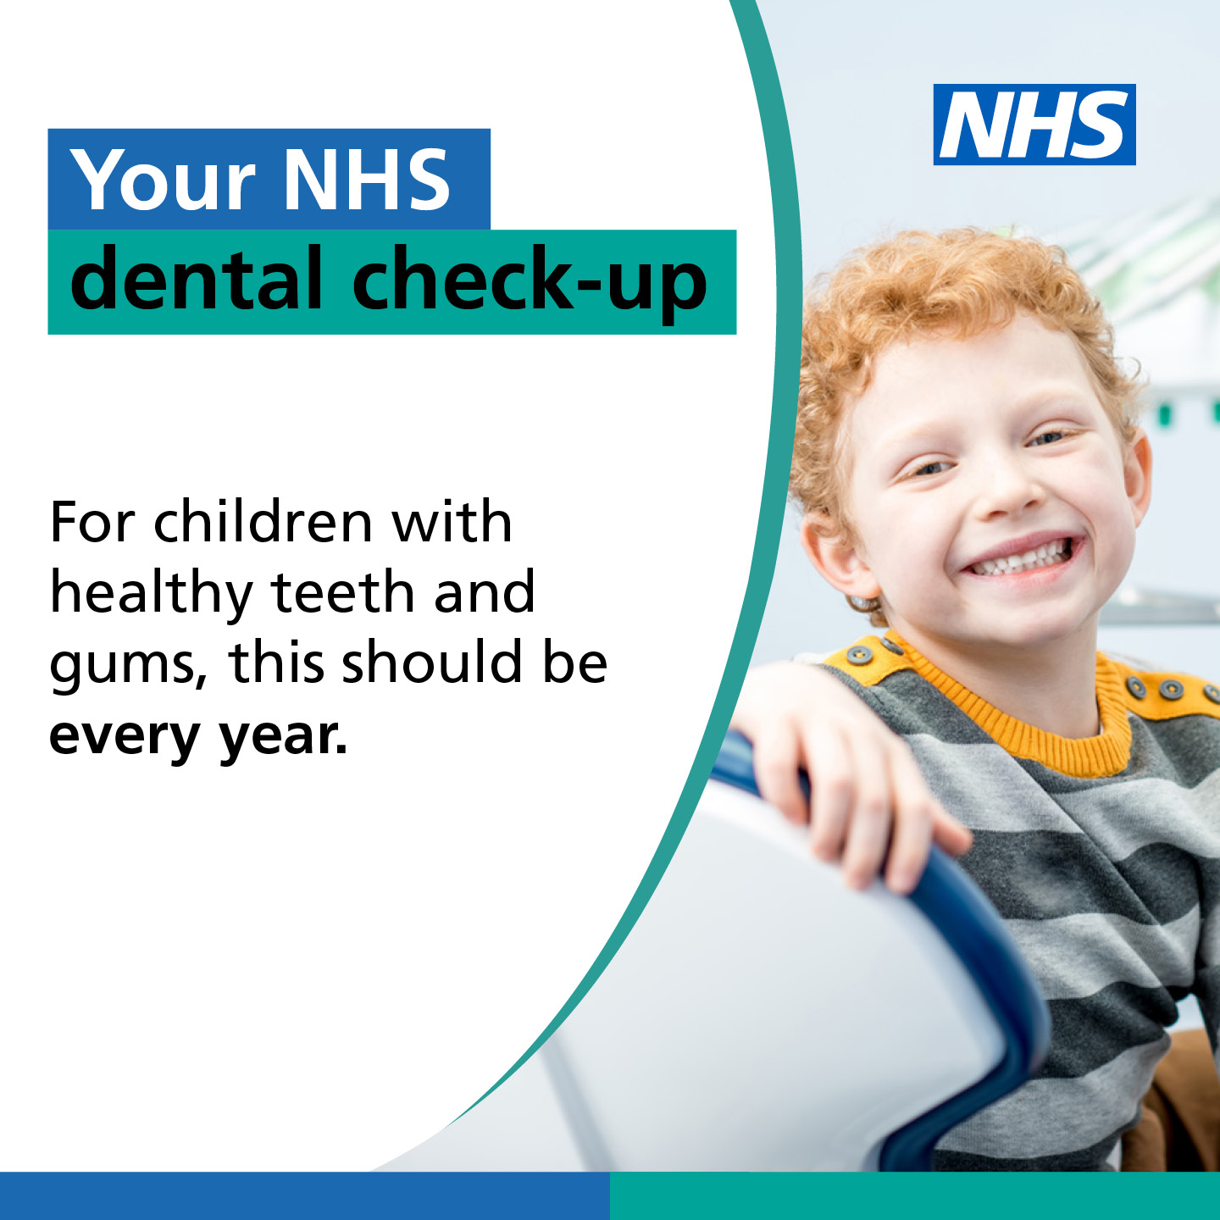
Social media posts
Copy | Asset | Alt text
Your #DentalTeam will talk to you about when you should come for your next #NHS check-up. This could be up to two years for people with low risk of dental disease #NHSDentistry |  | A person sitting in a chair. Text in image reads: Your NHS dental check-up For adults with healthy teeth and gums, this may be up to every 2 years.
People with healthy teeth and gums may only need an #NHS dental check-up every two years. Your #DentalTeam will talk to you about when you should come for your next check-up #NHSDentistry |  | A person having their teeth examined. Text in image reads: Your NHS dental check-up The dental team will discuss with you or your carer about when you should have your next check-up.
Children with healthy teeth and gums will be offered an #NHS dental check-up every 12 months. Your #DentalTeam will talk to you about when your child should have their next check-up #NHSDentistry |  | A child smiling at the camera. Text in image reads: Your NHS dental check-up For children with healthy teeth and gums, this should be every year.

Slide 12
Social media posts
Copy | Asset | Alt text
Your #DentalTeam will ask you to come back for an #NHS check-up more often if you have dental disease or risk of a dental problem #NHSDentistry |  | A person holding a mirror. Text in image reads: Your NHS dental check-up If you have a dental problem, you may be seen more than once a year.

Slide 13

Case studies
Two case studies have been produced to support dental teams with the implementation of the NICE recall guidelines:
Case study: How NICE guidelines support dentists to ‘do the right thing’ for NHS patients and local communities – A group of four practices in Manchester outline its journey to implementing recalls for NHS patients following the NICE guidelines on interval periods for dental checks, so everyone receives an NHS dental health check at the right time. This helps them target NHS care in the most appropriate ways and has increased the number of people they see and treat.
Case studies: Using NICE guidelines on recall intervals to effectively balance NHS routine, urgent and emergency dental care – A practice in Gateshead utilises a personalised recall approach as recommended in NICE guidance, recalling NHS patients based on their oral health needs. This frees up more appointments for those with high needs and ensuring the most effective balance between routine, urgent and emergency care.

Slide 14

Get in touch!
We want to know how your communications activity goes, and if you need any additional support. Please do share your stories with us to develop into potential case studies.
Any questions, please email the NHSE primary care communications
team at: england.pccscomms@nhs.net or subscribe to our weekly
primary care bulletin for the latest updates and policy information.

